Slide 1
Data Mining: Exploring Data
Lecture Notes for Data Exploration Chapter
Introduction to Data Mining
by
Tan, Steinbach, Karpatne, Kumar

Slide 2
What is data exploration?
A preliminary exploration of the data to better understand its characteristics.
Key motivations of data exploration include
Helping to select the right tool for preprocessing or analysis
Making use of humans’ abilities to recognize patterns
People can recognize patterns not captured by data analysis tools
Related to the area of Exploratory Data Analysis (EDA)
Created by statistician John Tukey
Seminal book is Exploratory Data Analysis by Tukey
A nice online introduction can be found in Chapter 1 of the NIST/SEMATECH e-Handbook of Statistical Methods http://www.itl.nist.gov/div898/handbook/index.htm

Slide 3
Techniques Used In Data Exploration
In EDA, as originally defined by Tukey
The focus was on visualization
Clustering and anomaly detection were viewed as exploratory techniques
In data mining, clustering and anomaly detection are major areas of interest, and not thought of as just exploratory
In our discussion of data exploration, we focus on
Summary statistics
Visualization
Online Analytical Processing (OLAP)

Slide 4
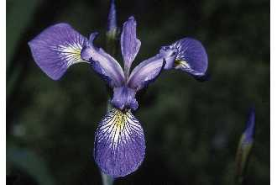
Iris Sample Data Set
Many of the exploratory data techniques are illustrated with the Iris Plant data set.
Can be obtained from the UCI Machine Learning Repository http://www.ics.uci.edu/~mlearn/MLRepository.html
From the statistician Douglas Fisher
Three flower types (classes):
Setosa
Virginica
Versicolour
Four (non-class) attributes
Sepal width and length
Petal width and length
Virginica. Robert H. Mohlenbrock. USDA NRCS. 1995. Northeast wetland flora: Field office guide to plant species. Northeast National Technical Center, Chester, PA. Courtesy of USDA NRCS Wetland Science Institute.

Slide 5
Iris Flower
Virginica. Robert H. Mohlenbrock. USDA NRCS. 1995. Northeast wetland flora: Field office guide to plant species. Northeast National Technical Center, Chester, PA. Courtesy of USDA NRCS Wetland Science Institute.

Slide 6
Summary Statistics
Summary statistics are numbers that summarize properties of the data
Summarized properties include frequency, location and spread
Examples: location - mean spread - standard deviation
Most summary statistics can be calculated in a single pass through the data

Slide 7
Frequency and Mode
The frequency of an attribute value is the percentage of time the value occurs in the data set
For example, given the attribute ‘gender’ and a representative population of people, the gender ‘female’ occurs about 50% of the time.
The mode of an attribute is the most frequent attribute value
The notions of frequency and mode are typically used with categorical data

Slide 8
Percentiles
For continuous data, the notion of a percentile is more useful.
Given an ordinal or continuous attribute x and a number p between 0 and 100, the pth percentile is a value x_{p} of x such that p% of the observed values of x are less than x_{p}.
For instance, the 50th percentile is the value x_{50%} such that 50% of all values of x are less than x_{50%.} .

Slide 9
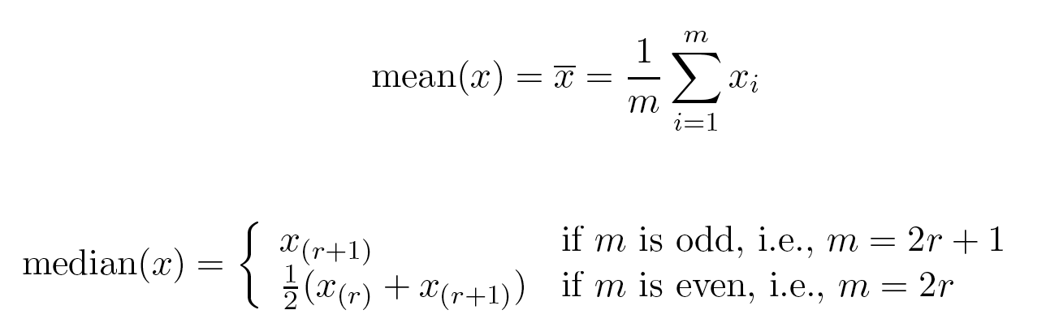
Measures of Location: Mean and Median
The mean is the most common measure of the location of a set of points.
However, the mean is very sensitive to outliers.
Thus, the median or a trimmed mean is also commonly used.

Slide 10
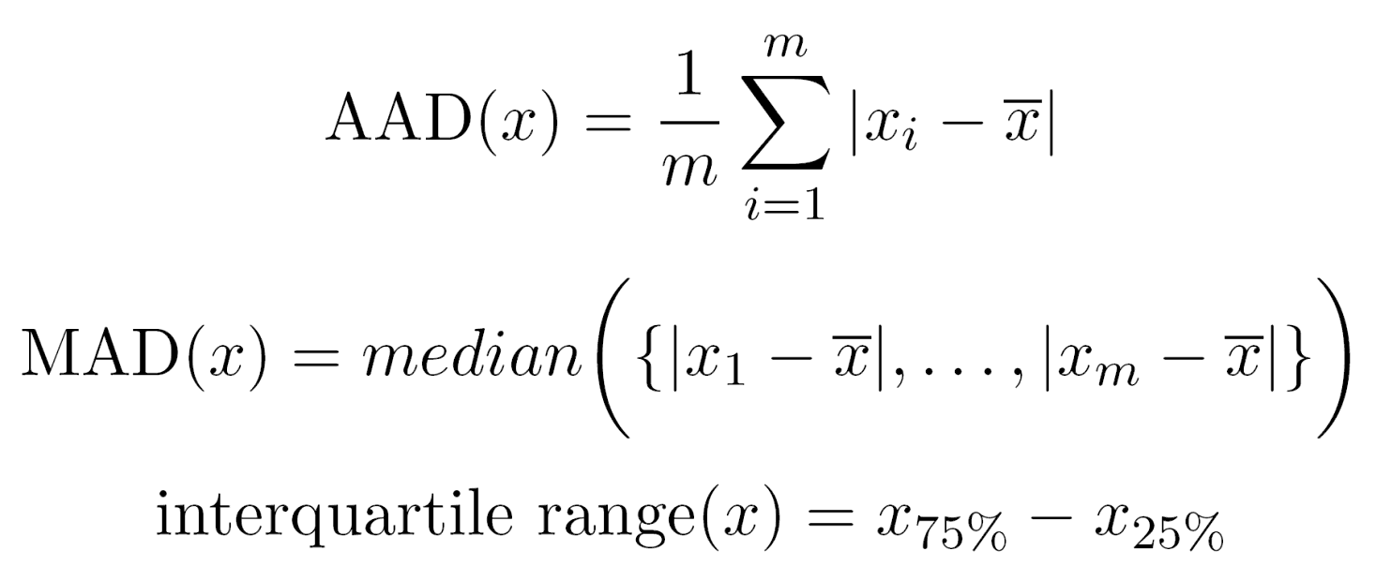
Measures of Spread: Range and Variance
Range is the difference between the max and min
The variance or standard deviation s_{x} is the most common measure of the spread of a set of points.
Because of outliers, other measures are often used.

Slide 11
Visualization
Visualization is the conversion of data into a visual or tabular format so that the characteristics of the data and the relationships among data items or attributes can be analyzed or reported.
Visualization of data is one of the most powerful and appealing techniques for data exploration.
Humans have a well developed ability to analyze large amounts of information that is presented visually
Can detect general patterns and trends
Can detect outliers and unusual patterns

Slide 12
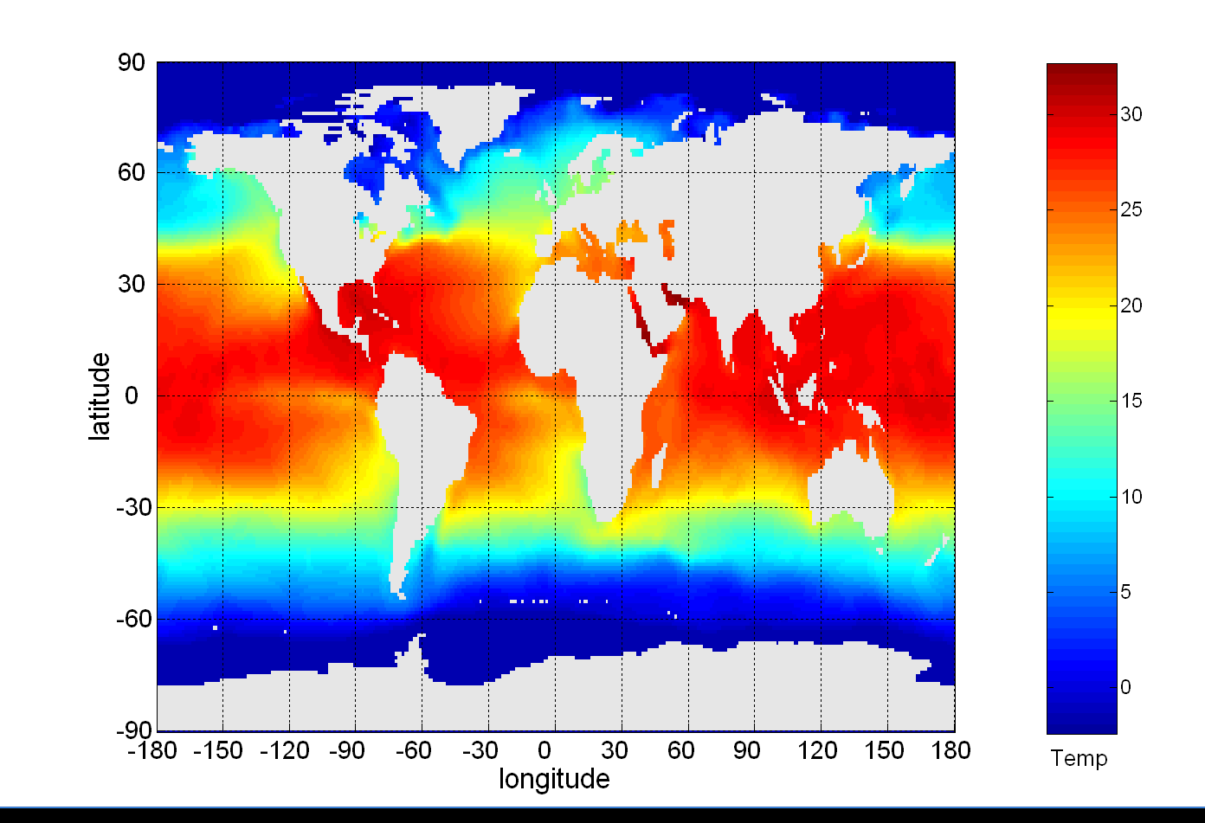
Example: Sea Surface Temperature
The following shows the Sea Surface Temperature (SST) for July 1982
Thousands of data points are summarized in a single figure

Slide 13
Representation
Is the mapping of information to a visual format
Data objects, their attributes, and the relationships among data objects are translated into graphical elements such as points, lines, shapes, and colors.
Example:
Objects are often represented as points
Their attribute values can be represented as the position of the points or the characteristics of the points, e.g., color, size, and shape
If position is used, then the relationships of points, i.e., whether they form groups or a point is an outlier, is easily perceived.

Slide 14
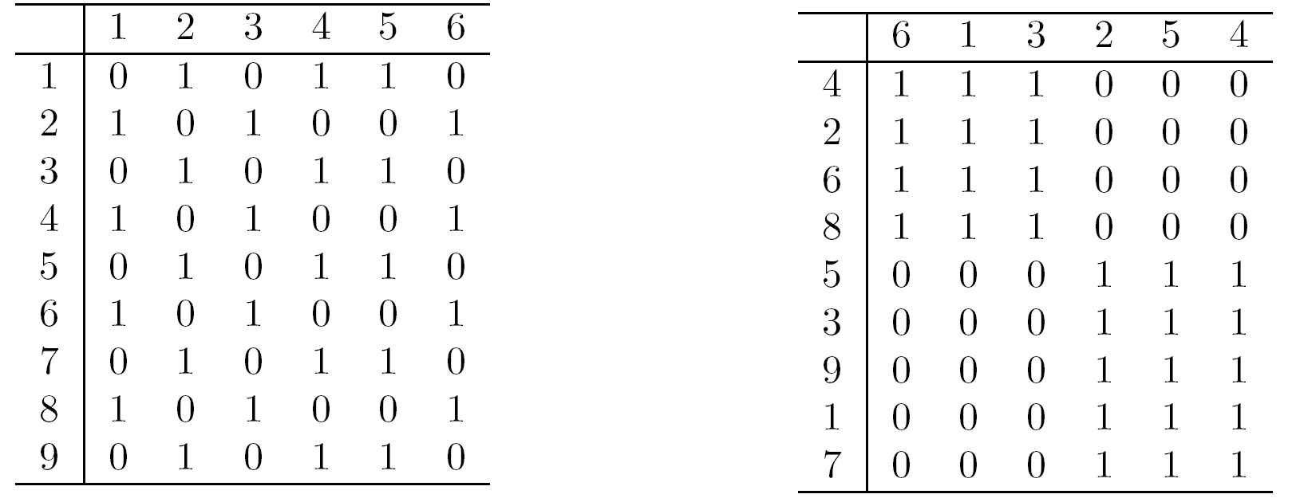
Arrangement
Is the placement of visual elements within a display
Can make a large difference in how easy it is to understand the data
Example:

Slide 15
Selection
Is the elimination or the de-emphasis of certain objects and attributes
Selection may involve the choosing a subset of attributes
Dimensionality reduction is often used to reduce the number of dimensions to two or three
Alternatively, pairs of attributes can be considered
Selection may also involve choosing a subset of objects
A region of the screen can only show so many points
Can sample, but want to preserve points in sparse areas

Slide 16
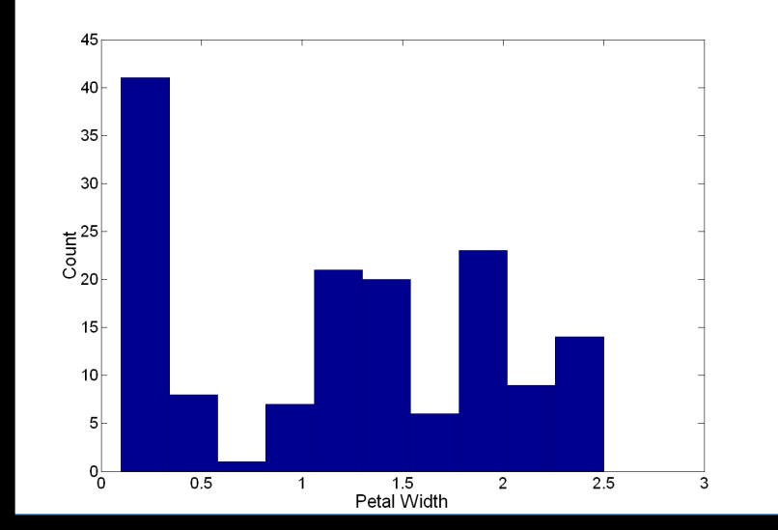
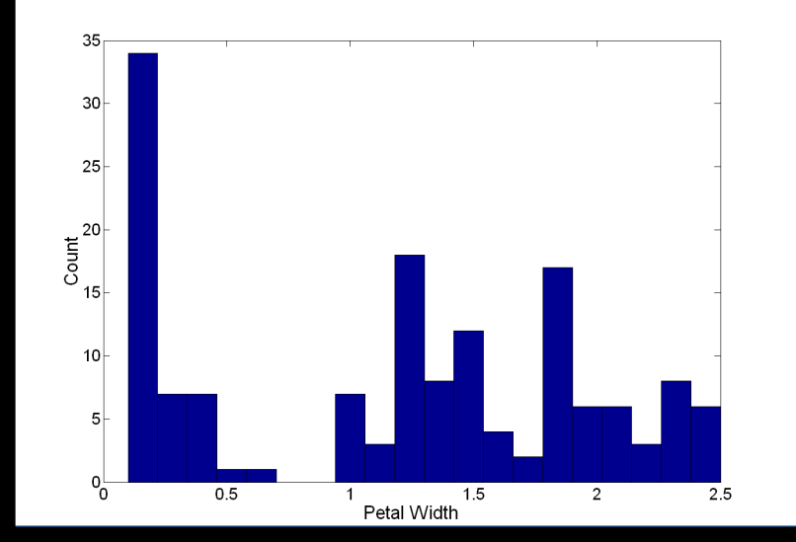
Visualization Techniques: Histograms
Histogram
Usually shows the distribution of values of a single variable
Divide the values into bins and show a bar plot of the number of objects in each bin.
The height of each bar indicates the number of objects
Shape of histogram depends on the number of bins
Example: Petal Width (10 and 20 bins, respectively)

Slide 17
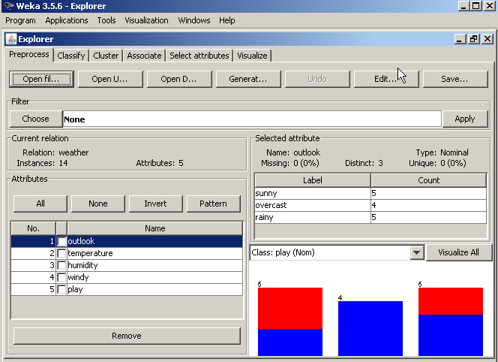
Histogram from Weka
Notes:
As soon as the data is loaded, more choices in Weka are available. Among many:
Editting the data set
Select a type of the studies that we would like to do, etc
We will be focusing on some classification studies today!

Slide 18
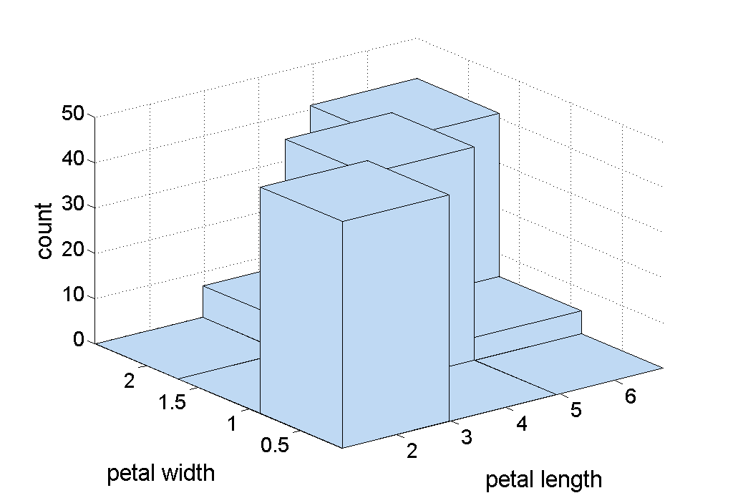
Two-Dimensional Histograms
Show the joint distribution of the values of two attributes
Example: petal width and petal length
What does this tell us?

Slide 19
Visualization Techniques: Box Plots
Box Plots
Invented by J. Tukey
Another way of displaying the distribution of data
Following figure shows the basic part of a box plot
outlier
90th percentile
75th percentile
50th percentile
25th percentile
10th percentile

Slide 20
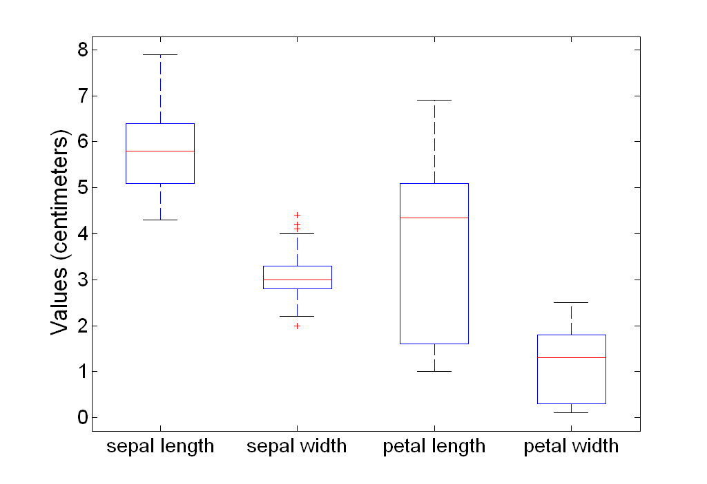
Example of Box Plots
Box plots can be used to compare attributes

Slide 21
Visualization Techniques: Scatter Plots
Scatter plots
Attributes values determine the position
Two-dimensional scatter plots most common, but can have three-dimensional scatter plots
Often additional attributes can be displayed by using the size, shape, and color of the markers that represent the objects
It is useful to have arrays of scatter plots can compactly summarize the relationships of several pairs of attributes
See example on the next slide

Slide 22
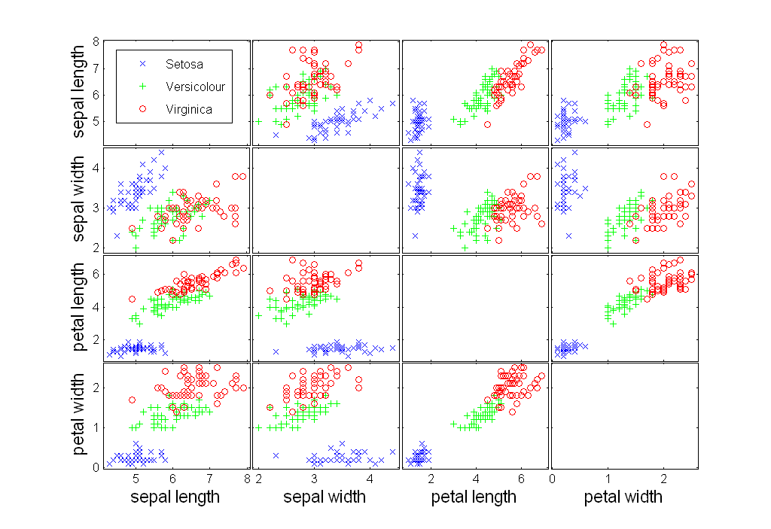
Scatter Plot Array of Iris Attributes

Slide 23
Visualization Techniques: Contour Plots
Contour plots
Useful when a continuous attribute is measured on a spatial grid
They partition the plane into regions of similar values
The contour lines that form the boundaries of these regions connect points with equal values
The most common example is contour maps of elevation
Can also display temperature, rainfall, air pressure, etc.
An example for Sea Surface Temperature (SST) is provided on the next slide

Slide 24
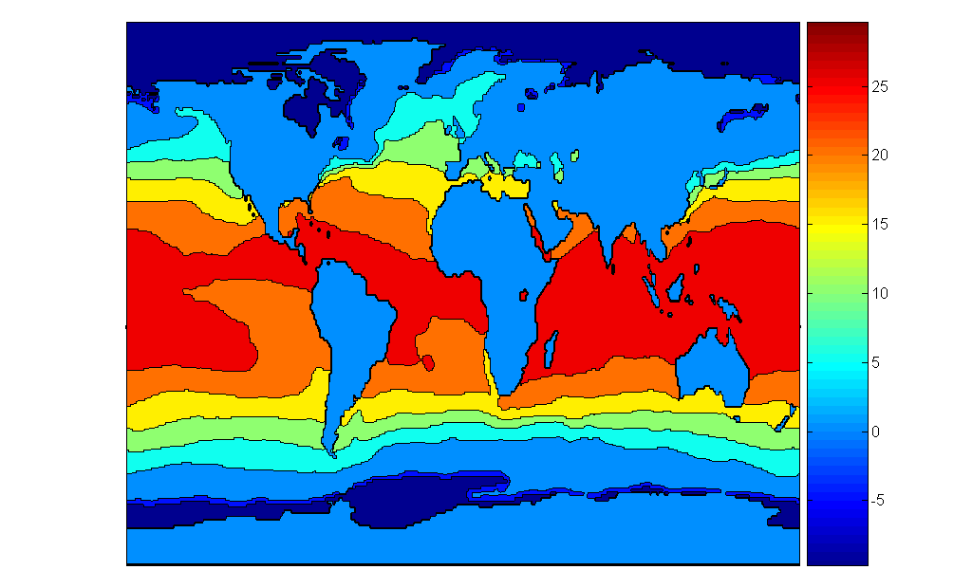
Contour Plot Example: SST Dec, 1998
Celsius

Slide 25
Visualization Techniques: Matrix Plots
Matrix plots
Can plot the data matrix
This can be useful when objects are sorted according to class
Typically, the attributes are normalized to prevent one attribute from dominating the plot
Plots of similarity or distance matrices can also be useful for visualizing the relationships between objects
Examples of matrix plots are presented on the next two slides

Slide 26
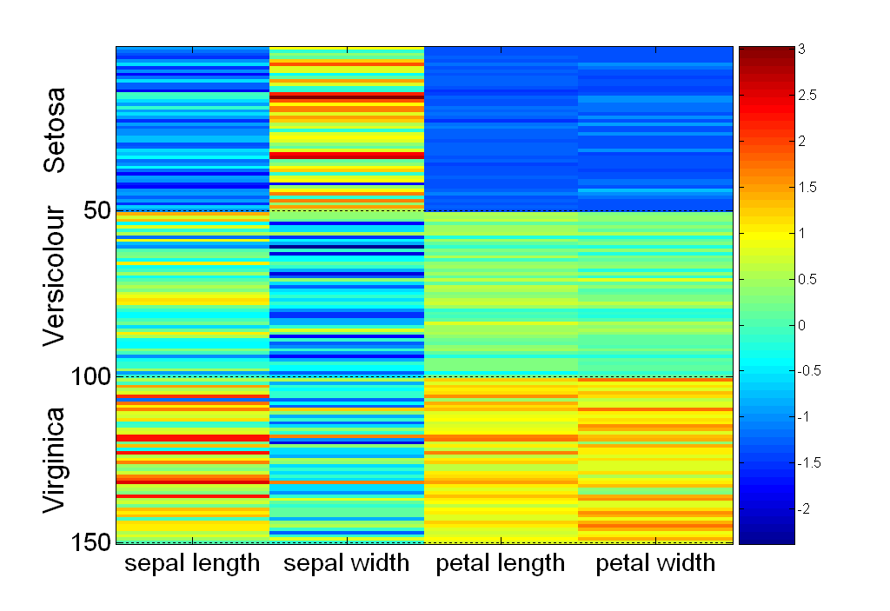
Visualization of the Iris Data Matrix
standard
deviation

Slide 27
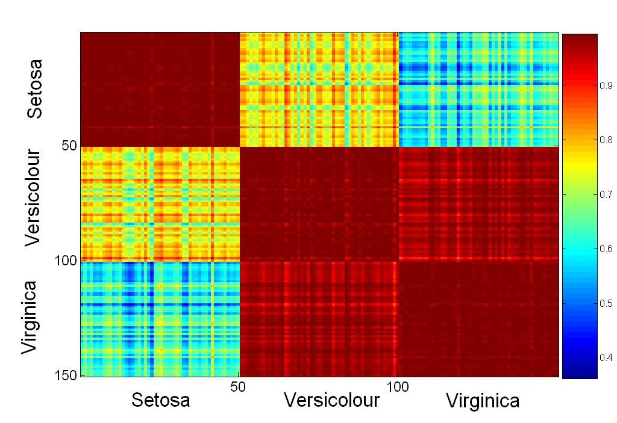
Visualization of the Iris Correlation Matrix

Slide 28
Visualization Techniques: Parallel Coordinates
Parallel Coordinates
Used to plot the attribute values of high-dimensional data
Instead of using perpendicular axes, use a set of parallel axes
The attribute values of each object are plotted as a point on each corresponding coordinate axis and the points are connected by a line
Thus, each object is represented as a line
Often, the lines representing a distinct class of objects group together, at least for some attributes
Ordering of attributes is important in seeing such groupings

Slide 29
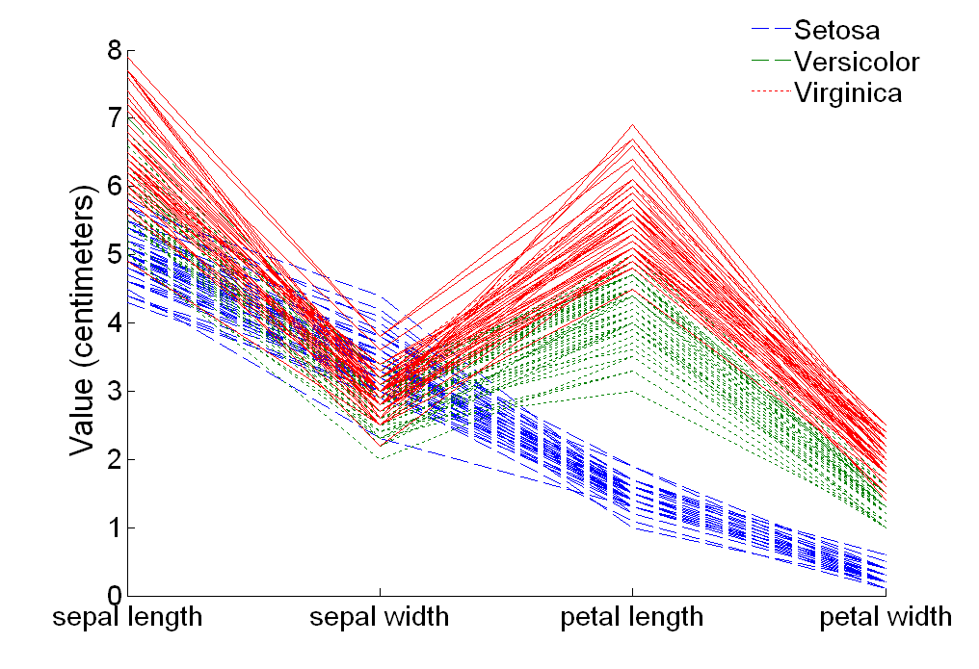
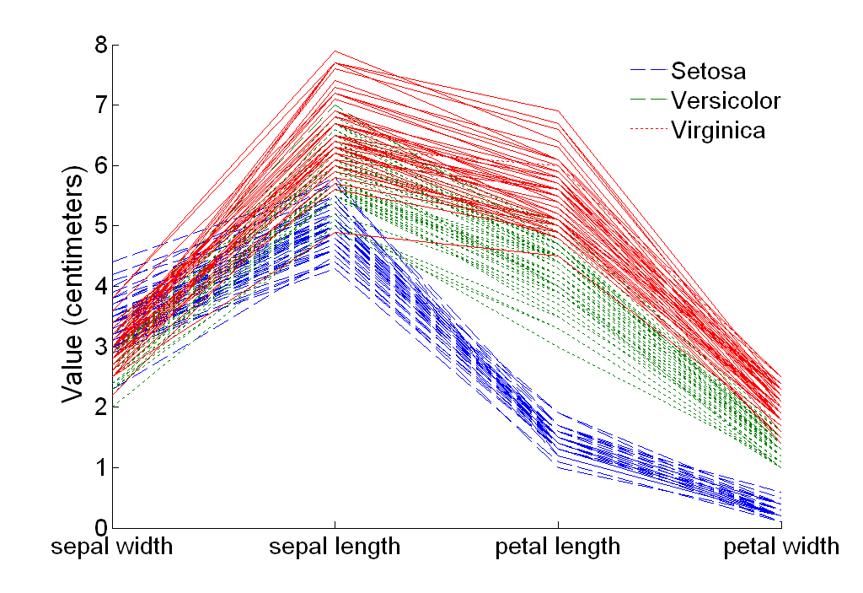
Parallel Coordinates Plots for Iris Data

Slide 30
Other Visualization Techniques
Star Plots
Similar approach to parallel coordinates, but axes radiate from a central point
The line connecting the values of an object is a polygon
Chernoff Faces
Approach created by Herman Chernoff
This approach associates each attribute with a characteristic of a face
The values of each attribute determine the appearance of the corresponding facial characteristic
Each object becomes a separate face
Relies on human’s ability to distinguish faces

Slide 31
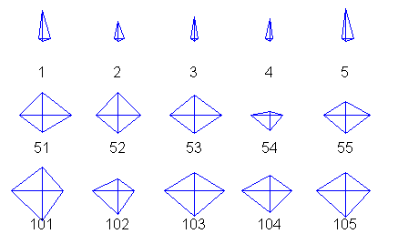
Star Plots for Iris Data
Setosa
Versicolour
Virginica

Slide 32
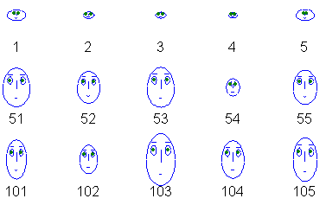
Chernoff Faces for Iris Data
Setosa
Versicolour
Virginica

Slide 33
OLAP
On-Line Analytical Processing (OLAP) was proposed by E. F. Codd, the father of the relational database.
Relational databases put data into tables, while OLAP uses a multidimensional array representation.
Such representations of data previously existed in statistics and other fields
There are a number of data analysis and data exploration operations that are easier with such a data representation.

Slide 34
Creating a Multidimensional Array
Converting tabular data into a multidimensional array:
Identify which attributes are to be the dimensions and which attribute is to be the target attribute
Attributes used as dimensions must have discrete values
Values of target variable appear as entries in the array
The target value is typically a count or continuous value
Can have no target variable at all except the count of objects that have the same set of attribute values
Find the value of each entry in the multidimensional array by summing the values (of the target attribute) or the count of all objects that have the attribute values corresponding to that entry.

Slide 35
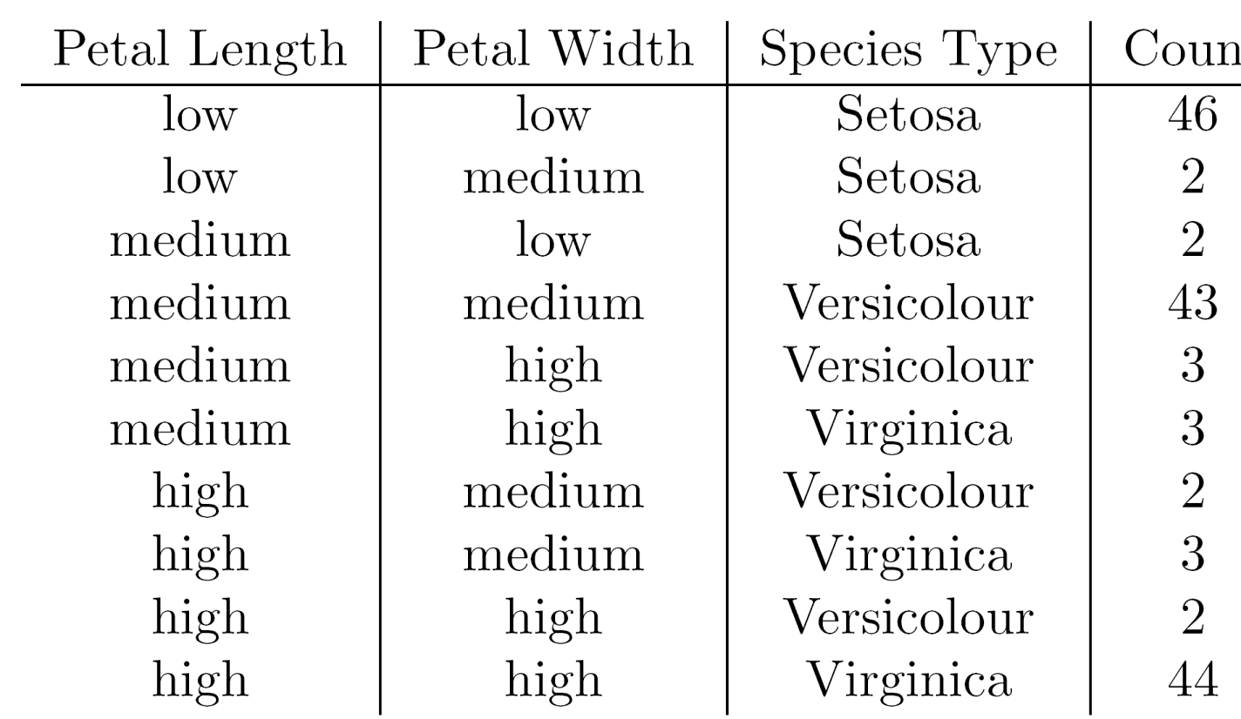
Example: Iris data
We show how the attributes, petal length, petal width, and species type can be converted to a multidimensional array
First, we discretized the petal width and length to have categorical values: low, medium, and high

Slide 36
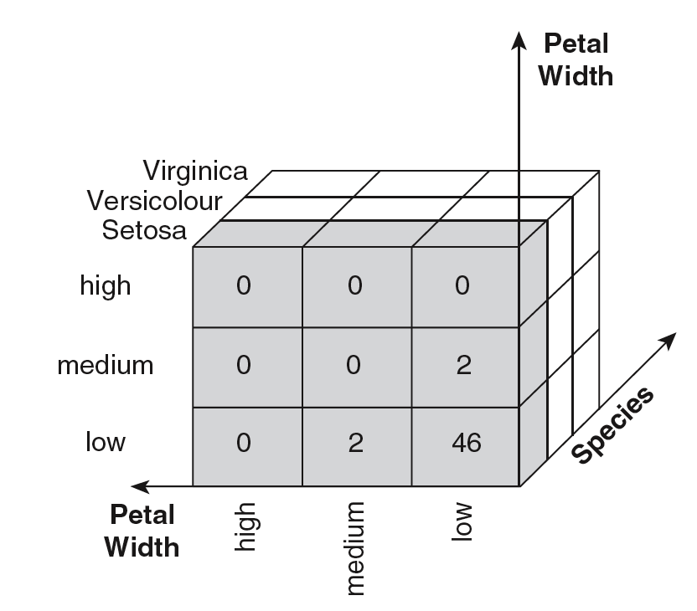
Example: Iris data (continued)
Each unique tuple of petal width, petal length, and species type identifies one element of the array.
This element is assigned the corresponding count value.
The figure illustrates the result.
All non-specified tuples are 0.

Slide 37
Example: Iris data (continued)
Slices of the multidimensional array are shown by the following cross-tabulations
What do these tables tell us?

Slide 38
OLAP Operations: Data Cube
The key operation of a OLAP is the formation of a data cube
A data cube is a multidimensional representation of data, together with all possible aggregates.
By all possible aggregates, we mean the aggregates that result by selecting a proper subset of the dimensions and summing over all remaining dimensions.
For example, if we choose the species type dimension of the Iris data and sum over all other dimensions, the result will be a one-dimensional entry with three entries, each of which gives the number of flowers of each type.

Slide 39
Data Cube Example
Consider a data set that records the sales of products at a number of company stores at various dates.
This data can be represented as a 3 dimensional array
There are 3 two-dimensional aggregates (3 choose 2 ), 3 one-dimensional aggregates, and 1 zero-dimensional aggregate (the overall total)

Slide 40
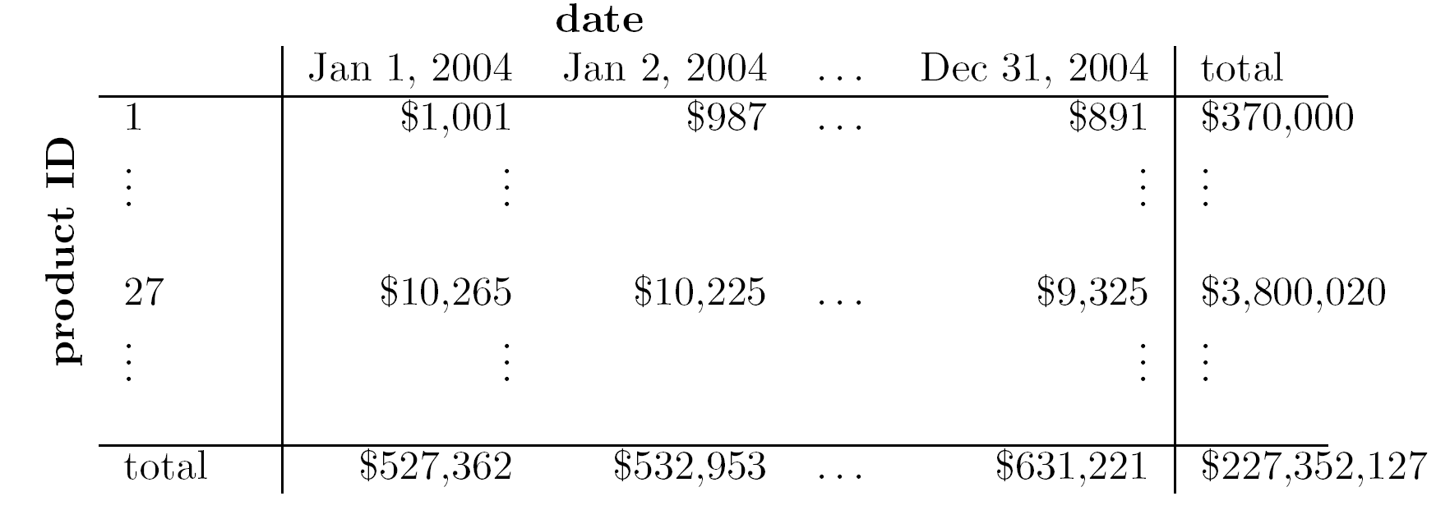
Data Cube Example (continued)
The following figure table shows one of the two dimensional aggregates, along with two of the one-dimensional aggregates, and the overall total

Slide 41
OLAP Operations: Slicing and Dicing
Slicing is selecting a group of cells from the entire multidimensional array by specifying a specific value for one or more dimensions.
Dicing involves selecting a subset of cells by specifying a range of attribute values.
This is equivalent to defining a subarray from the complete array.
In practice, both operations can also be accompanied by aggregation over some dimensions.

Slide 42
OLAP Operations: Roll-up and Drill-down
Attribute values often have a hierarchical structure.
Each date is associated with a year, month, and week.
A location is associated with a continent, country, state (province, etc.), and city.
Products can be divided into various categories, such as clothing, electronics, and furniture.
Note that these categories often nest and form a tree or lattice
A year contains months which contains day
A country contains a state which contains a city

Slide 43
OLAP Operations: Roll-up and Drill-down
This hierarchical structure gives rise to the roll-up and drill-down operations.
For sales data, we can aggregate (roll up) the sales across all the dates in a month.
Conversely, given a view of the data where the time dimension is broken into months, we could split the monthly sales totals (drill down) into daily sales totals.
Likewise, we can drill down or roll up on the location or product ID attributes.

Slide 44
Data Mining: Introduction
Lecture Notes for Chapter 1
Introduction to Data Mining, 2nd Edition
by
Tan, Steinbach, Karpatne, Kumar

Slide 45


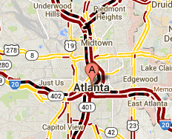
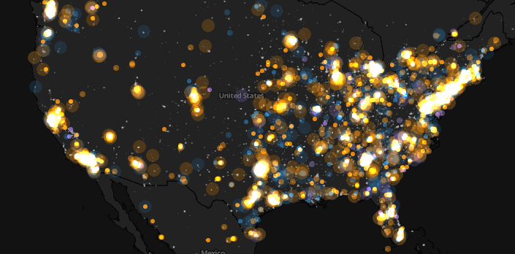
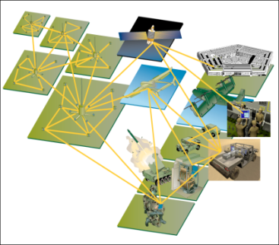
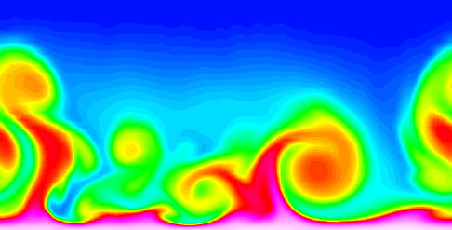
Large-scale Data is Everywhere!
There has been enormous data growth in both commercial and scientific databases due to advances in data generation and collection technologies
New mantra
Gather whatever data you can whenever and wherever possible.
Expectations
Gathered data will have value either for the purpose collected or for a purpose not envisioned.
E-Commerce
Cyber Security
Traffic Patterns
Social Networking: Twitter
Sensor Networks
Computational Simulations
Notes:
45

Slide 46




Why Data Mining? Commercial Viewpoint
Lots of data is being collected and warehoused
Web data
Google has Peta Bytes of web data
Facebook has billions of active users
purchases at department/ grocery stores, e-commerce
Amazon handles millions of visits/day
Bank/Credit Card transactions
Computers have become cheaper and more powerful
Competitive Pressure is Strong
Provide better, customized services for an edge (e.g. in Customer Relationship Management)
Notes:
46

Slide 47
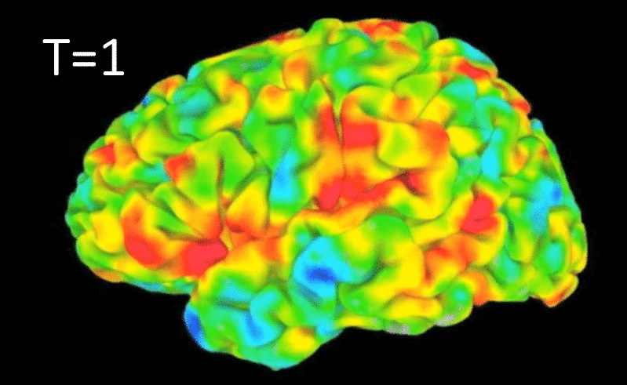
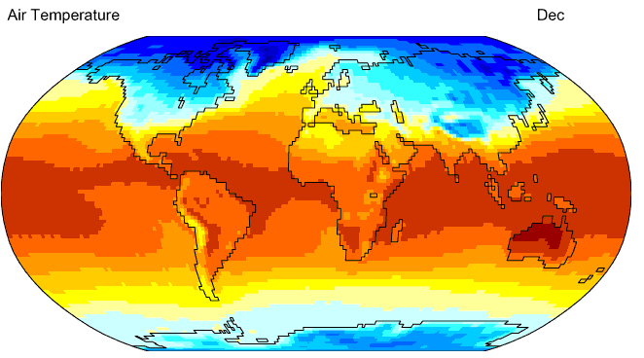
Why Data Mining? Scientific Viewpoint
Data collected and stored at enormous speeds
remote sensors on a satellite
NASA EOSDIS archives over petabytes of earth science data / year
telescopes scanning the skies
Sky survey data
High-throughput biological data
scientific simulations
terabytes of data generated in a few hours
Data mining helps scientists
in automated analysis of massive datasets
In hypothesis formation
fMRI Data from Brain
Sky Survey Data
Gene Expression Data
Surface Temperature of Earth
Notes:
47

Slide 48

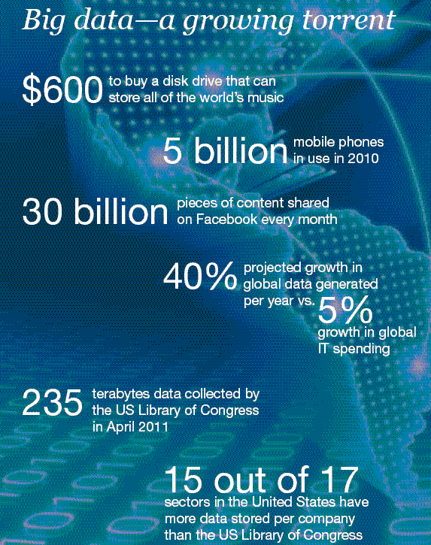
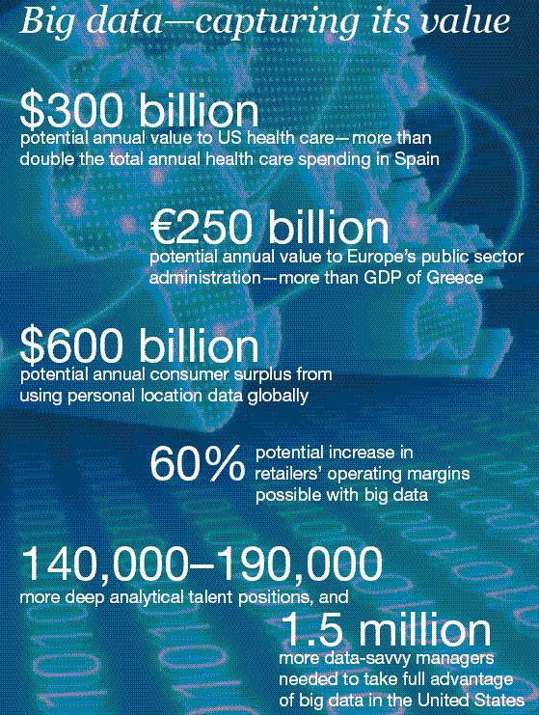
Great opportunities to improve productivity in all walks of life

Slide 49

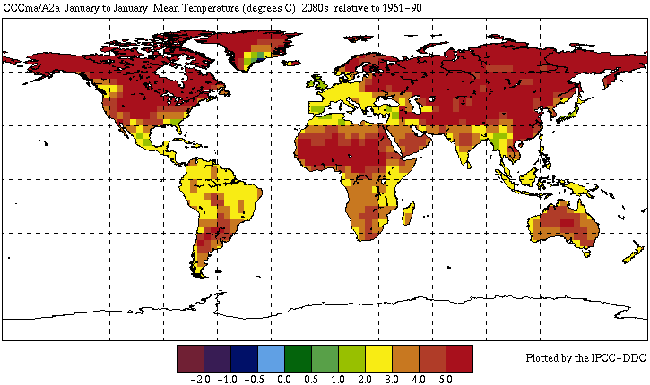

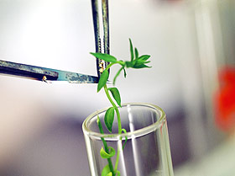
Great Opportunities to Solve Society’s Major Problems
Improving health care and reducing costs
Predicting the impact of climate change
Finding alternative/ green energy sources
Reducing hunger and poverty by
increasing agriculture production

Slide 50
What is Data Mining?
Many Definitions
Non-trivial extraction of implicit, previously unknown and potentially useful information from data
Exploration & analysis, by automatic or semi-automatic means, of large quantities of data in order to discover meaningful patterns

Slide 51
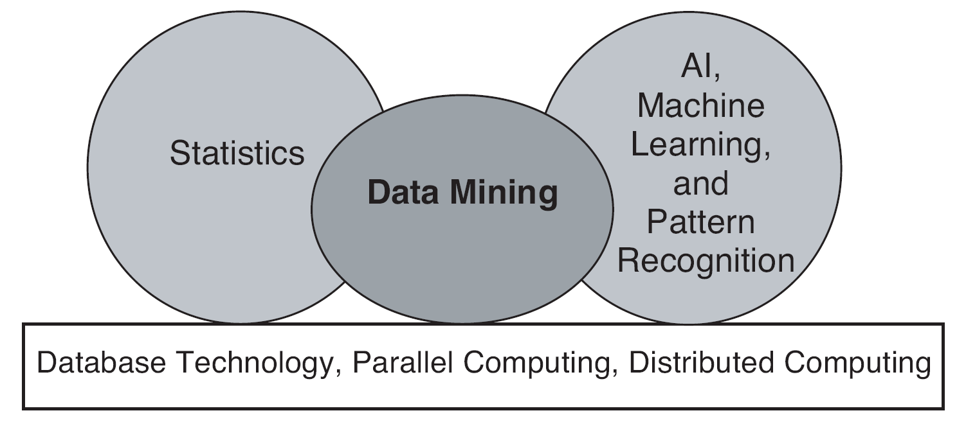
Origins of Data Mining
Draws ideas from machine learning/AI, pattern recognition, statistics, and database systems
Traditional techniques may be unsuitable due to data that is
Large-scale
High dimensional
Heterogeneous
Complex
Distributed
A key component of the emerging field of data science and data-driven discovery

Slide 52
Data Mining Tasks
Prediction Methods
Use some variables to predict unknown or future values of other variables.
Description Methods
Find human-interpretable patterns that describe the data.
From [Fayyad, et.al.] Advances in Knowledge Discovery and Data Mining, 1996

Slide 53


Data Mining Tasks …
Data
Clustering
Predictive Modeling
Association Rules
Anomaly Detection
Milk

Slide 54
Predictive Modeling: Classification
Find a model for class attribute as a function of the values of other attributes
Model for predicting credit worthiness
Class

Slide 55
Classification Example
categorical
categorical
quantitative
class
Test
Set
Learn
Classifier
Training
Set
Model

Slide 56
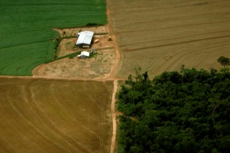
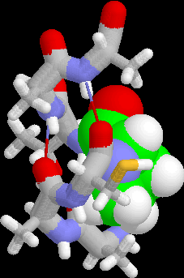
Examples of Classification Task
Classifying credit card transactions as legitimate or fraudulent
Classifying land covers (water bodies, urban areas, forests, etc.) using satellite data
Categorizing news stories as finance, weather, entertainment, sports, etc
Identifying intruders in the cyberspace
Predicting tumor cells as benign or malignant
Classifying secondary structures of protein as alpha-helix, beta-sheet, or random coil

Slide 57
Classification: Application 1
Fraud Detection
Goal: Predict fraudulent cases in credit card transactions.
Approach:
Use credit card transactions and the information on its account-holder as attributes.
When does a customer buy, what does he buy, how often he pays on time, etc
Label past transactions as fraud or fair transactions. This forms the class attribute.
Learn a model for the class of the transactions.
Use this model to detect fraud by observing credit card transactions on an account.

Slide 58
Classification: Application 2
Churn prediction for telephone customers
Goal: To predict whether a customer is likely to be lost to a competitor.
Approach:
Use detailed record of transactions with each of the past and present customers, to find attributes.
How often the customer calls, where he calls, what time-of-the day he calls most, his financial status, marital status, etc.
Label the customers as loyal or disloyal.
Find a model for loyalty.
From [Berry & Linoff] Data Mining Techniques, 1997

Slide 59
Classification: Application 3
Sky Survey Cataloging
Goal: To predict class (star or galaxy) of sky objects, especially visually faint ones, based on the telescopic survey images (from Palomar Observatory).
3000 images with 23,040 x 23,040 pixels per image.
Approach:
Segment the image.
Measure image attributes (features) - 40 of them per object.
Model the class based on these features.
Success Story: Could find 16 new high red-shift quasars, some of the farthest objects that are difficult to find!
From [Fayyad, et.al.] Advances in Knowledge Discovery and Data Mining, 1996

Slide 60
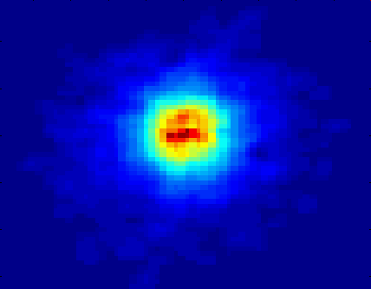
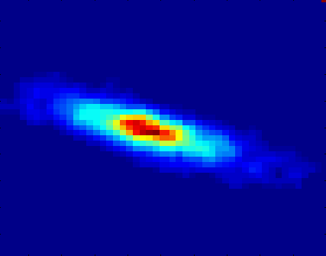
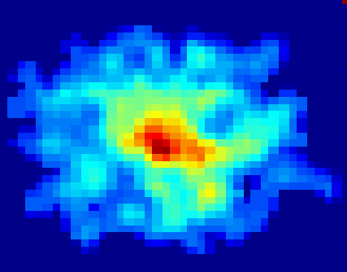
Classifying Galaxies
Courtesy: http://aps.umn.edu
Early
Class:
Stages of Formation
Attributes:
Image features,
Characteristics of light waves received, etc.
Intermediate
Late
Data Size:
72 million stars, 20 million galaxies
Object Catalog: 9 GB
Image Database: 150 GB

Slide 61
Regression
Predict a value of a given continuous valued variable based on the values of other variables, assuming a linear or nonlinear model of dependency.
Extensively studied in statistics, neural network fields.
Examples:
Predicting sales amounts of new product based on advetising expenditure.
Predicting wind velocities as a function of temperature, humidity, air pressure, etc.
Time series prediction of stock market indices.

Slide 62
Clustering
Finding groups of objects such that the objects in a group will be similar (or related) to one another and different from (or unrelated to) the objects in other groups
Inter-cluster distances are maximized
Intra-cluster distances are minimized

Slide 63
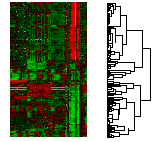

Applications of Cluster Analysis
Understanding
Custom profiling for targeted marketing
Group related documents for browsing
Group genes and proteins that have similar functionality
Group stocks with similar price fluctuations
Summarization
Reduce the size of large data sets
Courtesy: Michael Eisen
Use of K-means to partition Sea Surface Temperature (SST) and Net Primary Production (NPP) into clusters that reflect the Northern and Southern Hemispheres.

Slide 64
Clustering: Application 1
Market Segmentation:
Goal: subdivide a market into distinct subsets of customers where any subset may conceivably be selected as a market target to be reached with a distinct marketing mix.
Approach:
Collect different attributes of customers based on their geographical and lifestyle related information.
Find clusters of similar customers.
Measure the clustering quality by observing buying patterns of customers in same cluster vs. those from different clusters.

Slide 65
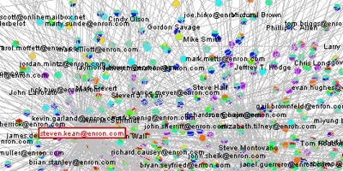
Clustering: Application 2
Document Clustering:
Goal: To find groups of documents that are similar to each other based on the important terms appearing in them.
Approach: To identify frequently occurring terms in each document. Form a similarity measure based on the frequencies of different terms. Use it to cluster.
Enron email dataset

Slide 66
Association Rule Discovery: Definition
Given a set of records each of which contain some number of items from a given collection
Produce dependency rules which will predict occurrence of an item based on occurrences of other items.
Rules Discovered:
{Milk} --> {Coke}
{Diaper, Milk} --> {Beer}

Slide 67
Association Analysis: Applications
Market-basket analysis
Rules are used for sales promotion, shelf management, and inventory management
Telecommunication alarm diagnosis
Rules are used to find combination of alarms that occur together frequently in the same time period
Medical Informatics
Rules are used to find combination of patient symptoms and test results associated with certain diseases

Slide 68
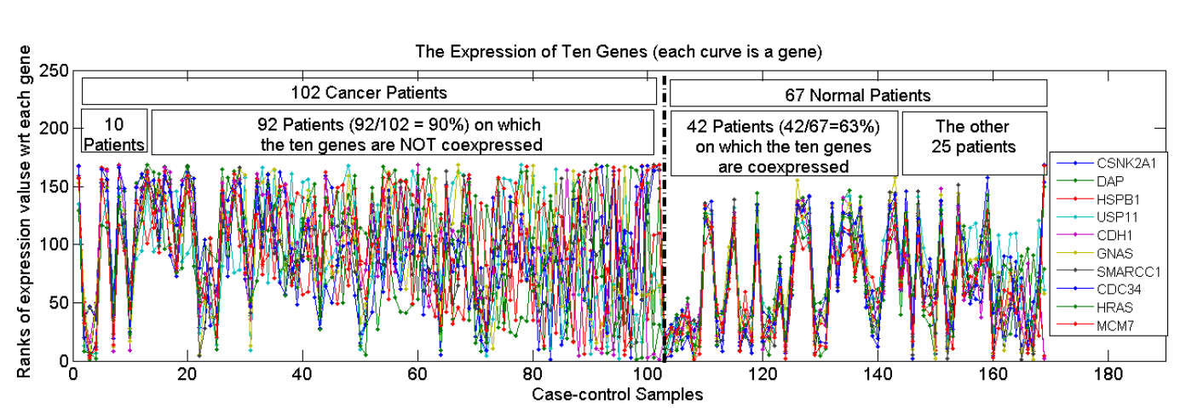
Association Analysis: Applications
An Example Subspace Differential Coexpression Pattern from lung cancer dataset
Enriched with the TNF/NFB signaling pathway
which is well-known to be related to lung cancer
P-value: 1.4*10⁻⁵ (6/10 overlap with the pathway)
Three lung cancer datasets [Bhattacharjee et al. 2001], [Stearman et al. 2005], [Su et al. 2007]
[Fang et al PSB 2010]

Slide 69
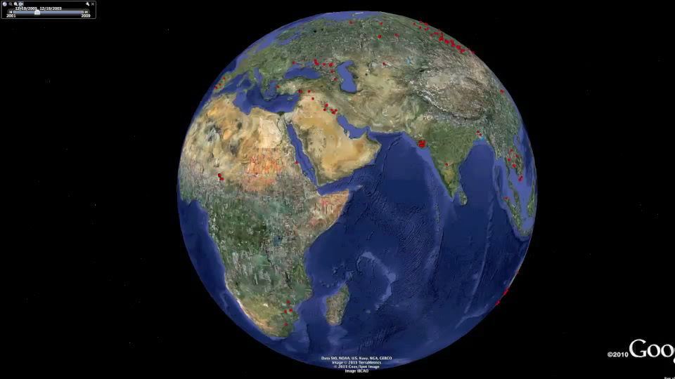
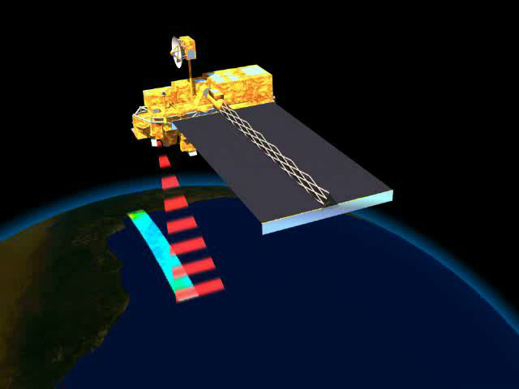
Deviation/Anomaly/Change Detection
Detect significant deviations from normal behavior
Applications:
Credit Card Fraud Detection
Network Intrusion Detection
Identify anomalous behavior from sensor networks for monitoring and surveillance.
Detecting changes in the global forest cover.

Slide 70
Motivating Challenges
Scalability
High Dimensionality
Heterogeneous and Complex Data
Data Ownership and Distribution
Non-traditional Analysis

Slide 71
Data Mining: Data
Lecture Notes for Chapter 2
Introduction to Data Mining , 2nd Edition
by
Tan, Steinbach, Kumar

Slide 72
Outline
Attributes and Objects
Types of Data
Data Quality
Similarity and Distance
Data Preprocessing

Slide 73
What is Data?
Collection of data objects and their attributes
An attribute is a property or characteristic of an object
Examples: eye color of a person, temperature, etc.
Attribute is also known as variable, field, characteristic, dimension, or feature
A collection of attributes describe an object
Object is also known as record, point, case, sample, entity, or instance
Attributes
Objects

Slide 74
Attribute Values
Attribute values are numbers or symbols assigned to an attribute for a particular object
Distinction between attributes and attribute values
Same attribute can be mapped to different attribute values
Example: height can be measured in feet or meters
Different attributes can be mapped to the same set of values
Example: Attribute values for ID and age are integers
But properties of attribute can be different than the properties of the values used to represent the attribute

Slide 75
Measurement of Length
The way you measure an attribute may not match the attributes properties.
This scale preserves only the ordering property of length.
This scale preserves the ordering and additvity properties of length.

Slide 76
Types of Attributes
There are different types of attributes
Nominal
Examples: ID numbers, eye color, zip codes
Ordinal
Examples: rankings (e.g., taste of potato chips on a scale from 1-10), grades, height {tall, medium, short}
Interval
Examples: calendar dates, temperatures in Celsius or Fahrenheit.
Ratio
Examples: temperature in Kelvin, length, counts, elapsed time (e.g., time to run a race)

Slide 77
Properties of Attribute Values
The type of an attribute depends on which of the following properties/operations it possesses:
Distinctness: = ≠
Order: < >
Differences are + - meaningful :
Ratios are * / meaningful
Nominal attribute: distinctness
Ordinal attribute: distinctness & order
Interval attribute: distinctness, order & meaningful differences
Ratio attribute: all 4 properties/operations

Slide 78
Difference Between Ratio and Interval
Is it physically meaningful to say that a temperature of 10 ° is twice that of 5° on
the Celsius scale?
the Fahrenheit scale?
the Kelvin scale?
Consider measuring the height above average
If Bill’s height is three inches above average and Bob’s height is six inches above average, then would we say that Bob is twice as tall as Bill?
Is this situation analogous to that of temperature?

Slide 79
This categorization of attributes is due to S. S. Stevens

Slide 80
This categorization of attributes is due to S. S. Stevens

Slide 81
Discrete and Continuous Attributes
Discrete Attribute
Has only a finite or countably infinite set of values
Examples: zip codes, counts, or the set of words in a collection of documents
Often represented as integer variables.
Note: binary attributes are a special case of discrete attributes
Continuous Attribute
Has real numbers as attribute values
Examples: temperature, height, or weight.
Practically, real values can only be measured and represented using a finite number of digits.
Continuous attributes are typically represented as floating-point variables.

Slide 82
Asymmetric Attributes
Only presence (a non-zero attribute value) is regarded as important
Words present in documents
Items present in customer transactions
If we met a friend in the grocery store would we ever say the following? “I see our purchases are very similar since we didn’t buy most of the same things.”

Slide 83
Critiques of the attribute categorization
Incomplete
Asymmetric binary
Cyclical
Multivariate
Partially ordered
Partial membership
Relationships between the data
Real data is approximate and noisy
This can complicate recognition of the proper attribute type
Treating one attribute type as another may be approximately correct

Slide 84
Key Messages for Attribute Types
The types of operations you choose should be “meaningful” for the type of data you have
Distinctness, order, meaningful intervals, and meaningful ratios are only four (among many possible) properties of data
The data type you see – often numbers or strings – may not capture all the properties or may suggest properties that are not present
Analysis may depend on these other properties of the data
Many statistical analyses depend only on the distribution
In the end, what is meaningful can be specific to domain

Slide 85
Important Characteristics of Data
Dimensionality (number of attributes)
High dimensional data brings a number of challenges
Sparsity
Only presence counts
Resolution
Patterns depend on the scale
Size
Type of analysis may depend on size of data

Slide 86
Types of data sets
Record
Data Matrix
Document Data
Transaction Data
Graph
World Wide Web
Molecular Structures
Ordered
Spatial Data
Temporal Data
Sequential Data
Genetic Sequence Data

Slide 87
Record Data
Data that consists of a collection of records, each of which consists of a fixed set of attributes

Slide 88
Data Matrix
If data objects have the same fixed set of numeric attributes, then the data objects can be thought of as points in a multi-dimensional space, where each dimension represents a distinct attribute
Such a data set can be represented by an m by n matrix, where there are m rows, one for each object, and n columns, one for each attribute

Slide 89
Document Data
Each document becomes a ‘term’ vector
Each term is a component (attribute) of the vector
The value of each component is the number of times the corresponding term occurs in the document.

Slide 90
Transaction Data
A special type of data, where
Each transaction involves a set of items.
For example, consider a grocery store. The set of products purchased by a customer during one shopping trip constitute a transaction, while the individual products that were purchased are the items.
Can represent transaction data as record data

Slide 91
Graph Data
Examples: Generic graph, a molecule, and webpages
Benzene Molecule: C6H6

Slide 92
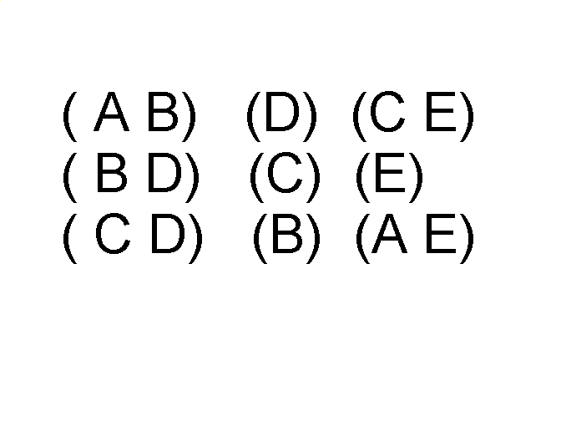
Ordered Data
Sequences of transactions
Items/Events
An element of the sequence

Slide 93
Ordered Data
Genomic sequence data

Slide 94
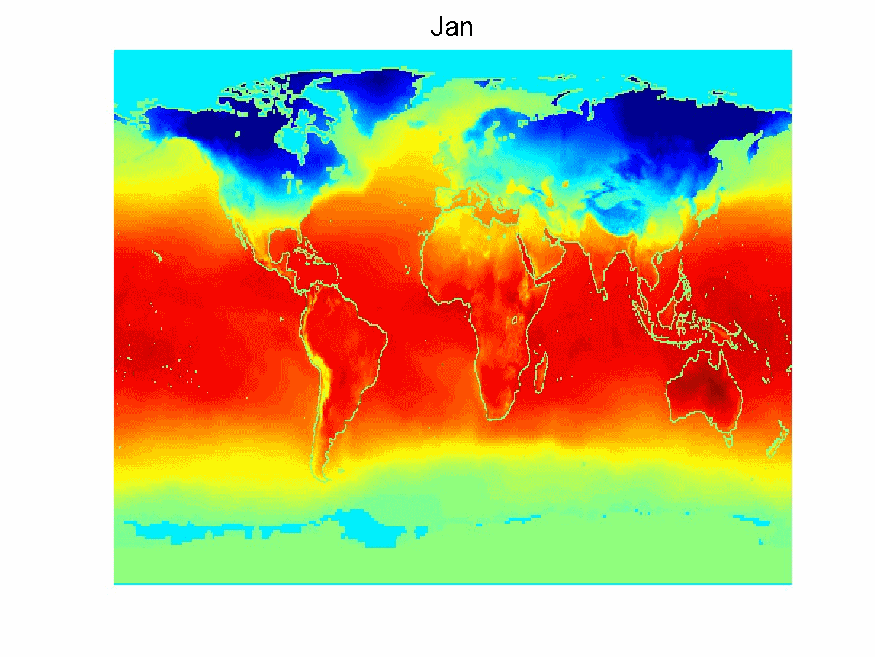
Ordered Data
Spatio-Temporal Data
Average Monthly Temperature of land and ocean

Slide 95
Data Quality
Poor data quality negatively affects many data processing efforts
Data mining example: a classification model for detecting people who are loan risks is built using poor data
Some credit-worthy candidates are denied loans
More loans are given to individuals that default

Slide 96
Data Quality …
What kinds of data quality problems?
How can we detect problems with the data?
What can we do about these problems?
Examples of data quality problems:
Noise and outliers
Wrong data
Fake data
Missing values
Duplicate data

Slide 97
Noise
For objects, noise is an extraneous object
For attributes, noise refers to modification of original values
Examples: distortion of a person’s voice when talking on a poor phone and “snow” on television screen
The figures below show two sine waves of the same magnitude and different frequencies, the waves combined, and the two sine waves with random noise
The magnitude and shape of the original signal is distorted

Slide 98
Outliers
Outliers are data objects with characteristics that are considerably different than most of the other data objects in the data set
Case 1: Outliers are noise that interferes with data analysis
Case 2: Outliers are the goal of our analysis
Credit card fraud
Intrusion detection
Causes?

Slide 99
Missing Values
Reasons for missing values
Information is not collected (e.g., people decline to give their age and weight)
Attributes may not be applicable to all cases (e.g., annual income is not applicable to children)
Handling missing values
Eliminate data objects or variables
Estimate missing values
Example: time series of temperature
Example: census results
Ignore the missing value during analysis

Slide 100
Duplicate Data
Data set may include data objects that are duplicates, or almost duplicates of one another
Major issue when merging data from heterogeneous sources
Examples:
Same person with multiple email addresses
Data cleaning
Process of dealing with duplicate data issues
When should duplicate data not be removed?

Slide 101
Similarity and Dissimilarity Measures
Similarity measure
Numerical measure of how alike two data objects are.
Is higher when objects are more alike.
Often falls in the range [0,1]
Dissimilarity measure
Numerical measure of how different two data objects are
Lower when objects are more alike
Minimum dissimilarity is often 0
Upper limit varies
Proximity refers to a similarity or dissimilarity

Slide 102
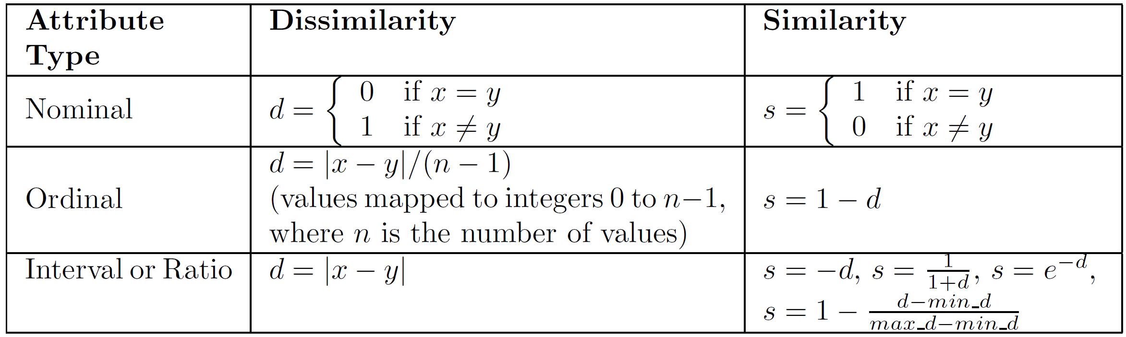
Similarity/Dissimilarity for Simple Attributes
The following table shows the similarity and dissimilarity between two objects, x and y, with respect to a single, simple attribute.

Slide 103
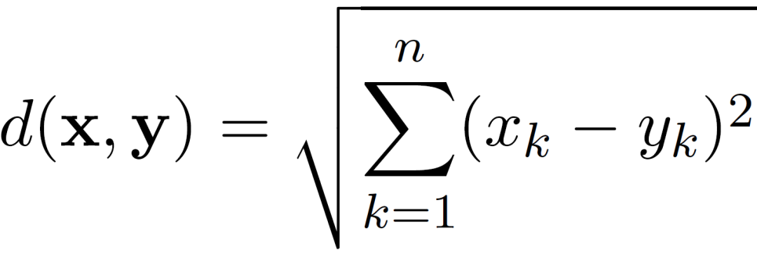
Euclidean Distance
Euclidean Distance
where n is the number of dimensions (attributes) and x_{k} and y_{k} are, respectively, the k^{th} attributes (components) or data objects x and y.
Standardization is necessary, if scales differ.

Slide 104
Euclidean Distance
Distance Matrix

Slide 105
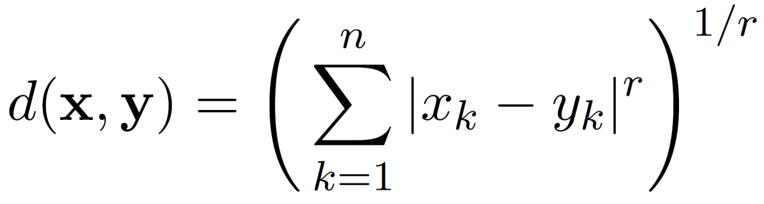
Minkowski Distance
Minkowski Distance is a generalization of Euclidean Distance
Where r is a parameter, n is the number of dimensions (attributes) and x_{k} and y_{k} are, respectively, the k^{th} attributes (components) or data objects x and y.

Slide 106
Minkowski Distance: Examples
r = 1. City block (Manhattan, taxicab, L₁ norm) distance.
A common example of this for binary vectors is the Hamming distance, which is just the number of bits that are different between two binary vectors
r = 2. Euclidean distance
r → ∞. “supremum” (L_{max} norm, L∞ norm) distance.
This is the maximum difference between any component of the vectors
Do not confuse r with n, i.e., all these distances are defined for all numbers of dimensions.

Slide 107
Minkowski Distance
Distance Matrix

Slide 108
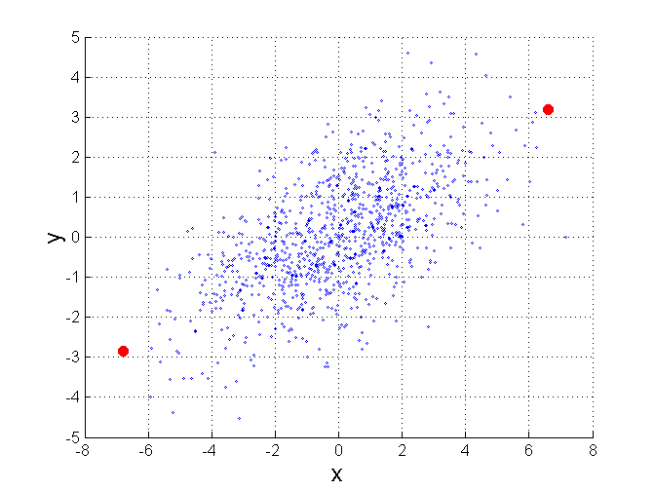
Mahalanobis Distance
$mahalanobis\left(x,y\right)={ ((x−y)}^{T}Ʃ^{−1}(x−y))$^{-0.5}
Σ is the covariance matrix
For red points, the Euclidean distance is 14.7, Mahalanobis distance is 6.

Slide 109
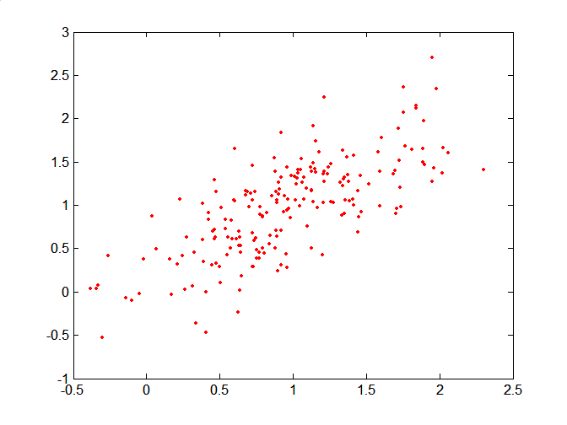
Mahalanobis Distance
Covariance Matrix:
C
B
A: (0.5, 0.5)
B: (0, 1)
C: (1.5, 1.5)
Mahal(A,B) = 5
Mahal(A,C) = 4
A

Slide 110
Common Properties of a Distance
Distances, such as the Euclidean distance, have some well known properties.
d(x, y) ≥ 0 for all x and y and d(x, y) = 0 if and only if x = y.
d(x, y) = d(y, x) for all x and y. (Symmetry)
d(x, z) ≤ d(x, y) + d(y, z) for all points x, y, and z. (Triangle Inequality)
where d(x, y) is the distance (dissimilarity) between points (data objects), x and y.
A distance that satisfies these properties is a metric

Slide 111
Common Properties of a Similarity
Similarities, also have some well known properties.
s(x, y) = 1 (or maximum similarity) only if x = y. (does not always hold, e.g., cosine)
s(x, y) = s(y, x) for all x and y. (Symmetry)
where s(x, y) is the similarity between points (data objects), x and y.

Slide 112
Similarity Between Binary Vectors
Common situation is that objects, x and y, have only binary attributes
Compute similarities using the following quantities
f₀₁ = the number of attributes where x was 0 and y was 1
f₁₀ = the number of attributes where x was 1 and y was 0
f₀₀ = the number of attributes where x was 0 and y was 0
f₁₁ = the number of attributes where x was 1 and y was 1
Simple Matching and Jaccard Coefficients
SMC = number of matches / number of attributes
= (f₁₁ + f₀₀) / (f₀₁ + f₁₀ + f₁₁ + f₀₀)
J = number of 11 matches / number of non-zero attributes
= (f₁₁) / (f₀₁ + f₁₀ + f₁₁)

Slide 113
SMC versus Jaccard: Example
x = 1 0 0 0 0 0 0 0 0 0
y = 0 0 0 0 0 0 1 0 0 1
f₀₁ = 2 (the number of attributes where x was 0 and y was 1)
f₁₀ = 1 (the number of attributes where x was 1 and y was 0)
f₀₀ = 7 (the number of attributes where x was 0 and y was 0)
f₁₁ = 0 (the number of attributes where x was 1 and y was 1)
SMC = (f₁₁ + f₀₀) / (f₀₁ + f₁₀ + f₁₁ + f₀₀)
= (0+7) / (2+1+0+7) = 0.7
J = (f₁₁) / (f₀₁ + f₁₀ + f₁₁) = 0 / (2 + 1 + 0) = 0

Slide 114
Cosine Similarity
If d₁ and d₂ are two document vectors, then
cos( d₁, d₂ ) = <d₁,d₂> / ||d₁|| ||d₂|| ,
where <d₁,d₂> indicates inner product or vector dot product of vectors, d₁ and d_{2,} and || d || is the length of vector d.
Example:
d₁ = 3 2 0 5 0 0 0 2 0 0
d₂ = 1 0 0 0 0 0 0 1 0 2
<d₁, d2> = 3*1 + 2*0 + 0*0 + 5*0 + 0*0 + 0*0 + 0*0 + 2*1 + 0*0 + 0*2 = 5
| d₁ || = (3*3+2*2+0*0+5*5+0*0+0*0+0*0+2*2+0*0+0*0)^{0.5} = (42) ^{0.5} = 6.481
|| d₂ || = (1*1+0*0+0*0+0*0+0*0+0*0+0*0+1*1+0*0+2*2) ^{0.5} = (6) ^{0.5} = 2.449
cos(d₁, d₂ ) = 0.3150

Slide 115
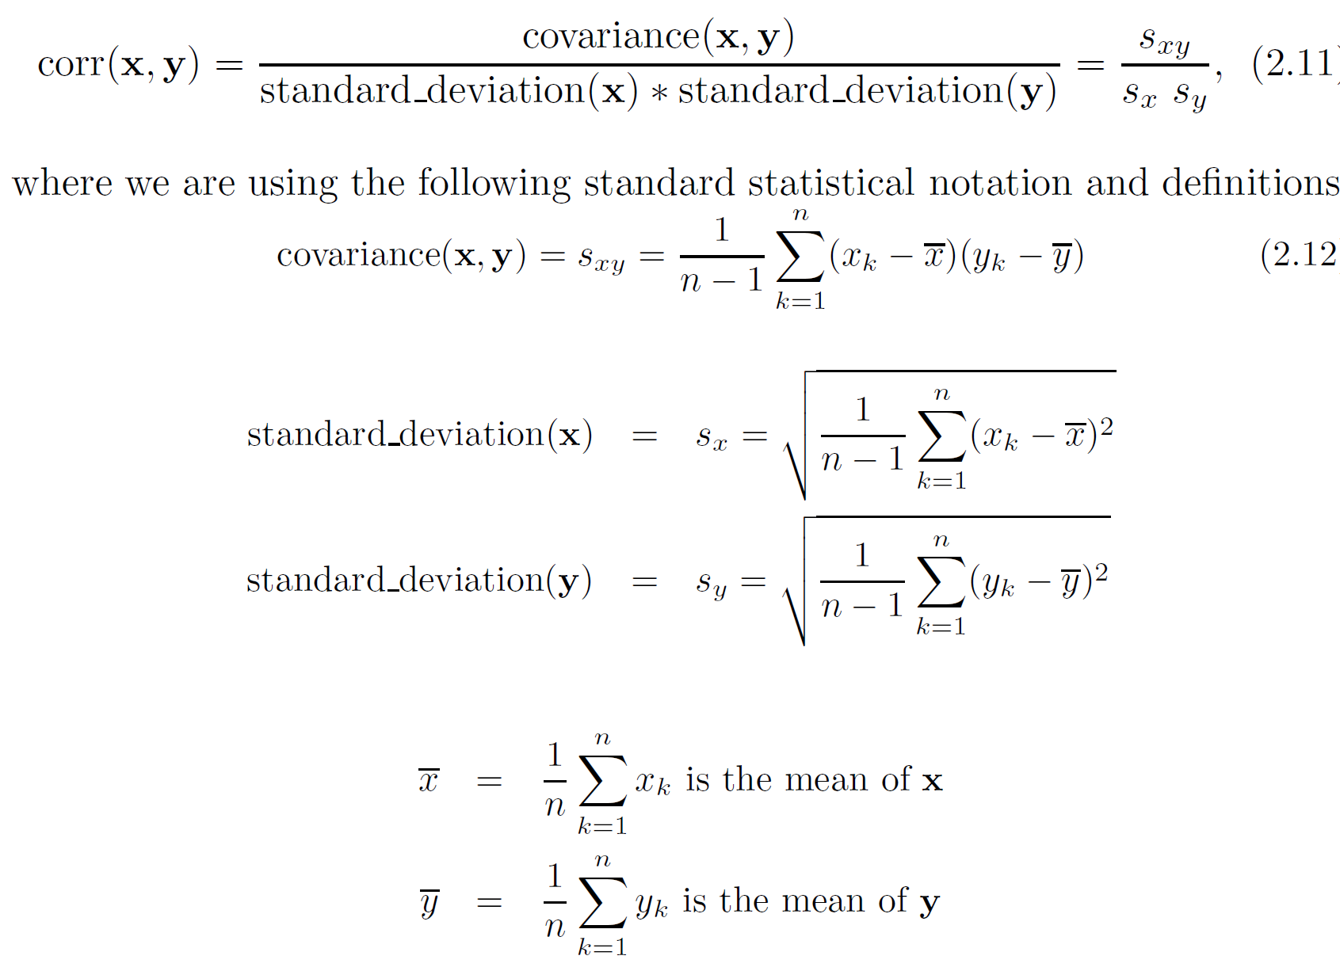
Correlation measures the linear relationship between objects

Slide 116

Visually Evaluating Correlation
Scatter plots showing the similarity from –1 to 1.

Slide 117
Drawback of Correlation
x = (-3, -2, -1, 0, 1, 2, 3)
y = (9, 4, 1, 0, 1, 4, 9)
y_{i} = x_{i}²
mean(x) = 0, mean(y) = 4
std(x) = 2.16, std(y) = 3.74
corr = (-3)(5)+(-2)(0)+(-1)(-3)+(0)(-4)+(1)(-3)+(2)(0)+3(5) / ( 6 * 2.16 * 3.74 )
= 0

Slide 118
Correlation vs Cosine vs Euclidean Distance
Compare the three proximity measures according to their behavior under variable transformation
scaling: multiplication by a value
translation: adding a constant
Consider the example
x = (1, 2, 4, 3, 0, 0, 0), y = (1, 2, 3, 4, 0, 0, 0)
y_{s} = y * 2 (scaled version of y), y_{t} = y + 5 (translated version)
Property | Cosine | Correlation | Euclidean Distance
Invariant to scaling (multiplication) | Yes | Yes | No
Invariant to translation (addition) | No | Yes | No
Measure | (x , y) | (x , y_{s}) | (x , y_{t})
Cosine | 0.9667 | 0.9667 | 0.7940
Correlation | 0.9429 | 0.9429 | 0.9429
Euclidean Distance | 1.4142 | 5.8310 | 14.2127

Slide 119
Correlation vs cosine vs Euclidean distance
Choice of the right proximity measure depends on the domain
What is the correct choice of proximity measure for the following situations?
Comparing documents using the frequencies of words
Documents are considered similar if the word frequencies are similar
Comparing the temperature in Celsius of two locations
Two locations are considered similar if the temperatures are similar in magnitude
Comparing two time series of temperature measured in Celsius
Two time series are considered similar if their “shape” is similar, i.e., they vary in the same way over time, achieving minimums and maximums at similar times, etc.

Slide 120
Comparison of Proximity Measures
Domain of application
Similarity measures tend to be specific to the type of attribute and data
Record data, images, graphs, sequences, 3D-protein structure, etc. tend to have different measures
However, one can talk about various properties that you would like a proximity measure to have
Symmetry is a common one
Tolerance to noise and outliers is another
Ability to find more types of patterns?
Many others possible
The measure must be applicable to the data and produce results that agree with domain knowledge

Slide 121
Information Based Measures
Information theory is a well-developed and fundamental disciple with broad applications
Some similarity measures are based on information theory
Mutual information in various versions
Maximal Information Coefficient (MIC) and related measures
General and can handle non-linear relationships
Can be complicated and time intensive to compute

Slide 122



Information and Probability
Information relates to possible outcomes of an event
transmission of a message, flip of a coin, or measurement of a piece of data
The more certain an outcome, the less information that it contains and vice-versa
For example, if a coin has two heads, then an outcome of heads provides no information
More quantitatively, the information is related the probability of an outcome
The smaller the probability of an outcome, the more information it provides and vice-versa
Entropy is the commonly used measure

Slide 123

Entropy
For
a variable (event), X,
with n possible values (outcomes), x₁, x₂ …, x_{n}
each outcome having probability, p₁, p₂ …, p_{n}
the entropy of X , H(X), is given by
$$H\left(X\right)=−\sum_{i=1}^{n}{{p_{i}log}_{2}{p_{i}}}$$
Entropy is between 0 and log₂n and is measured in bits
Thus, entropy is a measure of how many bits it takes to represent an observation of X on average

Slide 124

Entropy Examples
For a coin with probability p of heads and probability q = 1 – p of tails
$$H=−p\log_{2}{p−}q\log_{2}{q}$$
For p= 0.5, q = 0.5 (fair coin) H = 1
For p = 1 or q = 1, H = 0
What is the entropy of a fair four-sided die?

Slide 125
Entropy for Sample Data: Example
Maximum entropy is log₂5 = 2.3219
Hair Color | Count | p | -plog₂p
Black | 75 | 0.75 | 0.3113
Brown | 15 | 0.15 | 0.4105
Blond | 5 | 0.05 | 0.2161
Red | 0 | 0.00 | 0
Other | 5 | 0.05 | 0.2161
Total | 100 | 1.0 | 1.1540

Slide 126

Entropy for Sample Data
Suppose we have
a number of observations (m) of some attribute, X, e.g., the hair color of students in the class,
where there are n different possible values
And the number of observation in the i^{th} category is m_{i}
Then, for this sample
$$H\left(X\right)=−\sum_{i=1}^{n}{{\frac{m_{i}}{m}log}_{2}{\frac{m_{i}}{m}}}$$
For continuous data, the calculation is harder

Slide 127

Mutual Information
Information one variable provides about another
Formally, $I\left(X,Y\right)=H\left(X\right)+H\left(Y\right)−H(X,Y)$, where
H(X,Y) is the joint entropy of X and Y,
$$H\left(X,Y\right)=−\sum_{i}{\sum_{j}{{pijlog}_{2}{pij}}}$$
Where p_{ij} is the probability that the i^{th} value of X and the j^{th} value of Y occur together
For discrete variables, this is easy to compute
Maximum mutual information for discrete variables is log₂(min( n_{X}, n_{Y} ), where n_{X} (n_{Y}) is the number of values of X (Y)

Slide 128
Mutual Information Example
Student Status | Count | p | -plog₂p
Undergrad | 45 | 0.45 | 0.5184
Grad | 55 | 0.55 | 0.4744
Total | 100 | 1.00 | 0.9928
Student Status | Grade | Count | p | -plog₂p
Undergrad | A | 5 | 0.05 | 0.2161
Undergrad | B | 30 | 0.30 | 0.5211
Undergrad | C | 10 | 0.10 | 0.3322
Grad | A | 30 | 0.30 | 0.5211
Grad | B | 20 | 0.20 | 0.4644
Grad | C | 5 | 0.05 | 0.2161
Total |  | 100 | 1.00 | 2.2710
Grade | Count | p | -plog₂p
A | 35 | 0.35 | 0.5301
B | 50 | 0.50 | 0.5000
C | 15 | 0.15 | 0.4105
Total | 100 | 1.00 | 1.4406
Mutual information of Student Status and Grade = 0.9928 + 1.4406 - 2.2710 = 0.1624

Slide 129
Maximal Information Coefficient
Reshef, David N., Yakir A. Reshef, Hilary K. Finucane, Sharon R. Grossman, Gilean McVean, Peter J. Turnbaugh, Eric S. Lander, Michael Mitzenmacher, and Pardis C. Sabeti. "Detecting novel associations in large data sets." science 334, no. 6062 (2011): 1518-1524.
Applies mutual information to two continuous variables
Consider the possible binnings of the variables into discrete categories
n_{X} × n_{Y} ≤ N^{0.6} where
n_{X} is the number of values of X
n_{Y} is the number of values of Y
N is the number of samples (observations, data objects)
Compute the mutual information
Normalized by log₂(min( n_{X}, n_{Y} )
Take the highest value

Slide 130
General Approach for Combining Similarities
Sometimes attributes are of many different types, but an overall similarity is needed.
1: For the k^{th} attribute, compute a similarity, s_{k}(x, y), in the range [0, 1].
2: Define an indicator variable, δ_{k}, for the k^{th} attribute as follows:
δ_{k} = 0 if the k^{th} attribute is an asymmetric attribute and
both objects have a value of 0, or if one of the objects has a missing value for the kth attribute
δ_{k} = 1 otherwise
3. Compute

Slide 131

Using Weights to Combine Similarities
May not want to treat all attributes the same.
Use non-negative weights $ω_{k}$
$similarity\left(x,y\right)= \frac{\sum_{k=1}^{n}{ω_{k}δ_{k}s_{k}(x,y)}}{\sum_{k=1}^{n}{ω_{k}δ_{k}}}$
Can also define a weighted form of distance

Slide 132
Data Preprocessing
Aggregation
Sampling
Discretization and Binarization
Attribute Transformation
Dimensionality Reduction
Feature subset selection
Feature creation

Slide 133

Aggregation
Combining two or more attributes (or objects) into a single attribute (or object)
Purpose
Data reduction - reduce the number of attributes or objects
Change of scale
Cities aggregated into regions, states, countries, etc.
Days aggregated into weeks, months, or years
More “stable” data - aggregated data tends to have less variability

Slide 134
Example: Precipitation in Australia
This example is based on precipitation in Australia from the period 1982 to 1993.
The next slide shows
A histogram for the standard deviation of average monthly precipitation for 3,030 0.5◦ by 0.5◦ grid cells in Australia, and
A histogram for the standard deviation of the average yearly precipitation for the same locations.
The average yearly precipitation has less variability than the average monthly precipitation.
All precipitation measurements (and their standard deviations) are in centimeters.

Slide 135


Example: Precipitation in Australia …
Variation of Precipitation in Australia
Standard Deviation of Average Monthly Precipitation
Standard Deviation of Average Yearly Precipitation

Slide 136
Sampling
Sampling is the main technique employed for data reduction.
It is often used for both the preliminary investigation of the data and the final data analysis.
Statisticians often sample because obtaining the entire set of data of interest is too expensive or time consuming.
Sampling is typically used in data mining because processing the entire set of data of interest is too expensive or time consuming.

Slide 137
Sampling …
The key principle for effective sampling is the following:
Using a sample will work almost as well as using the entire data set, if the sample is representative
A sample is representative if it has approximately the same properties (of interest) as the original set of data

Slide 138



Sample Size
8000 points 2000 Points 500 Points

Slide 139
Types of Sampling
Simple Random Sampling
There is an equal probability of selecting any particular item
Sampling without replacement
As each item is selected, it is removed from the population
Sampling with replacement
Objects are not removed from the population as they are selected for the sample.
In sampling with replacement, the same object can be picked up more than once
Stratified sampling
Split the data into several partitions; then draw random samples from each partition

Slide 140

Sample Size
What sample size is necessary to get at least one object from each of 10 equal-sized groups.

Slide 141
Discretization
Discretization is the process of converting a continuous attribute into an ordinal attribute
A potentially infinite number of values are mapped into a small number of categories
Discretization is used in both unsupervised and supervised settings

Slide 142

Unsupervised Discretization
Data consists of four groups of points and two outliers. Data is one-dimensional, but a random y component is added to reduce overlap.

Slide 143

Unsupervised Discretization
Equal interval width approach used to obtain 4 values.

Slide 144

Unsupervised Discretization
Equal frequency approach used to obtain 4 values.

Slide 145

Unsupervised Discretization
K-means approach to obtain 4 values.

Slide 146
Discretization in Supervised Settings
Many classification algorithms work best if both the independent and dependent variables have only a few values
We give an illustration of the usefulness of discretization using the following example.

Slide 147
Binarization
Binarization maps a continuous or categorical attribute into one or more binary variables

Slide 148
Attribute Transformation
An attribute transform is a function that maps the entire set of values of a given attribute to a new set of replacement values such that each old value can be identified with one of the new values
Simple functions: x^{k}, log(x), e^{x}, |x|
Normalization
Refers to various techniques to adjust to differences among attributes in terms of frequency of occurrence, mean, variance, range
Take out unwanted, common signal, e.g., seasonality
In statistics, standardization refers to subtracting off the means and dividing by the standard deviation

Slide 149

Example: Sample Time Series of Plant Growth
Minneapolis
Net Primary Production (NPP) is a measure of plant growth used by ecosystem scientists.
Correlations between time series
Correlations between time series

Slide 150

Seasonality Accounts for Much Correlation
Minneapolis
Normalized using monthly Z Score:
Subtract off monthly mean and divide by monthly standard deviation
Correlations between time series
Correlations between time series

Slide 151

Curse of Dimensionality
When dimensionality increases, data becomes increasingly sparse in the space that it occupies
Definitions of density and distance between points, which are critical for clustering and outlier detection, become less meaningful
Randomly generate 500 points
Compute difference between max and min distance between any pair of points

Slide 152
Dimensionality Reduction
Purpose:
Avoid curse of dimensionality
Reduce amount of time and memory required by data mining algorithms
Allow data to be more easily visualized
May help to eliminate irrelevant features or reduce noise
Techniques
Principal Components Analysis (PCA)
Singular Value Decomposition
Others: supervised and non-linear techniques

Slide 153
Dimensionality Reduction: PCA
Goal is to find a projection that captures the largest amount of variation in data
x₂
e
x₁

Slide 154





Dimensionality Reduction: PCA

Slide 155
Feature Subset Selection
Another way to reduce dimensionality of data
Redundant features
Duplicate much or all of the information contained in one or more other attributes
Example: purchase price of a product and the amount of sales tax paid
Irrelevant features
Contain no information that is useful for the data mining task at hand
Example: students' ID is often irrelevant to the task of predicting students' GPA
Many techniques developed, especially for classification

Slide 156
Feature Creation
Create new attributes that can capture the important information in a data set much more efficiently than the original attributes
Three general methodologies:
Feature extraction
Example: extracting edges from images
Feature construction
Example: dividing mass by volume to get density
Mapping data to new space
Example: Fourier and wavelet analysis

Slide 157


Mapping Data to a New Space
Fourier and wavelet transform
Frequency
Two Sine Waves + Noise
Frequency

Slide 158
Data Mining Classification: Basic Concepts and Techniques
Lecture Notes for Chapter 3
Introduction to Data Mining, 2nd Edition
by
Tan, Steinbach, Karpatne, Kumar

Slide 159
Classification: Definition
Given a collection of records (training set )
Each record is by characterized by a tuple (x,y), where x is the attribute set and y is the class label
x: attribute, predictor, independent variable, input
y: class, response, dependent variable, output
Task:
Learn a model that maps each attribute set x into one of the predefined class labels y

Slide 160
Examples of Classification Task
Task | Attribute set, x | Class label, y
Categorizing email messages | Features extracted from email message header and content | spam or non-spam
Identifying tumor cells | Features extracted from x-rays or MRI scans | malignant or benign cells
Cataloging galaxies | Features extracted from telescope images | Elliptical, spiral, or irregular-shaped galaxies

Slide 161
General Approach for Building Classification Model

Slide 162
Classification Techniques
Base Classifiers
Decision Tree based Methods
Rule-based Methods
Nearest-neighbor
Naïve Bayes and Bayesian Belief Networks
Support Vector Machines
Neural Networks, Deep Neural Nets
Ensemble Classifiers
Boosting, Bagging, Random Forests

Slide 163
Example of a Decision Tree
categorical
categorical
continuous
class
Splitting Attributes
Home Owner
Yes
No
NO
MarSt
Single, Divorced
Married
Income
NO
< 80K
> 80K
NO
YES
Training Data
Model: Decision Tree

Slide 164
Apply Model to Test Data
Test Data
Start from the root of tree.
Home Owner
Yes
No
NO
MarSt
Single, Divorced
Married
Income
NO
< 80K
> 80K
NO
YES

Slide 165
Apply Model to Test Data
Test Data
Home Owner
Yes
No
NO
MarSt
Single, Divorced
Married
Income
NO
< 80K
> 80K
NO
YES

Slide 166
Apply Model to Test Data
Test Data
Home Owner
Yes
No
NO
MarSt
Single, Divorced
Married
Income
NO
< 80K
> 80K
NO
YES

Slide 167
Apply Model to Test Data
Test Data
Home Owner
Yes
No
NO
MarSt
Single, Divorced
Married
Income
NO
< 80K
> 80K
NO
YES

Slide 168
Apply Model to Test Data
Test Data
Home Owner
Yes
No
NO
MarSt
Single, Divorced
Married
Income
NO
< 80K
> 80K
NO
YES

Slide 169
Apply Model to Test Data
Test Data
Home Owner
Yes
No
NO
MarSt
Single, Divorced
Married
Assign Defaulted to “No”
Income
NO
< 80K
> 80K
NO
YES

Slide 170
Another Example of Decision Tree
categorical
categorical
continuous
class
Single, Divorced
MarSt
Married
NO
Home Owner
Yes
No
NO
Income
< 80K
> 80K
NO
YES
There could be more than one tree that fits the same data!

Slide 171
Decision Tree Classification Task
Decision Tree

Slide 172
Decision Tree Induction
Many Algorithms:
Hunt’s Algorithm (one of the earliest)
CART
ID3, C4.5
SLIQ,SPRINT

Slide 173
General Structure of Hunt’s Algorithm
Let D_{t} be the set of training records that reach a node t
General Procedure:
If D_{t} contains records that belong the same class y_{t}, then t is a leaf node labeled as y_{t}
If D_{t} contains records that belong to more than one class, use an attribute test to split the data into smaller subsets. Recursively apply the procedure to each subset.
D_{t}
?

Slide 174
Hunt’s Algorithm
(7,3)
(3,0)
(4,3)
(3,0)
(3,0)
(3,0)
(1,3)
(3,0)
(1,0)
(0,3)

Slide 175
Hunt’s Algorithm
(7,3)
(3,0)
(4,3)
(3,0)
(3,0)
(3,0)
(1,3)
(3,0)
(1,0)
(0,3)

Slide 176
Hunt’s Algorithm
(7,3)
(3,0)
(4,3)
(3,0)
(3,0)
(3,0)
(1,3)
(3,0)
(1,0)
(0,3)

Slide 177
Hunt’s Algorithm
(7,3)
(3,0)
(4,3)
(3,0)
(3,0)
(3,0)
(1,3)
(3,0)
(1,0)
(0,3)

Slide 178
Design Issues of Decision Tree Induction
How should training records be split?
Method for expressing test condition
depending on attribute types
Measure for evaluating the goodness of a test condition
How should the splitting procedure stop?
Stop splitting if all the records belong to the same class or have identical attribute values
Early termination

Slide 179
Methods for Expressing Test Conditions
Depends on attribute types
Binary
Nominal
Ordinal
Continuous

Slide 180
Test Condition for Nominal Attributes
Multi-way split:
Use as many partitions as distinct values.
Binary split:
Divides values into two subsets

Slide 181
Test Condition for Ordinal Attributes
Multi-way split:
Use as many partitions as distinct values
Binary split:
Divides values into two subsets
Preserve order property among attribute values
This grouping violates order property

Slide 182
Test Condition for Continuous Attributes

Slide 183
Splitting Based on Continuous Attributes
Different ways of handling
Discretization to form an ordinal categorical attribute
Ranges can be found by equal interval bucketing, equal frequency bucketing (percentiles), or clustering.
Static – discretize once at the beginning
Dynamic – repeat at each node
Binary Decision: (A < v) or (A ≥ v)
consider all possible splits and finds the best cut
can be more compute intensive

Slide 184

How to determine the Best Split
Before Splitting: 10 records of class 0, 10 records of class 1
Which test condition is the best?

Slide 185
How to determine the Best Split
Greedy approach:
Nodes with purer class distribution are preferred
Need a measure of node impurity:
High degree of impurity
Low degree of impurity

Slide 186



Measures of Node Impurity
Gini Index
Entropy
Misclassification error
$$Gini Index=1 −\sum_{i=0}^{c−1}{p_{i}{\left(t\right)}^{2}}$$
Where $p_{i}\left(t\right)$ is the frequency of class $i$ at node t, and $c$ is the total number of classes
$$Entropy=−\sum_{i=0}^{c−1}{p_{i}\left(t\right)log_{2}p_{i}(t)}$$
$$Classification error={1 −max⁡[p}_{i}(t)]$$

Slide 187
Finding the Best Split
Compute impurity measure (P) before splitting
Compute impurity measure (M) after splitting
Compute impurity measure of each child node
M is the weighted impurity of child nodes
Choose the attribute test condition that produces the highest gain
Gain = P - M or equivalently, lowest impurity measure after splitting (M)

Slide 188
Finding the Best Split
Before Splitting:
P
A?
B?
Yes
No
Yes
No
Node N1
Node N2
Node N3
Node N4
M11
M12
M21
M22
M1
M2
Gain = P – M1 vs P – M2

Slide 189


Measure of Impurity: GINI
Gini Index for a given node $t$
Where $p_{i}\left(t\right)$ is the frequency of class $i$ at node $t$, and $c$ is the total number of classes
Maximum of $1−1/c$when records are equally distributed among all classes, implying the least beneficial situation for classification
Minimum of 0 when all records belong to one class, implying the most beneficial situation for classification
Gini index is used in decision tree algorithms such as CART, SLIQ, SPRINT
$$Gini Index=1 − \sum_{i=0}^{c−1}{p_{i}{\left(t\right)}^{2}}$$

Slide 190

Measure of Impurity: GINI
Gini Index for a given node t :
For 2-class problem (p, 1 – p):
GINI = 1 – p² – (1 – p)² = 2p (1-p)
$$Gini Index=1 − \sum_{i=0}^{c−1}{p_{i}{\left(t\right)}^{2}}$$

Slide 191

Computing Gini Index of a Single Node
$$Gini Index=1 − \sum_{i=0}^{c−1}{p_{i}{\left(t\right)}^{2}}$$
P(C1) = 0/6 = 0 P(C2) = 6/6 = 1
Gini = 1 – P(C1)² – P(C2)² = 1 – 0 – 1 = 0
P(C1) = 1/6 P(C2) = 5/6
Gini = 1 – (1/6)² – (5/6)² = 0.278
P(C1) = 2/6 P(C2) = 4/6
Gini = 1 – (2/6)² – (4/6)² = 0.444

Slide 192


Computing Gini Index for a Collection of Nodes
When a node $p$ is split into $k$ partitions (children)
where, $n_{i}$ = number of records at child $i$,
$n$ = number of records at parent node $p$.
$$GINI_{split}= \sum_{i=1}^{k}{\frac{n_{i}}{n}GINI(i)}$$

Slide 193
Binary Attributes: Computing GINI Index
Splits into two partitions (child nodes)
Effect of Weighing partitions:
Larger and purer partitions are sought
B?
Yes
No
Node N1
Node N2
Gini(N1) = 1 – (5/6)² – (1/6)² = 0.278
Gini(N2) = 1 – (2/6)² – (4/6)² = 0.444
Weighted Gini of N1 N2 = 6/12 * 0.278 + 6/12 * 0.444 = 0.361
Gain = 0.486 – 0.361 = 0.125

Slide 194
Categorical Attributes: Computing Gini Index
For each distinct value, gather counts for each class in the dataset
Use the count matrix to make decisions
Multi-way split
Two-way split
(find best partition of values)
Which of these is the best?

Slide 195
Continuous Attributes: Computing Gini Index
Use Binary Decisions based on one value
Several Choices for the splitting value
Number of possible splitting values = Number of distinct values
Each splitting value has a count matrix associated with it
Class counts in each of the partitions, A ≤ v and A > v
Simple method to choose best v
For each v, scan the database to gather count matrix and compute its Gini index
Computationally Inefficient! Repetition of work.
Annual Income ?
 | ≤ 80 | > 80
Defaulted Yes | 0 | 3
Defaulted No | 3 | 4

Slide 196
Continuous Attributes: Computing Gini Index...
For efficient computation: for each attribute,
Sort the attribute on values
Linearly scan these values, each time updating the count matrix and computing gini index
Choose the split position that has the least gini index
Sorted Values

Slide 197
Continuous Attributes: Computing Gini Index...
For efficient computation: for each attribute,
Sort the attribute on values
Linearly scan these values, each time updating the count matrix and computing gini index
Choose the split position that has the least gini index
Sorted Values
Split Positions

Slide 198
Continuous Attributes: Computing Gini Index...
For efficient computation: for each attribute,
Sort the attribute on values
Linearly scan these values, each time updating the count matrix and computing gini index
Choose the split position that has the least gini index
Sorted Values
Split Positions

Slide 199
Continuous Attributes: Computing Gini Index...
For efficient computation: for each attribute,
Sort the attribute on values
Linearly scan these values, each time updating the count matrix and computing gini index
Choose the split position that has the least gini index
Sorted Values
Split Positions

Slide 200
Continuous Attributes: Computing Gini Index...
For efficient computation: for each attribute,
Sort the attribute on values
Linearly scan these values, each time updating the count matrix and computing gini index
Choose the split position that has the least gini index
Sorted Values
Split Positions

Slide 201


Measure of Impurity: Entropy
Entropy at a given node $t$
Where $p_{i}\left(t\right)$ is the frequency of class $i$ at node $t$, and $c$ is the total number of classes
Maximum of $\log_{2}c$ when records are equally distributed among all classes, implying the least beneficial situation for classification
Minimum of 0 when all records belong to one class, implying most beneficial situation for classification
Entropy based computations are quite similar to the GINI index computations
$$Entropy=−\sum_{i=0}^{c−1}{p_{i}\left(t\right)log_{2}p_{i}(t)}$$

Slide 202

Computing Entropy of a Single Node
$$Entropy=−\sum_{i=0}^{c−1}{p_{i}\left(t\right)log_{2}p_{i}(t)}$$
P(C1) = 0/6 = 0 P(C2) = 6/6 = 1
Entropy = – 0 log 0 – 1 log 1 = – 0 – 0 = 0
P(C1) = 1/6 P(C2) = 5/6
Entropy = – (1/6) log₂ (1/6) – (5/6) log₂ (1/6) = 0.65
P(C1) = 2/6 P(C2) = 4/6
Entropy = – (2/6) log₂ (2/6) – (4/6) log₂ (4/6) = 0.92

Slide 203


Computing Information Gain After Splitting
Information Gain:
Parent Node, $p$ is split into $k$ partitions (children)
$n_{i}$ is number of records in child node $i$
Choose the split that achieves most reduction (maximizes GAIN)
Used in the ID3 and C4.5 decision tree algorithms
Information gain is the mutual information between the class variable and the splitting variable
$$Gain_{split}=Entropy\left(p\right)−\sum_{i=1}^{k}{\frac{n_{i}}{n}Entropy(i)}$$

Slide 204
Problem with large number of partitions
Node impurity measures tend to prefer splits that result in large number of partitions, each being small but pure
Customer ID has highest information gain because entropy for all the children is zero

Slide 205


Gain Ratio
Gain Ratio:
Parent Node, $p$ is split into $k$ partitions (children)
$n_{i}$ is number of records in child node $i$
Adjusts Information Gain by the entropy of the partitioning ($Split Info$).
Higher entropy partitioning (large number of small partitions) is penalized!
Used in C4.5 algorithm
Designed to overcome the disadvantage of Information Gain
$$Gain Ratio= \frac{Gain_{split}}{Split Info} Split Info=−\sum_{i=1}^{k}{\frac{n_{i}}{n}log_{2}}\frac{n_{i}}{n}$$

Slide 206


Gain Ratio
Gain Ratio:
Parent Node, $p$ is split into $k$ partitions (children)
$n_{i}$ is number of records in child node $i$
$$Gain Ratio= \frac{Gain_{split}}{Split Info} Split Info= \sum_{i=1}^{k}{\frac{n_{i}}{n}log_{2}}\frac{n_{i}}{n}$$
SplitINFO = 1.52
SplitINFO = 0.72
SplitINFO = 0.97

Slide 207


Measure of Impurity: Classification Error
Classification error at a node $t$
Maximum of $1−1/c$when records are equally distributed among all classes, implying the least interesting situation
Minimum of 0 when all records belong to one class, implying the most interesting situation
$$Error\left(t\right)=\underset{ i}{1 −max}⁡[p_{i}\left(t\right)]$$

Slide 208

Computing Error of a Single Node
$$Error\left(t\right)=\underset{ i}{1 −max}⁡[p_{i}\left(t\right)]$$
P(C1) = 0/6 = 0 P(C2) = 6/6 = 1
Error = 1 – max (0, 1) = 1 – 1 = 0
P(C1) = 1/6 P(C2) = 5/6
Error = 1 – max (1/6, 5/6) = 1 – 5/6 = 1/6
P(C1) = 2/6 P(C2) = 4/6
Error = 1 – max (2/6, 4/6) = 1 – 4/6 = 1/3

Slide 209

Comparison among Impurity Measures
For a 2-class problem:

Slide 210
Misclassification Error vs Gini Index
A?
Yes
No
Node N1
Node N2
Gini(N1) = 1 – (3/3)² – (0/3)² = 0
Gini(N2) = 1 – (4/7)² – (3/7)² = 0.489
Gini(Children) = 3/10 * 0 + 7/10 * 0.489 = 0.342
Gini improves but error remains the same!!

Slide 211
Misclassification Error vs Gini Index
A?
Yes
No
Node N1
Node N2
Misclassification error for all three cases = 0.3 !

Slide 212
Decision Tree Based Classification
Advantages:
Relatively inexpensive to construct
Extremely fast at classifying unknown records
Easy to interpret for small-sized trees
Robust to noise (especially when methods to avoid overfitting are employed)
Can easily handle redundant attributes
Can easily handle irrelevant attributes (unless the attributes are interacting)
Disadvantages: .
Due to the greedy nature of splitting criterion, interacting attributes (that can distinguish between classes together but not individually) may be passed over in favor of other attributed that are less discriminating.
Each decision boundary involves only a single attribute

Slide 213

Handling interactions
+ : 1000 instances
o : 1000 instances
Entropy (X) : 0.99
Entropy (Y) : 0.99
Y
X

Slide 214
Handling interactions

Slide 215

Handling interactions given irrelevant attributes
+ : 1000 instances
o : 1000 instances
Adding Z as a noisy attribute generated from a uniform distribution
Entropy (X) : 0.99
Entropy (Y) : 0.99
Entropy (Z) : 0.98
Attribute Z will be chosen for splitting!
Y
X

Slide 216


Limitations of single attribute-based decision boundaries
Both positive (+) and negative (o) classes generated from skewed Gaussians with centers at (8,8) and (12,12) respectively.

Slide 217
Data Mining
Model Overfitting
Introduction to Data Mining, 2nd Edition
by
Tan, Steinbach, Karpatne, Kumar

Slide 218
Classification Errors
Training errors (apparent errors)
Errors committed on the training set
Test errors
Errors committed on the test set
Generalization errors
Expected error of a model over random selection of records from same distribution

Slide 219

Example Data Set
Two class problem:
+ : 5200 instances
5000 instances generated from a Gaussian centered at (10,10)
200 noisy instances added
o : 5200 instances
Generated from a uniform distribution
10 % of the data used for training and 90% of the data used for testing

Slide 220

Increasing number of nodes in Decision Trees

Slide 221
Decision Tree with 4 nodes
Decision Tree
Decision boundaries on Training data

Slide 222
Decision Tree with 50 nodes
Decision Tree
Decision Tree
Decision boundaries on Training data

Slide 223
Which tree is better?
Decision Tree with 4 nodes
Which tree is better ?
Decision Tree with 50 nodes

Slide 224


Model Overfitting
Underfitting: when model is too simple, both training and test errors are large
Overfitting: when model is too complex, training error is small but test error is large

Slide 225

Model Overfitting
Using twice the number of data instances
If training data is under-representative, testing errors increase and training errors decrease on increasing number of nodes
Increasing the size of training data reduces the difference between training and testing errors at a given number of nodes

Slide 226
Model Overfitting
Decision Tree with 50 nodes
Decision Tree with 50 nodes
Using twice the number of data instances
If training data is under-representative, testing errors increase and training errors decrease on increasing number of nodes
Increasing the size of training data reduces the difference between training and testing errors at a given number of nodes

Slide 227
Reasons for Model Overfitting
Limited Training Size
High Model Complexity
Multiple Comparison Procedure

Slide 228
Effect of Multiple Comparison Procedure
Consider the task of predicting whether stock market will rise/fall in the next 10 trading days
Random guessing:
P(correct) = 0.5
Make 10 random guesses in a row:
Day 1 | Up
Day 2 | Down
Day 3 | Down
Day 4 | Up
Day 5 | Down
Day 6 | Down
Day 7 | Up
Day 8 | Up
Day 9 | Up
Day 10 | Down

Slide 229
Effect of Multiple Comparison Procedure
Approach:
Get 50 analysts
Each analyst makes 10 random guesses
Choose the analyst that makes the most number of correct predictions
Probability that at least one analyst makes at least 8 correct predictions

Slide 230
Effect of Multiple Comparison Procedure
Many algorithms employ the following greedy strategy:
Initial model: M
Alternative model: M’ = M ∪ γ, where γ is a component to be added to the model (e.g., a test condition of a decision tree)
Keep M’ if improvement, Δ(M,M’) > α
Often times, γ is chosen from a set of alternative components, Γ = {γ₁, γ₂, …, γ_{k}}
If many alternatives are available, one may inadvertently add irrelevant components to the model, resulting in model overfitting

Slide 231



Effect of Multiple Comparison - Example
Use additional 100 noisy variables generated from a uniform distribution along with X and Y as attributes.
Use 30% of the data for training and 70% of the data for testing
Using only X and Y as attributes

Slide 232
Notes on Overfitting
Overfitting results in decision trees that are more complex than necessary
Training error does not provide a good estimate of how well the tree will perform on previously unseen records
Need ways for estimating generalization errors

Slide 233
Model Selection
Performed during model building
Purpose is to ensure that model is not overly complex (to avoid overfitting)
Need to estimate generalization error
Using Validation Set
Incorporating Model Complexity
Estimating Statistical Bounds

Slide 234
Model Selection: Using Validation Set
Divide training data into two parts:
Training set:
use for model building
Validation set:
use for estimating generalization error
Note: validation set is not the same as test set
Drawback:
Less data available for training

Slide 235
Model Selection: Incorporating Model Complexity
Rationale: Occam’s Razor
Given two models of similar generalization errors, one should prefer the simpler model over the more complex model
A complex model has a greater chance of being fitted accidentally by errors in data
Therefore, one should include model complexity when evaluating a model
Gen. Error(Model) = Train. Error(Model, Train. Data) +
x Complexity(Model)

Slide 236
Estimating the Complexity of Decision Trees
Pessimistic Error Estimate of decision tree T with k leaf nodes:
err(T): error rate on all training records
Ω: trade-off hyper-parameter (similar to )
Relative cost of adding a leaf node
k: number of leaf nodes
N_{train}: total number of training records

Slide 237
Estimating the Complexity of Decision Trees: Example
e(T_{L}) = 4/24
e(T_{R}) = 6/24
Ω = 1
e_{gen}(T_{L}) = 4/24 + 1*7/24 = 11/24 = 0.458
e_{gen}(T_{R}) = 6/24 + 1*4/24 = 10/24 = 0.417

Slide 238
Estimating the Complexity of Decision Trees
Resubstitution Estimate:
Using training error as an optimistic estimate of generalization error
Referred to as optimistic error estimate
e(T_{L}) = 4/24
e(T_{R}) = 6/24

Slide 239
Minimum Description Length (MDL)
Cost(Model,Data) = Cost(Data|Model) + x Cost(Model)
Cost is the number of bits needed for encoding.
Search for the least costly model.
Cost(Data|Model) encodes the misclassification errors.
Cost(Model) uses node encoding (number of children) plus splitting condition encoding.

Slide 240
Estimating Statistical Bounds
Before splitting: e = 2/7, e’(7, 2/7, 0.25) = 0.503 e’(T) = 7 × 0.503 = 3.521
After splitting: e(T_{L}) = 1/4, e’(4, 1/4, 0.25) = 0.537 e(T_{R}) = 1/3, e’(3, 1/3, 0.25) = 0.650 e’(T) = 4 × 0.537 + 3 × 0.650 = 4.098
Therefore, do not split

Slide 241
Model Selection for Decision Trees
Pre-Pruning (Early Stopping Rule)
Stop the algorithm before it becomes a fully-grown tree
Typical stopping conditions for a node:
Stop if all instances belong to the same class
Stop if all the attribute values are the same
More restrictive conditions:
Stop if number of instances is less than some user-specified threshold
Stop if class distribution of instances are independent of the available features (e.g., using χ ² test)
Stop if expanding the current node does not improve impurity measures (e.g., Gini or information gain).
Stop if estimated generalization error falls below certain threshold

Slide 242
Model Selection for Decision Trees
Post-pruning
Grow decision tree to its entirety
Subtree replacement
Trim the nodes of the decision tree in a bottom-up fashion
If generalization error improves after trimming, replace sub-tree by a leaf node
Class label of leaf node is determined from majority class of instances in the sub-tree
Subtree raising
Replace subtree with most frequently used branch

Slide 243
Example of Post-Pruning
Training Error (Before splitting) = 10/30
Pessimistic error = (10 + 0.5)/30 = 10.5/30
Training Error (After splitting) = 9/30
Pessimistic error (After splitting)
= (9 + 4 × 0.5)/30 = 11/30
PRUNE!
Class = Yes | 20
Class = No | 10
Error = 10/30
Class = Yes | 8
Class = No | 4
Class = Yes | 3
Class = No | 4
Class = Yes | 4
Class = No | 1
Class = Yes | 5
Class = No | 1

Slide 244
Examples of Post-pruning

Slide 245
Model Evaluation
Purpose:
To estimate performance of classifier on previously unseen data (test set)
Holdout
Reserve k% for training and (100-k)% for testing
Random subsampling: repeated holdout
Cross validation
Partition data into k disjoint subsets
k-fold: train on k-1 partitions, test on the remaining one
Leave-one-out: k=n

Slide 246
Cross-validation Example
3-fold cross-validation

Slide 247
Data Mining
Lecture Notes for Chapter 4
Artificial Neural Networks
Introduction to Data Mining , 2nd Edition
by
Tan, Steinbach, Karpatne, Kumar

Slide 248
Artificial Neural Networks (ANN)
Basic Idea: A complex non-linear function can be learned as a composition of simple processing units
ANN is a collection of simple processing units (nodes) that are connected by directed links (edges)
Every node receives signals from incoming edges, performs computations, and transmits signals to outgoing edges
Analogous to human brain where nodes are neurons and signals are electrical impulses
Weight of an edge determines the strength of connection between the nodes
Simplest ANN: Perceptron (single neuron)

Slide 249
Basic Architecture of Perceptron
Activation Function
Learns linear decision boundaries
Related to logistic regression (activation function is sign instead of sigmoid)

Slide 250
Perceptron Example
Output Y is 1 if at least two of the three inputs are equal to 1.

Slide 251
Perceptron Example

Slide 252

Perceptron Learning Rule
Initialize the weights (w₀, w₁, …, w_{d})
Repeat
For each training example (x_{i}, y_{i})
Compute $\hat{y_{i}}$
Update the weights:
Until stopping condition is met
k: iteration number; $λ:$ learning rate

Slide 253

Perceptron Learning Rule
Weight update formula:
Intuition:
Update weight based on error: e =
If y = $\hat{y}$, e=0: no update needed
If y > $\hat{y}$, e=2: weight must be increased (assuming Xij is positive) so that $\hat{y}$ will increase
If y < $\hat{y}$, e=-2: weight must be decreased (assuming Xij is positive) so that $\hat{y}$ will decrease

Slide 254
Example of Perceptron Learning
Weight updates over all epochs
Weight updates over first epoch

Slide 255
Perceptron Learning
Since y is a linear combination of input variables, decision boundary is linear

Slide 256
Nonlinearly Separable Data
For nonlinearly separable problems, perceptron learning algorithm will fail because no linear hyperplane can separate the data perfectly
XOR Data

Slide 257
Multi-layer Neural Network
More than one hidden layer of computing nodes
Every node in a hidden layer operates on activations from preceding layer and transmits activations forward to nodes of next layer
Also referred to as “feedforward neural networks”
Notes:
Hidden layers represent levels of abstraction. ANN models provide a natural way of representing features at multiple levels of abstraction, where complex features are seen as compositions of simpler features. In many classification problems, modeling such a hierarchy of features turns out to be very useful. For example, in order to detect a human face in an image, we can first identify low-level features such as sharp edges with different gradients and orientations. These features can then be combined to identify facial parts such as eyes, nose, ears, and lips. Finally, an appropriate arrangement of facial parts can be used to correctly identify a human face. ANN models provide a powerful architecture to represent a hierarchical abstraction of features, from
k lower levels of abstraction (e.g., edges) to higher levels (e.g., facial parts).

Slide 258

Multi-layer Neural Network
Multi-layer neural networks with at least one hidden layer can solve any type of classification task involving nonlinear decision surfaces
XOR Data

Slide 259

Why Multiple Hidden Layers?
Activations at hidden layers can be viewed as features extracted as functions of inputs
Every hidden layer represents a level of abstraction
Complex features are compositions of simpler features
Number of layers is known as depth of ANN
Deeper networks express complex hierarchy of features
Notes:
ANN models provide a natural way of representing features at multiple levels of abstraction, where complex features are seen as compositions of simpler features. In many classification problems, modeling such a hierarchy of features turns out to be very useful. For example, in order to detect a human face in an image, we can first identify low-level features such as sharp edges with different gradients and orientations. These features can then be combined to identify facial parts such as eyes, nose, ears, and lips. Finally, an appropriate arrangement of facial parts can be used to correctly identify a human face. ANN models provide a powerful architecture to represent a hierarchical abstraction of features, from
k lower levels of abstraction (e.g., edges) to higher levels (e.g., facial parts).

Slide 260
Multi-Layer Network Architecture
Activation value at node i at layer l
Activation Function
Linear Predictor

Slide 261


Activation Functions

Slide 262

Learning Multi-layer Neural Network
Can we apply perceptron learning rule to each node, including hidden nodes?
Perceptron learning rule computes error term e = y - $\hat{y}$ and updates weights accordingly
Problem: how to determine the true value of y for hidden nodes?
Approximate error in hidden nodes by error in the output nodes
Problem:
Not clear how adjustment in the hidden nodes affect overall error
No guarantee of convergence to optimal solution

Slide 263




Gradient Descent
Loss Function to measure errors across all training points
Gradient descent: Update parameters in the direction of “maximum descent” in the loss function across all points
Stochastic gradient descent (SGD): update the weight for every instance (minibatch SGD: update over min-batches of instances)
Squared Loss:
$λ$: learning rate

Slide 264







Computing Gradients
$$\hat{y}=a^{L}$$
Using chain rule of differentiation (on a single instance):
For sigmoid activation function:
How can we compute $δ_{i}^{l}$ for every layer?
$$ij$$
$$ij$$

Slide 265



Backpropagation Algorithm
At output layer L:
At a hidden layer $l$ (using chain rule):
Gradients at layer l can be computed using gradients at layer l + 1
Start from layer L and “backpropagate” gradients to all previous layers
Use gradient descent to update weights at every epoch
For next epoch, use updated weights to compute loss fn. and its gradient
Iterate until convergence (loss does not change)

Slide 266
Design Issues in ANN
Number of nodes in input layer
One input node per binary/continuous attribute
k or log₂ k nodes for each categorical attribute with k values
Number of nodes in output layer
One output for binary class problem
k or log₂ k nodes for k-class problem
Number of hidden layers and nodes per layer
Initial weights and biases
Learning rate, max. number of epochs, mini-batch size for mini-batch SGD, …

Slide 267
Characteristics of ANN
Multilayer ANN are universal approximators but could suffer from overfitting if the network is too large
Naturally represents a hierarchy of features at multiple levels of abstractions
Gradient descent may converge to local minimum
Model building is compute intensive, but testing is fast
Can handle redundant and irrelevant attributes because weights are automatically learnt for all attributes
Sensitive to noise in training data
This issue can be addressed by incorporating model complexity in the loss function
Difficult to handle missing attributes

Slide 268
Deep Learning Trends
Training deep neural networks (more than 5-10 layers) could only be possible in recent times with:
Faster computing resources (GPU)
Larger labeled training sets
Algorithmic Improvements in Deep Learning
Responsive activation functions (e.g., RELU)
Regularization (e.g., Dropout)
Supervised pre-training
Unsupervised pre-training (auto-encoders)
Specialized ANN Architectures:
Convolutional Neural Networks (for image data)
Recurrent Neural Networks (for sequence data)
Residual Networks (with skip connections)
Generative Models: Generative Adversarial Networks

Slide 269
Data Mining
Lecture Notes for Chapter 4
Artificial Neural Networks
Introduction to Data Mining , 2nd Edition
by
Tan, Steinbach, Karpatne, Kumar

Slide 270
Artificial Neural Networks (ANN)
Output Y is 1 if at least two of the three inputs are equal to 1.

Slide 271
Artificial Neural Networks (ANN)

Slide 272
Artificial Neural Networks (ANN)
Model is an assembly of inter-connected nodes and weighted links
Output node sums up each of its input value according to the weights of its links
Compare output node against some threshold t
Perceptron Model

Slide 273
General Structure of ANN
Training ANN means learning the weights of the neurons

Slide 274
Artificial Neural Networks (ANN)
Various types of neural network topology
single-layered network (perceptron) versus multi-layered network
Feed-forward versus recurrent network
Various types of activation functions (f)

Slide 275
Perceptron
Single layer network
Contains only input and output nodes
Activation function: f = sign(w•x)
Applying model is straightforward
X₁ = 1, X₂ = 0, X₃ =1 => y = sign(0.2) = 1

Slide 276
Perceptron Learning Rule
Initialize the weights (w₀, w₁, …, w_{d})
Repeat
For each training example (x_{i}, y_{i})
Compute f(w, x_{i})
Update the weights:
Until stopping condition is met

Slide 277
Perceptron Learning Rule
Weight update formula:
Intuition:
Update weight based on error:
If y=f(x,w), e=0: no update needed
If y>f(x,w), e=2: weight must be increased so that f(x,w) will increase
If y<f(x,w), e=-2: weight must be decreased so that f(x,w) will decrease

Slide 278
Example of Perceptron Learning

Slide 279

Perceptron Learning Rule
Since f(w,x) is a linear combination of input variables, decision boundary is linear
For nonlinearly separable problems, perceptron learning algorithm will fail because no linear hyperplane can separate the data perfectly

Slide 280
Nonlinearly Separable Data
XOR Data

Slide 281
Multilayer Neural Network
Hidden layers
intermediary layers between input & output layers
More general activation functions (sigmoid, linear, etc)

Slide 282
Multi-layer Neural Network
Multi-layer neural network can solve any type of classification task involving nonlinear decision surfaces
XOR Data

Slide 283
Learning Multi-layer Neural Network
Can we apply perceptron learning rule to each node, including hidden nodes?
Perceptron learning rule computes error term e = y-f(w,x) and updates weights accordingly
Problem: how to determine the true value of y for hidden nodes?
Approximate error in hidden nodes by error in the output nodes
Problem:
Not clear how adjustment in the hidden nodes affect overall error
No guarantee of convergence to optimal solution

Slide 284
Gradient Descent for Multilayer NN
Weight update:
Error function:
Activation function f must be differentiable
For sigmoid function:
Stochastic gradient descent (update the weight immediately)

Slide 285
Gradient Descent for MultiLayer NN
For output neurons, weight update formula is the same as before (gradient descent for perceptron)
For hidden neurons:

Slide 286
Design Issues in ANN
Number of nodes in input layer
One input node per binary/continuous attribute
k or log₂ k nodes for each categorical attribute with k values
Number of nodes in output layer
One output for binary class problem
k or log₂ k nodes for k-class problem
Number of nodes in hidden layer
Initial weights and biases

Slide 287
Characteristics of ANN
Multilayer ANN are universal approximators but could suffer from overfitting if the network is too large
Gradient descent may converge to local minimum
Model building can be very time consuming, but testing can be very fast
Can handle redundant attributes because weights are automatically learnt
Sensitive to noise in training data
Difficult to handle missing attributes

Slide 288
Recent Noteworthy Developments in ANN
Use in deep learning and unsupervised feature learning
Seek to automatically learn a good representation of the input from unlabeled data
Google Brain project
Learned the concept of a ‘cat’ by looking at unlabeled pictures from YouTube
One billion connection network

Slide 289
Data Mining Classification: Alternative Techniques
Imbalanced Class Problem
Introduction to Data Mining, 2nd Edition
by
Tan, Steinbach, Karpatne, Kumar

Slide 290
Class Imbalance Problem
Lots of classification problems where the classes are skewed (more records from one class than another)
Credit card fraud
Intrusion detection
Defective products in manufacturing assembly line

Slide 291
Challenges
Evaluation measures such as accuracy is not well-suited for imbalanced class
Detecting the rare class is like finding needle in a haystack

Slide 292
Confusion Matrix
Confusion Matrix:
 | PREDICTED CLASS
ACTUAL CLASS |  | Class=Yes | Class=No
 | Class=Yes | a | b
 | Class=No | c | d
a: TP (true positive)
b: FN (false negative)
c: FP (false positive)
d: TN (true negative)

Slide 293
Accuracy
Most widely-used metric:
 | PREDICTED CLASS
ACTUAL CLASS |  | Class=Yes | Class=No
 | Class=Yes | a (TP) | b (FN)
 | Class=No | c (FP) | d (TN)

Slide 294
Problem with Accuracy
Consider a 2-class problem
Number of Class 0 examples = 9990
Number of Class 1 examples = 10

Slide 295
Problem with Accuracy
Consider a 2-class problem
Number of Class NO examples = 990
Number of Class YES examples = 10
If a model predicts everything to be class NO, accuracy is 990/1000 = 99 %
This is misleading because the model does not detect any class YES example
Detecting the rare class is usually more interesting (e.g., frauds, intrusions, defects, etc)

Slide 296
Alternative Measures
 | PREDICTED CLASS
ACTUAL CLASS |  | Class=Yes | Class=No
 | Class=Yes | a | b
 | Class=No | c | d

Slide 297
Alternative Measures
 | PREDICTED CLASS
ACTUAL CLASS |  | Class=Yes | Class=No
 | Class=Yes | 10 | 0
 | Class=No | 10 | 980

Slide 298
Alternative Measures
 | PREDICTED CLASS
ACTUAL CLASS |  | Class=Yes | Class=No
 | Class=Yes | 10 | 0
 | Class=No | 10 | 980
 | PREDICTED CLASS
ACTUAL CLASS |  | Class=Yes | Class=No
 | Class=Yes | 1 | 9
 | Class=No | 0 | 990

Slide 299
Alternative Measures
 | PREDICTED CLASS
ACTUAL CLASS |  | Class=Yes | Class=No
 | Class=Yes | 40 | 10
 | Class=No | 10 | 40

Slide 300
Alternative Measures
 | PREDICTED CLASS
ACTUAL CLASS |  | Class=Yes | Class=No
 | Class=Yes | 40 | 10
 | Class=No | 10 | 40
 | PREDICTED CLASS
ACTUAL CLASS |  | Class=Yes | Class=No
 | Class=Yes | 40 | 10
 | Class=No | 1000 | 4000

Slide 301

Measures of Classification Performance
 | PREDICTED CLASS
ACTUAL CLASS |  | Yes | No
 | Yes | TP | FN
 | No | FP | TN
α is the probability that we reject the null hypothesis when it is true. This is a Type I error or a false positive (FP).
β is the probability that we accept the null hypothesis when it is false. This is a Type II error or a false negative (FN).

Slide 302
Alternative Measures
 | PREDICTED CLASS
ACTUAL CLASS |  | Class=Yes | Class=No
 | Class=Yes | 40 | 10
 | Class=No | 10 | 40
 | PREDICTED CLASS
ACTUAL CLASS |  | Class=Yes | Class=No
 | Class=Yes | 40 | 10
 | Class=No | 1000 | 4000

Slide 303
Alternative Measures
 | PREDICTED CLASS
ACTUAL CLASS |  | Class=Yes | Class=No
 | Class=Yes | 10 | 40
 | Class=No | 10 | 40
 | PREDICTED CLASS
ACTUAL CLASS |  | Class=Yes | Class=No
 | Class=Yes | 25 | 25
 | Class=No | 25 | 25
 | PREDICTED CLASS
ACTUAL CLASS |  | Class=Yes | Class=No
 | Class=Yes | 40 | 10
 | Class=No | 40 | 10

Slide 304
ROC (Receiver Operating Characteristic)
A graphical approach for displaying trade-off between detection rate and false alarm rate
Developed in 1950s for signal detection theory to analyze noisy signals
ROC curve plots TPR against FPR
Performance of a model represented as a point in an ROC curve
Changing the threshold parameter of classifier changes the location of the point

Slide 305

ROC Curve
(TPR,FPR):
(0,0): declare everything to be negative class
(1,1): declare everything to be positive class
(1,0): ideal
Diagonal line:
Random guessing
Below diagonal line:
prediction is opposite of the true class

Slide 306
ROC (Receiver Operating Characteristic)
To draw ROC curve, classifier must produce continuous-valued output
Outputs are used to rank test records, from the most likely positive class record to the least likely positive class record
Many classifiers produce only discrete outputs (i.e., predicted class)
How to get continuous-valued outputs?
Decision trees, rule-based classifiers, neural networks, Bayesian classifiers, k-nearest neighbors, SVM

Slide 307
Example: Decision Trees
Decision Tree
Continuous-valued outputs

Slide 308


ROC Curve Example

Slide 309

ROC Curve Example
- 1-dimensional data set containing 2 classes (positive and negative)
- Any points located at x > t is classified as positive
At threshold t:
TPR=0.5, FNR=0.5, FPR=0.12, TNR=0.88

Slide 310

Using ROC for Model Comparison
No model consistently outperform the other
M₁ is better for small FPR
M₂ is better for large FPR
Area Under the ROC curve
Ideal:
Area = 1
Random guess:
Area = 0.5

Slide 311
How to Construct an ROC curve
Use a classifier that produces a continuous-valued score for each instance
The more likely it is for the instance to be in the + class, the higher the score
Sort the instances in decreasing order according to the score
Apply a threshold at each unique value of the score
Count the number of TP, FP, TN, FN at each threshold
TPR = TP/(TP+FN)
FPR = FP/(FP + TN)
Instance | Score | True Class
1 | 0.95 | +
2 | 0.93 | +
3 | 0.87 | -
4 | 0.85 | -
5 | 0.85 | -
6 | 0.85 | +
7 | 0.76 | -
8 | 0.53 | +
9 | 0.43 | -
10 | 0.25 | +

Slide 312

How to construct an ROC curve
Threshold >=
ROC Curve:

Slide 313
Handling Class Imbalanced Problem
Class-based ordering (e.g. RIPPER)
Rules for rare class have higher priority
Cost-sensitive classification
Misclassifying rare class as majority class is more expensive than misclassifying majority as rare class
Sampling-based approaches

Slide 314
Cost Matrix
 | PREDICTED CLASS
ACTUAL CLASS |  | Class=Yes | Class=No
 | Class=Yes | f(Yes, Yes) | f(Yes,No)
 | Class=No | f(No, Yes) | f(No, No)
C(i,j): Cost of misclassifying class i example as class j
Cost Matrix | PREDICTED CLASS
ACTUAL CLASS | C(i, j) | Class=Yes | Class=No
 | Class=Yes | C(Yes, Yes) | C(Yes, No)
 | Class=No | C(No, Yes) | C(No, No)

Slide 315
Computing Cost of Classification
Cost Matrix | PREDICTED CLASS
ACTUAL CLASS | C(i,j) | + | -
 | + | -1 | 100
 | - | 1 | 0
Model M₁ | PREDICTED CLASS
ACTUAL CLASS |  | + | -
 | + | 150 | 40
 | - | 60 | 250
Model M₂ | PREDICTED CLASS
ACTUAL CLASS |  | + | -
 | + | 250 | 45
 | - | 5 | 200
Accuracy = 80%
Cost = 3910
Accuracy = 90%
Cost = 4255

Slide 316
Cost Sensitive Classification
Example: Bayesian classifer
Given a test record x:
Compute p(i|x) for each class i
Decision rule: classify node as class k if
For 2-class, classify x as + if p(+|x) > p(-|x)
This decision rule implicitly assumes that C(+|+) = C(-|-) = 0 and C(+|-) = C(-|+)

Slide 317
Cost Sensitive Classification
General decision rule:
Classify test record x as class k if
2-class:
Cost(+) = p(+|x) C(+,+) + p(-|x) C(-,+)
Cost(-) = p(+|x) C(+,-) + p(-|x) C(-,-)
Decision rule: classify x as + if Cost(+) < Cost(-)
if C(+,+) = C(-,-) = 0:

Slide 318
Sampling-based Approaches
Modify the distribution of training data so that rare class is well-represented in training set
Undersample the majority class
Oversample the rare class
Advantages and disadvantages

Slide 319
Data Mining Classification: Alternative Techniques
Lecture Notes for Chapter 4
Instance-Based Learning
Introduction to Data Mining , 2nd Edition
by
Tan, Steinbach, Karpatne, Kumar

Slide 320
Instance Based Classifiers
Examples:
Rote-learner
Memorizes entire training data and performs classification only if attributes of record match one of the training examples exactly
Nearest neighbor
Uses k “closest” points (nearest neighbors) for performing classification

Slide 321
Nearest Neighbor Classifiers
Basic idea:
If it walks like a duck, quacks like a duck, then it’s probably a duck
Compute Distance
Test Record
Training Records
Choose k of the “nearest” records

Slide 322
Nearest-Neighbor Classifiers
Requires three things
The set of labeled records
Distance Metric to compute distance between records
The value of k, the number of nearest neighbors to retrieve
To classify an unknown record:
Compute distance to other training records
Identify k nearest neighbors
Use class labels of nearest neighbors to determine the class label of unknown record (e.g., by taking majority vote)

Slide 323
Definition of Nearest Neighbor
K-nearest neighbors of a record x are data points that have the k smallest distances to x

Slide 324

1 nearest-neighbor
Voronoi Diagram

Slide 325
Nearest Neighbor Classification
Compute distance between two points:
Euclidean distance
Determine the class from nearest neighbor list
Take the majority vote of class labels among the k-nearest neighbors
Weigh the vote according to distance
weight factor, w = 1/d²

Slide 326
Nearest Neighbor Classification…
Choosing the value of k:
If k is too small, sensitive to noise points
If k is too large, neighborhood may include points from other classes

Slide 327
Nearest Neighbor Classification…
Scaling issues
Attributes may have to be scaled to prevent distance measures from being dominated by one of the attributes
Example:
height of a person may vary from 1.5m to 1.8m
weight of a person may vary from 90lb to 300lb
income of a person may vary from $10K to $1M

Slide 328
Nearest Neighbor Classification…
Selection of the right similarity measure is critical:
1 1 1 1 1 1 1 1 1 1 1 0
0 0 0 0 0 0 0 0 0 0 0 1
vs
0 1 1 1 1 1 1 1 1 1 1 1
1 0 0 0 0 0 0 0 0 0 0 0
Euclidean distance = 1.4142 for both pairs

Slide 329
Nearest neighbor Classification…
k-NN classifiers are lazy learners since they do not build models explicitly
Classifying unknown records are relatively expensive
Can produce arbitrarily shaped decision boundaries
Easy to handle variable interactions since the decisions are based on local information
Selection of right proximity measure is essential
Superfluous or redundant attributes can create problems
Missing attributes are hard to handle

Slide 330
Improving KNN Efficiency
Avoid having to compute distance to all objects in the training set
Multi-dimensional access methods (k-d trees)
Fast approximate similarity search
Locality Sensitive Hashing (LSH)
Condensing
Determine a smaller set of objects that give the same performance
Editing
Remove objects to improve efficiency

Slide 331
KNN and Proximity Graphs
Proximity graphs
a graph in which two vertices are connected by an edge if and only if the vertices satisfy particular geometric requirements
nearest neighbor graphs,
minimum spanning trees
Delaunay triangulations
relative neighborhood graphs
Gabriel graphs
See recent papers by Toussaint
G. T. Toussaint. Proximity graphs for nearest neighbor decision rules: recent progress. In Interface-2002, 34th Symposium on Computing and Statistics, ontreal, Canada, April 17–20 2002.
G. T. Toussaint. Open problems in geometric methods for instance based learning. In Discrete and Computational Geometry, volume 2866 of Lecture Notes in Computer Science, pages 273–283, December 6-9, 2003.
G. T. Toussaint. Geometric proximity graphs for improving nearest neighbor methods in instance-based learning and data mining. Int. J. Comput. Geometry Appl., 15(2):101–150, 2005.

Slide 332
Data Mining Classification: Alternative Techniques
Bayesian Classifiers
Introduction to Data Mining, 2nd Edition
by
Tan, Steinbach, Karpatne, Kumar

Slide 333
Bayes Classifier
A probabilistic framework for solving classification problems
Conditional Probability:
Bayes theorem:

Slide 334
Example of Bayes Theorem
Given:
A doctor knows that meningitis causes stiff neck 50% of the time
Prior probability of any patient having meningitis is 1/50,000
Prior probability of any patient having stiff neck is 1/20
If a patient has stiff neck, what’s the probability he/she has meningitis?

Slide 335
Using Bayes Theorem for Classification
Consider each attribute and class label as random variables
Given a record with attributes (X₁, X₂,…, X_{d})
Goal is to predict class Y
Specifically, we want to find the value of Y that maximizes P(Y| X₁, X₂,…, X_{d} )
Can we estimate P(Y| X₁, X₂,…, X_{d} ) directly from data?

Slide 336
Example Data
Given a Test Record:
Can we estimate
P(Evade = Yes | X) and P(Evade = No | X)?
In the following we will replace
Evade = Yes by Yes, and
Evade = No by No

Slide 337
Using Bayes Theorem for Classification
Approach:
compute posterior probability P(Y | X₁, X₂, …, X_{d}) using the Bayes theorem
Maximum a-posteriori: Choose Y that maximizes P(Y | X₁, X₂, …, X_{d})
Equivalent to choosing value of Y that maximizes P(X₁, X₂, …, X_{d}|Y) P(Y)
How to estimate P(X₁, X₂, …, X_{d} | Y )?

Slide 338

Example Data
Given a Test Record:

Slide 339
Naïve Bayes Classifier
Assume independence among attributes X_{i} when class is given:
P(X₁, X₂, …, X_{d} |Y_{j}) = P(X₁| Y_{j}) P(X₂| Y_{j})… P(X_{d}| Y_{j})
Now we can estimate P(X_{i}| Y_{j}) for all X_{i} and Y_{j} combinations from the training data
New point is classified to Y_{j} if P(Y_{j}) Π P(X_{i}| Y_{j}) is maximal.

Slide 340
Conditional Independence
X and Y are conditionally independent given Z if P(X|YZ) = P(X|Z)
Example: Arm length and reading skills
Young child has shorter arm length and limited reading skills, compared to adults
If age is fixed, no apparent relationship between arm length and reading skills
Arm length and reading skills are conditionally independent given age

Slide 341
Naïve Bayes on Example Data
Given a Test Record:
P(X | Yes) =
P(Refund = No | Yes) x
P(Divorced | Yes) x
P(Income = 120K | Yes)
P(X | No) =
P(Refund = No | No) x
P(Divorced | No) x
P(Income = 120K | No)

Slide 342
Estimate Probabilities from Data
Class: P(Y) = N_{c}/N
e.g., P(No) = 7/10, P(Yes) = 3/10
For categorical attributes: P(X_{i} | Y_{k}) = |X_{ik}|/ N_{c}
where |X_{ik}| is number of instances having attribute value X_{i} and belonging to class Y_{k}
Examples:
P(Status=Married|No) = 4/7 P(Refund=Yes|Yes)=0
k

Slide 343
Estimate Probabilities from Data
For continuous attributes:
Discretization: Partition the range into bins:
Replace continuous value with bin value
Attribute changed from continuous to ordinal
Probability density estimation:
Assume attribute follows a normal distribution
Use data to estimate parameters of distribution (e.g., mean and standard deviation)
Once probability distribution is known, use it to estimate the conditional probability P(X_{i}|Y)
k

Slide 344
Estimate Probabilities from Data
Normal distribution:
One for each (X_{i},Y_{i}) pair
For (Income, Class=No):
If Class=No
sample mean = 110
sample variance = 2975

Slide 345
Example of Naïve Bayes Classifier
Given a Test Record:
Naïve Bayes Classifier:
P(Refund = Yes | No) = 3/7
P(Refund = No | No) = 4/7
P(Refund = Yes | Yes) = 0
P(Refund = No | Yes) = 1
P(Marital Status = Single | No) = 2/7
P(Marital Status = Divorced | No) = 1/7
P(Marital Status = Married | No) = 4/7
P(Marital Status = Single | Yes) = 2/3
P(Marital Status = Divorced | Yes) = 1/3
P(Marital Status = Married | Yes) = 0
For Taxable Income:
If class = No: sample mean = 110
sample variance = 2975
If class = Yes: sample mean = 90
sample variance = 25
P(X | No) = P(Refund=No | No) × P(Divorced | No) × P(Income=120K | No) = 4/7 × 1/7 × 0.0072 = 0.0006
P(X | Yes) = P(Refund=No | Yes) × P(Divorced | Yes) × P(Income=120K | Yes) = 1 × 1/3 × 1.2 × 10⁻⁹ = 4 × 10⁻¹⁰
Since P(X|No)P(No) > P(X|Yes)P(Yes)
Therefore P(No|X) > P(Yes|X) => Class = No

Slide 346
Example of Naïve Bayes Classifier
Given a Test Record:
Naïve Bayes Classifier:
P(Refund = Yes | No) = 3/7
P(Refund = No | No) = 4/7
P(Refund = Yes | Yes) = 0
P(Refund = No | Yes) = 1
P(Marital Status = Single | No) = 2/7
P(Marital Status = Divorced | No) = 1/7
P(Marital Status = Married | No) = 4/7
P(Marital Status = Single | Yes) = 2/3
P(Marital Status = Divorced | Yes) = 1/3
P(Marital Status = Married | Yes) = 0
For Taxable Income:
If class = No: sample mean = 110
sample variance = 2975
If class = Yes: sample mean = 90
sample variance = 25
P(Yes) = 3/10
P(No) = 7/10
P(Yes | Divorced) = 1/3 x 3/10 / P(Divorced)
P(No | Divorced) = 1/7 x 7/10 / P(Divorced)
P(Yes | Refund = No, Divorced) = 1 x 1/3 x 3/10 / P(Divorced, Refund = No)
P(No | Refund = No, Divorced) = 4/7 x 1/7 x 7/10 / P(Divorced, Refund = No)

Slide 347
Issues with Naïve Bayes Classifier
Naïve Bayes Classifier:
P(Refund = Yes | No) = 3/7
P(Refund = No | No) = 4/7
P(Refund = Yes | Yes) = 0
P(Refund = No | Yes) = 1
P(Marital Status = Single | No) = 2/7
P(Marital Status = Divorced | No) = 1/7
P(Marital Status = Married | No) = 4/7
P(Marital Status = Single | Yes) = 2/3
P(Marital Status = Divorced | Yes) = 1/3
P(Marital Status = Married | Yes) = 0
For Taxable Income:
If class = No: sample mean = 110
sample variance = 2975
If class = Yes: sample mean = 90
sample variance = 25
P(Yes) = 3/10
P(No) = 7/10
P(Yes | Married) = 0 x 3/10 / P(Married)
P(No | Married) = 4/7 x 7/10 / P(Married)

Slide 348
Issues with Naïve Bayes Classifier
Consider the table with Tid = 7 deleted
Naïve Bayes Classifier:
P(Refund = Yes | No) = 2/6
P(Refund = No | No) = 4/6
P(Refund = Yes | Yes) = 0
P(Refund = No | Yes) = 1
P(Marital Status = Single | No) = 2/6
P(Marital Status = Divorced | No) = 0
P(Marital Status = Married | No) = 4/6
P(Marital Status = Single | Yes) = 2/3
P(Marital Status = Divorced | Yes) = 1/3
P(Marital Status = Married | Yes) = 0/3
For Taxable Income:
If class = No: sample mean = 91
sample variance = 685
If class = No: sample mean = 90
sample variance = 25
Given X = (Refund = Yes, Divorced, 120K)
P(X | No) = 2/6 X 0 X 0.0083 = 0
P(X | Yes) = 0 X 1/3 X 1.2 X 10⁻⁹ = 0
Naïve Bayes will not be able to classify X as Yes or No!

Slide 349
Issues with Naïve Bayes Classifier
If one of the conditional probabilities is zero, then the entire expression becomes zero
Need to use other estimates of conditional probabilities than simple fractions
Probability estimation:
c: number of classes
p: prior probability of the class
m: parameter N_{c}: number of instances in the class
N_{ic}: number of instances having attribute value A_{i} in class c

Slide 350
Example of Naïve Bayes Classifier
A: attributes
M: mammals
N: non-mammals
P(A|M)P(M) > P(A|N)P(N)
=> Mammals

Slide 351
Naïve Bayes (Summary)
Robust to isolated noise points
Handle missing values by ignoring the instance during probability estimate calculations
Robust to irrelevant attributes
Independence assumption may not hold for some attributes
Use other techniques such as Bayesian Belief Networks (BBN)

Slide 352
Naïve Bayes
How does Naïve Bayes perform on the following dataset?
Conditional independence of attributes is violated

Slide 353
Naïve Bayes
How does Naïve Bayes perform on the following dataset?
Naïve Bayes can construct oblique decision boundaries

Slide 354
Naïve Bayes
How does Naïve Bayes perform on the following dataset?
Y = 1 | 1 | 1 | 1 | 0
Y = 2 | 0 | 1 | 0 | 0
Y = 3 | 0 | 0 | 1 | 1
Y = 4 | 0 | 0 | 1 | 1
 | X = 1 | X = 2 | X = 3 | X = 4
Y = 1 | 1 | 1 | 1 | 0
Y = 2 | 0 | 1 | 0 | 0
Y = 3 | 0 | 0 | 1 | 1
Y = 4 | 0 | 0 | 1 | 1
 | X = 1 | X = 2 | X = 3 | X = 4
Conditional independence of attributes is violated

Slide 355
Bayesian Belief Networks
Provides graphical representation of probabilistic relationships among a set of random variables
Consists of:
A directed acyclic graph (dag)
Node corresponds to a variable
Arc corresponds to dependence relationship between a pair of variables
A probability table associating each node to its immediate parent

Slide 356
Conditional Independence
D is parent of C
A is child of C
B is descendant of D
D is ancestor of A
A node in a Bayesian network is conditionally independent of all of its nondescendants, if its parents are known

Slide 357
Conditional Independence
Naïve Bayes assumption:

Slide 358
Probability Tables
If X does not have any parents, table contains prior probability P(X)
If X has only one parent (Y), table contains conditional probability P(X|Y)
If X has multiple parents (Y₁, Y₂,…, Y_{k}), table contains conditional probability P(X|Y₁, Y₂,…, Y_{k})

Slide 359
Example of Bayesian Belief Network

Slide 360
Example of Inferencing using BBN
Given: X = (E=No, D=Yes, CP=Yes, BP=High)
Compute P(HD|E,D,CP,BP)?
P(HD=Yes| E=No,D=Yes) = 0.55 P(CP=Yes| HD=Yes) = 0.8 P(BP=High| HD=Yes) = 0.85
P(HD=Yes|E=No,D=Yes,CP=Yes,BP=High) ∝ 0.55 × 0.8 × 0.85 = 0.374
P(HD=No| E=No,D=Yes) = 0.45 P(CP=Yes| HD=No) = 0.01 P(BP=High| HD=No) = 0.2
P(HD=No|E=No,D=Yes,CP=Yes,BP=High) ∝ 0.45 × 0.01 × 0.2 = 0.0009
Classify X as Yes

Slide 361
Data Mining
Support Vector Machines
Introduction to Data Mining, 2nd Edition
by
Tan, Steinbach, Karpatne, Kumar

Slide 362
Support Vector Machines
Find a linear hyperplane (decision boundary) that will separate the data

Slide 363
Support Vector Machines
One Possible Solution

Slide 364
Support Vector Machines
Another possible solution

Slide 365
Support Vector Machines
Other possible solutions

Slide 366
Support Vector Machines
Which one is better? B1 or B2?
How do you define better?

Slide 367
Support Vector Machines
Find hyperplane maximizes the margin => B1 is better than B2

Slide 368
Support Vector Machines

Slide 369
Linear SVM
Linear model:
Learning the model is equivalent to determining the values of
How to find from training data?

Slide 370
Learning Linear SVM
Objective is to maximize:
Which is equivalent to minimizing:
Subject to the following constraints:
or
This is a constrained optimization problem
Solve it using Lagrange multiplier method

Slide 371
Example of Linear SVM
Support vectors

Slide 372
Learning Linear SVM
Decision boundary depends only on support vectors
If you have data set with same support vectors, decision boundary will not change
How to classify using SVM once w and b are found? Given a test record, x_{i}

Slide 373
Support Vector Machines
What if the problem is not linearly separable?

Slide 374
Support Vector Machines
What if the problem is not linearly separable?
Introduce slack variables
Need to minimize:
Subject to:
If k is 1 or 2, this leads to same objective function as linear SVM but with different constraints (see textbook)

Slide 375
Support Vector Machines
Find the hyperplane that optimizes both factors

Slide 376


Nonlinear Support Vector Machines
What if decision boundary is not linear?

Slide 377




Nonlinear Support Vector Machines
Trick: Transform data into higher dimensional space
Decision boundary:

Slide 378




Learning Nonlinear SVM
Optimization problem:
Which leads to the same set of equations (but involve Φ(x) instead of x)

Slide 379
Learning NonLinear SVM
Issues:
What type of mapping function Φ should be used?
How to do the computation in high dimensional space?
Most computations involve dot product Φ(x_{i})• Φ(x_{j})
Curse of dimensionality?

Slide 380

Learning Nonlinear SVM
Kernel Trick:
Φ(x_{i})• Φ(x_{j}) = K(x_{i}, x_{j})
K(x_{i}, x_{j}) is a kernel function (expressed in terms of the coordinates in the original space)
Examples:

Slide 381

Example of Nonlinear SVM
SVM with polynomial degree 2 kernel

Slide 382
Learning Nonlinear SVM
Advantages of using kernel:
Don’t have to know the mapping function Φ
Computing dot product Φ(x_{i})• Φ(x_{j}) in the original space avoids curse of dimensionality
Not all functions can be kernels
Must make sure there is a corresponding Φ in some high-dimensional space
Mercer’s theorem (see textbook)

Slide 383
Characteristics of SVM
Since the learning problem is formulated as a convex optimization problem, efficient algorithms are available to find the global minima of the objective function (many of the other methods use greedy approaches and find locally optimal solutions)
Overfitting is addressed by maximizing the margin of the decision boundary, but the user still needs to provide the type of kernel function and cost function
Difficult to handle missing values
Robust to noise
High computational complexity for building the model

Slide 384
Data Mining
Chapter 5
Association Analysis: Basic Concepts
Introduction to Data Mining, 2nd Edition
by
Tan, Steinbach, Karpatne, Kumar

Slide 385
Association Rule Mining
Given a set of transactions, find rules that will predict the occurrence of an item based on the occurrences of other items in the transaction
Market-Basket transactions
Example of Association Rules
{Diaper} → {Beer}, {Milk, Bread} → {Eggs,Coke}, {Beer, Bread} → {Milk},
Implication means co-occurrence, not causality!

Slide 386
Definition: Frequent Itemset
Itemset
A collection of one or more items
Example: {Milk, Bread, Diaper}
k-itemset
An itemset that contains k items
Support count (σ)
Frequency of occurrence of an itemset
E.g. σ({Milk, Bread,Diaper}) = 2
Support
Fraction of transactions that contain an itemset
E.g. s({Milk, Bread, Diaper}) = 2/5
Frequent Itemset
An itemset whose support is greater than or equal to a minsup threshold

Slide 387
Definition: Association Rule
Association Rule
An implication expression of the form X → Y, where X and Y are itemsets
Example: {Milk, Diaper} → {Beer}
Rule Evaluation Metrics
Support (s)
Fraction of transactions that contain both X and Y
Confidence (c)
Measures how often items in Y appear in transactions that contain X
Example:

Slide 388
Association Rule Mining Task
Given a set of transactions T, the goal of association rule mining is to find all rules having
support ≥ minsup threshold
confidence ≥ minconf threshold
Brute-force approach:
List all possible association rules
Compute the support and confidence for each rule
Prune rules that fail the minsup and minconf thresholds
⇒ Computationally prohibitive!

Slide 389

Computational Complexity
Given d unique items:
Total number of itemsets = 2^{d}
Total number of possible association rules:
If d=6, R = 602 rules

Slide 390
Mining Association Rules
Example of Rules:
{Milk,Diaper} → {Beer} (s=0.4, c=0.67) {Milk,Beer} → {Diaper} (s=0.4, c=1.0)
{Diaper,Beer} → {Milk} (s=0.4, c=0.67)
{Beer} → {Milk,Diaper} (s=0.4, c=0.67) {Diaper} → {Milk,Beer} (s=0.4, c=0.5)
{Milk} → {Diaper,Beer} (s=0.4, c=0.5)
Observations:
All the above rules are binary partitions of the same itemset: {Milk, Diaper, Beer}
Rules originating from the same itemset have identical support but can have different confidence
Thus, we may decouple the support and confidence requirements

Slide 391
Mining Association Rules
Two-step approach:
Frequent Itemset Generation
Generate all itemsets whose support ≥ minsup
Rule Generation
Generate high confidence rules from each frequent itemset, where each rule is a binary partitioning of a frequent itemset
Frequent itemset generation is still computationally expensive

Slide 392
Frequent Itemset Generation
Given d items, there are 2^{d} possible candidate itemsets

Slide 393
Frequent Itemset Generation
Brute-force approach:
Each itemset in the lattice is a candidate frequent itemset
Count the support of each candidate by scanning the database
Match each transaction against every candidate
Complexity ~ O(NMw) => Expensive since M = 2^{d} !!!

Slide 394
Frequent Itemset Generation Strategies
Reduce the number of candidates (M)
Complete search: M=2^{d}
Use pruning techniques to reduce M
Reduce the number of transactions (N)
Reduce size of N as the size of itemset increases
Used by DHP and vertical-based mining algorithms
Reduce the number of comparisons (NM)
Use efficient data structures to store the candidates or transactions
No need to match every candidate against every transaction

Slide 395
Reducing Number of Candidates
Apriori principle:
If an itemset is frequent, then all of its subsets must also be frequent
Apriori principle holds due to the following property of the support measure:
Support of an itemset never exceeds the support of its subsets
This is known as the anti-monotone property of support

Slide 396
Illustrating Apriori Principle
Found to be Infrequent
Pruned supersets

Slide 397
Illustrating Apriori Principle
Items (1-itemsets)
Minimum Support = 3
If every subset is considered,
⁶C₁ + ⁶C₂ + ⁶C₃
6 + 15 + 20 = 41
With support-based pruning,
6 + 6 + 4 = 16

Slide 398
Illustrating Apriori Principle
Items (1-itemsets)
Minimum Support = 3
If every subset is considered,
⁶C₁ + ⁶C₂ + ⁶C₃
6 + 15 + 20 = 41
With support-based pruning,
6 + 6 + 4 = 16

Slide 399
Illustrating Apriori Principle
Items (1-itemsets)
Pairs (2-itemsets)
(No need to generate candidates involving Coke or Eggs)
Minimum Support = 3
If every subset is considered,
⁶C₁ + ⁶C₂ + ⁶C₃
6 + 15 + 20 = 41
With support-based pruning,
6 + 6 + 4 = 16

Slide 400
Illustrating Apriori Principle
Items (1-itemsets)
Pairs (2-itemsets)
(No need to generate candidates involving Coke or Eggs)
Minimum Support = 3
If every subset is considered,
⁶C₁ + ⁶C₂ + ⁶C₃
6 + 15 + 20 = 41
With support-based pruning,
6 + 6 + 4 = 16

Slide 401
Illustrating Apriori Principle
Items (1-itemsets)
Pairs (2-itemsets)
(No need to generate candidates involving Coke or Eggs)
Minimum Support = 3
Triplets (3-itemsets)
If every subset is considered,
⁶C₁ + ⁶C₂ + ⁶C₃
6 + 15 + 20 = 41
With support-based pruning,
6 + 6 + 4 = 16

Slide 402
Illustrating Apriori Principle
Items (1-itemsets)
Pairs (2-itemsets)
(No need to generate candidates involving Coke or Eggs)
Minimum Support = 3
Triplets (3-itemsets)
If every subset is considered,
⁶C₁ + ⁶C₂ + ⁶C₃
6 + 15 + 20 = 41
With support-based pruning,
6 + 6 + 4 = 16
6 + 6 + 1 = 13

Slide 403
Apriori Algorithm
F_{k}: frequent k-itemsets
L_{k}: candidate k-itemsets
Algorithm
Let k=1
Generate F₁ = {frequent 1-itemsets}
Repeat until F_{k} is empty
Candidate Generation: Generate L_{k+1} from F_{k}
Candidate Pruning: Prune candidate itemsets in L_{k+1} containing subsets of length k that are infrequent
Support Counting: Count the support of each candidate in L_{k+1} by scanning the DB
Candidate Elimination: Eliminate candidates in L_{k+1} that are infrequent, leaving only those that are frequent => F_{k+1}

Slide 404
Candidate Generation: Brute-force method

Slide 405
Candidate Generation: Merge Fk-1 and F1 itemsets

Slide 406
Candidate Generation: Fk-1 x Fk-1 Method

Slide 407
Candidate Generation: F_{k-1} x F_{k-1} Method
Merge two frequent (k-1)-itemsets if their first (k-2) items are identical
F₃ = {ABC,ABD,ABE,ACD,BCD,BDE,CDE}
Merge(ABC, ABD) = ABCD
Merge(ABC, ABE) = ABCE
Merge(ABD, ABE) = ABDE
Do not merge(ABD,ACD) because they share only prefix of length 1 instead of length 2

Slide 408
Candidate Pruning
Let F₃ = {ABC,ABD,ABE,ACD,BCD,BDE,CDE} be the set of frequent 3-itemsets
L₄ = {ABCD,ABCE,ABDE} is the set of candidate 4-itemsets generated (from previous slide)
Candidate pruning
Prune ABCE because ACE and BCE are infrequent
Prune ABDE because ADE is infrequent
After candidate pruning: L₄ = {ABCD}

Slide 409
Alternate F_{k-1} x F_{k-1} Method
Merge two frequent (k-1)-itemsets if the last (k-2) items of the first one is identical to the first (k-2) items of the second.
F₃ = {ABC,ABD,ABE,ACD,BCD,BDE,CDE}
Merge(ABC, BCD) = ABCD
Merge(ABD, BDE) = ABDE
Merge(ACD, CDE) = ACDE
Merge(BCD, CDE) = BCDE

Slide 410
Candidate Pruning for Alternate F_{k-1} x F_{k-1} Method
Let F₃ = {ABC,ABD,ABE,ACD,BCD,BDE,CDE} be the set of frequent 3-itemsets
L₄ = {ABCD,ABDE,ACDE,BCDE} is the set of candidate 4-itemsets generated (from previous slide)
Candidate pruning
Prune ABDE because ADE is infrequent
Prune ACDE because ACE and ADE are infrequent
Prune BCDE because BCE
After candidate pruning: L₄ = {ABCD}

Slide 411
Illustrating Apriori Principle
Items (1-itemsets)
Pairs (2-itemsets)
(No need to generate candidates involving Coke or Eggs)
Minimum Support = 3
Triplets (3-itemsets)
If every subset is considered,
⁶C₁ + ⁶C₂ + ⁶C₃
6 + 15 + 20 = 41
With support-based pruning,
6 + 6 + 1 = 13
Use of F_{k-1}xF_{k-1} method for candidate generation results in
only one 3-itemset. This is eliminated after the support counting step.

Slide 412
Support Counting of Candidate Itemsets
Scan the database of transactions to determine the support of each candidate itemset
Must match every candidate itemset against every transaction, which is an expensive operation

Slide 413
Support Counting of Candidate Itemsets
To reduce number of comparisons, store the candidate itemsets in a hash structure
Instead of matching each transaction against every candidate, match it against candidates contained in the hashed buckets

Slide 414
Support Counting: An Example
Suppose you have 15 candidate itemsets of length 3:
{1 4 5}, {1 2 4}, {4 5 7}, {1 2 5}, {4 5 8}, {1 5 9}, {1 3 6}, {2 3 4}, {5 6 7}, {3 4 5}, {3 5 6}, {3 5 7}, {6 8 9}, {3 6 7}, {3 6 8}
How many of these itemsets are supported by transaction (1,2,3,5,6)?

Slide 415
Support Counting Using a Hash Tree
Suppose you have 15 candidate itemsets of length 3:
{1 4 5}, {1 2 4}, {4 5 7}, {1 2 5}, {4 5 8}, {1 5 9}, {1 3 6}, {2 3 4}, {5 6 7}, {3 4 5}, {3 5 6}, {3 5 7}, {6 8 9}, {3 6 7}, {3 6 8}
You need:
Hash function
Max leaf size: max number of itemsets stored in a leaf node (if number of candidate itemsets exceeds max leaf size, split the node)
Hash function
2 3 4
5 6 7
3,6,9
1,4,7
1 4 5
3 4 5
3 5 6
3 5 7
6 8 9
3 6 7
3 6 8
1 3 6
2,5,8
1 2 4
4 5 7
1 2 5
4 5 8
1 5 9

Slide 416
Support Counting Using a Hash Tree
Hash Function
Candidate Hash Tree
1,4,7
3,6,9
2,5,8
2 3 4
5 6 7
1 4 5
1 3 6
3 4 5
3 5 6
3 6 7
Hash on 1, 4 or 7
3 5 7
3 6 8
1 2 4
1 5 9
6 8 9
1 2 5
4 5 7
4 5 8

Slide 417
Support Counting Using a Hash Tree
Hash Function
Candidate Hash Tree
1,4,7
3,6,9
2,5,8
2 3 4
5 6 7
1 4 5
1 3 6
3 4 5
3 5 6
3 6 7
Hash on 2, 5 or 8
3 5 7
3 6 8
1 2 4
1 5 9
6 8 9
1 2 5
4 5 7
4 5 8

Slide 418
Support Counting Using a Hash Tree
Hash Function
Candidate Hash Tree
1,4,7
3,6,9
2,5,8
2 3 4
5 6 7
1 4 5
1 3 6
3 4 5
3 5 6
3 6 7
Hash on 3, 6 or 9
3 5 7
3 6 8
1 2 4
1 5 9
6 8 9
1 2 5
4 5 7
4 5 8

Slide 419
Support Counting Using a Hash Tree
1 2 3 5 6
transaction
Hash Function
1 +
2 3 5 6
2 +
3 5 6
1,4,7
3,6,9
3 +
5 6
2,5,8
2 3 4
5 6 7
1 4 5
1 3 6
3 4 5
3 5 6
3 6 7
3 5 7
3 6 8
1 2 4
1 2 5
1 5 9
6 8 9
4 5 7
4 5 8

Slide 420
Support Counting Using a Hash Tree
1 2 3 5 6
transaction
Hash Function
1 +
2 3 5 6
2 +
3 5 6
1,4,7
3,6,9
1 2 +
3 5 6
3 +
5 6
2,5,8
1 3 +
5 6
2 3 4
1 5 +
6
5 6 7
1 4 5
1 3 6
3 4 5
3 5 6
3 6 7
3 5 7
3 6 8
1 2 4
1 2 5
1 5 9
6 8 9
4 5 7
4 5 8

Slide 421
Support Counting Using a Hash Tree
1 2 3 5 6
transaction
Hash Function
1 +
2 3 5 6
2 +
3 5 6
1,4,7
3,6,9
1 2 +
3 5 6
3 +
5 6
2,5,8
1 3 +
5 6
2 3 4
1 5 +
6
5 6 7
1 4 5
1 3 6
3 4 5
3 5 6
3 6 7
3 5 7
3 6 8
1 2 4
1 2 5
1 5 9
6 8 9
4 5 7
4 5 8
Match transaction against 11 out of 15 candidates

Slide 422
Rule Generation
Given a frequent itemset L, find all non-empty subsets f ⊂ L such that f → L – f satisfies the minimum confidence requirement
If {A,B,C,D} is a frequent itemset, candidate rules:
ABC →D, ABD →C, ACD →B, BCD →A, A →BCD, B →ACD, C →ABD, D →ABC AB →CD, AC → BD, AD → BC, BC →AD, BD →AC, CD →AB,
If |L| = k, then there are 2^{k} – 2 candidate association rules (ignoring L → ∅ and ∅ → L)

Slide 423
Rule Generation
In general, confidence does not have an anti-monotone property
c(ABC →D) can be larger or smaller than c(AB →D)
But confidence of rules generated from the same itemset has an anti-monotone property
E.g., Suppose {A,B,C,D} is a frequent 4-itemset: c(ABC → D) ≥ c(AB → CD) ≥ c(A → BCD)
Confidence is anti-monotone w.r.t. number of items on the RHS of the rule

Slide 424
Rule Generation for Apriori Algorithm
Lattice of rules
Low Confidence Rule
Pruned Rules

Slide 425
Association Analysis: Basic Concepts and Algorithms
Algorithms and Complexity

Slide 426
Factors Affecting Complexity of Apriori
Choice of minimum support threshold
lowering support threshold results in more frequent itemsets
this may increase number of candidates and max length of frequent itemsets
Dimensionality (number of items) of the data set
more space is needed to store support count of each item
if number of frequent items also increases, both computation and I/O costs may also increase
Size of database
since Apriori makes multiple passes, run time of algorithm may increase with number of transactions
Average transaction width
transaction width increases with denser data sets
This may increase max length of frequent itemsets and traversals of hash tree (number of subsets in a transaction increases with its width)

Slide 427


Factors Affecting Complexity of Apriori

Slide 428
Compact Representation of Frequent Itemsets
Some itemsets are redundant because they have identical support as their supersets
Number of frequent itemsets
Need a compact representation

Slide 429
Maximal Frequent Itemset
An itemset is maximal frequent if it is frequent and none of its immediate supersets is frequent
Maximal Itemsets
Infrequent Itemsets
Border

Slide 430
What are the Maximal Frequent Itemsets in this Data?
Minimum support threshold = 5

Slide 431
An illustrative example
Items
 | A | B | C | D | E | F | G | H | I | J
1
2
3
4
5
6
7
8
9
10
Support threshold (by count) : 5
Frequent itemsets: ?
Transactions

Slide 432
An illustrative example
Items
 | A | B | C | D | E | F | G | H | I | J
1
2
3
4
5
6
7
8
9
10
Support threshold (by count) : 5
Frequent itemsets: {F}
Transactions

Slide 433
An illustrative example
Items
 | A | B | C | D | E | F | G | H | I | J
1
2
3
4
5
6
7
8
9
10
Support threshold (by count) : 5
Frequent itemsets: {F}
Support threshold (by count): 4
Frequent itemsets: ?
Transactions

Slide 434
An illustrative example
Items
 | A | B | C | D | E | F | G | H | I | J
1
2
3
4
5
6
7
8
9
10
Support threshold (by count) : 5
Frequent itemsets: {F}
Support threshold (by count): 4
Frequent itemsets: {E}, {F}, {E,F}, {J}
Transactions

Slide 435
An illustrative example
Items
 | A | B | C | D | E | F | G | H | I | J
1
2
3
4
5
6
7
8
9
10
Support threshold (by count) : 5
Frequent itemsets: {F}
Support threshold (by count): 4
Frequent itemsets: {E}, {F}, {E,F}, {J}
Support threshold (by count): 3
Frequent itemsets: ?
Transactions

Slide 436
An illustrative example
Items
 | A | B | C | D | E | F | G | H | I | J
1
2
3
4
5
6
7
8
9
10
Support threshold (by count) : 5
Frequent itemsets: {F}
Support threshold (by count): 4
Frequent itemsets: {E}, {F}, {E,F}, {J}
Support threshold (by count): 3
Frequent itemsets:
All subsets of {C,D,E,F} + {J}
Transactions

Slide 437
An illustrative example
Items
 | A | B | C | D | E | F | G | H | I | J
1
2
3
4
5
6
7
8
9
10
Support threshold (by count) : 5
Frequent itemsets: {F}
Maximal itemsets: ?
Support threshold (by count): 4
Frequent itemsets: {E}, {F}, {E,F}, {J}
Maximal itemsets: ?
Support threshold (by count): 3
Frequent itemsets:
All subsets of {C,D,E,F} + {J}
Maximal itemsets: ?
Transactions

Slide 438
An illustrative example
Items
 | A | B | C | D | E | F | G | H | I | J
1
2
3
4
5
6
7
8
9
10
Support threshold (by count) : 5
Frequent itemsets: {F}
Maximal itemsets: {F}
Support threshold (by count): 4
Frequent itemsets: {E}, {F}, {E,F}, {J}
Maximal itemsets: ?
Support threshold (by count): 3
Frequent itemsets:
All subsets of {C,D,E,F} + {J}
Maximal itemsets: ?
Transactions

Slide 439
An illustrative example
Items
 | A | B | C | D | E | F | G | H | I | J
1
2
3
4
5
6
7
8
9
10
Support threshold (by count) : 5
Frequent itemsets: {F}
Maximal itemsets: {F}
Support threshold (by count): 4
Frequent itemsets: {E}, {F}, {E,F}, {J}
Maximal itemsets: {E,F}, {J}
Support threshold (by count): 3
Frequent itemsets:
All subsets of {C,D,E,F} + {J}
Maximal itemsets: ?
Transactions

Slide 440
An illustrative example
Items
 | A | B | C | D | E | F | G | H | I | J
1
2
3
4
5
6
7
8
9
10
Support threshold (by count) : 5
Frequent itemsets: {F}
Maximal itemsets: {F}
Support threshold (by count): 4
Frequent itemsets: {E}, {F}, {E,F}, {J}
Maximal itemsets: {E,F}, {J}
Support threshold (by count): 3
Frequent itemsets:
All subsets of {C,D,E,F} + {J}
Maximal itemsets:
{C,D,E,F}, {J}
Transactions

Slide 441
Another illustrative example
Items
 | A | B | C | D | E | F | G | H | I | J
1
2
3
4
5
6
7
8
9
10
Support threshold (by count) : 5
Maximal itemsets: {A}, {B}, {C}
Support threshold (by count): 4
Maximal itemsets: {A,B}, {A,C},{B,C}
Support threshold (by count): 3
Maximal itemsets: {A,B,C}
Transactions

Slide 442
Closed Itemset
An itemset X is closed if none of its immediate supersets has the same support as the itemset X.
X is not closed if at least one of its immediate supersets has support count as X.

Slide 443
Maximal vs Closed Itemsets
Transaction Ids
Not supported by any transactions

Slide 444
Maximal vs Closed Frequent Itemsets
Minimum support = 2
Closed but not maximal
Closed and maximal
# Closed = 9
# Maximal = 4

Slide 445
What are the Closed Itemsets in this Data?

Slide 446
Example 1
Items
 | A | B | C | D | E | F | G | H | I | J
1
2
3
4
5
6
7
8
9
10
Itemsets | Support (counts) | Closed itemsets
{C} | 3
{D} | 2
{C,D} | 2
Transactions

Slide 447
Example 1
Items
 | A | B | C | D | E | F | G | H | I | J
1
2
3
4
5
6
7
8
9
10
Itemsets | Support (counts) | Closed itemsets
{C} | 3 | ✓
{D} | 2
{C,D} | 2 | ✓
Transactions

Slide 448
Example 2
Items
 | A | B | C | D | E | F | G | H | I | J
1
2
3
4
5
6
7
8
9
10
Itemsets | Support (counts) | Closed itemsets
{C} | 3
{D} | 2
{E} | 2
{C,D} | 2
{C,E} | 2
{D,E} | 2
{C,D,E} | 2
Transactions

Slide 449
Example 2
Items
 | A | B | C | D | E | F | G | H | I | J
1
2
3
4
5
6
7
8
9
10
Itemsets | Support (counts) | Closed itemsets
{C} | 3 | ✓
{D} | 2
{E} | 2
{C,D} | 2
{C,E} | 2
{D,E} | 2
{C,D,E} | 2 | ✓
Transactions

Slide 450
Example 3
Items
 | A | B | C | D | E | F | G | H | I | J
1
2
3
4
5
6
7
8
9
10
Closed itemsets: {C,D,E,F}, {C,F}
Transactions

Slide 451
Example 4
Items
 | A | B | C | D | E | F | G | H | I | J
1
2
3
4
5
6
7
8
9
10
Closed itemsets: {C,D,E,F}, {C}, {F}
Transactions

Slide 452
Maximal vs Closed Itemsets

Slide 453



Example question
Given the following transaction data sets (dark cells indicate presence of an item in a transaction) and a support threshold of 20%, answer the following questions
What is the number of frequent itemsets for each dataset? Which dataset will produce the most number of frequent itemsets?
Which dataset will produce the longest frequent itemset?
Which dataset will produce frequent itemsets with highest maximum support?
Which dataset will produce frequent itemsets containing items with widely varying support levels (i.e., itemsets containing items with mixed support, ranging from 20% to more than 70%)?
What is the number of maximal frequent itemsets for each dataset? Which dataset will produce the most number of maximal frequent itemsets?
What is the number of closed frequent itemsets for each dataset? Which dataset will produce the most number of closed frequent itemsets?

Slide 454
Pattern Evaluation
Association rule algorithms can produce large number of rules
Interestingness measures can be used to prune/rank the patterns
In the original formulation, support & confidence are the only measures used

Slide 455
Computing Interestingness Measure
Given X → Y or {X,Y}, information needed to compute interestingness can be obtained from a contingency table
Contingency table
 | Y | Y
X | f₁₁ | f₁₀ | f₁₊
X | f₀₁ | f₀₀ | f_{o+}
 | f₊₁ | f₊₀ | N
f₁₁: support of X and Y f₁₀: support of X and Y f₀₁: support of X and Y f₀₀: support of X and Y
Used to define various measures
support, confidence, Gini, entropy, etc.

Slide 456
Drawback of Confidence
Customers | Tea | Coffee | …
C1 | 0 | 1 | …
C2 | 1 | 0 | …
C3 | 1 | 1 | …
C4 | 1 | 0 | …
…
 | Coffee | Coffee
Tea | 15 | 5 | 20
Tea | 75 | 5 | 80
 | 90 | 10 | 100
Association Rule: Tea → Coffee
Confidence ≅ P(Coffee|Tea) = 15/20 = 0.75
Confidence > 50%, meaning people who drink tea are more likely to drink coffee than not drink coffee
So rule seems reasonable

Slide 457
Drawback of Confidence
 | Coffee | Coffee
Tea | 15 | 5 | 20
Tea | 75 | 5 | 80
 | 90 | 10 | 100
Association Rule: Tea → Coffee
Confidence= P(Coffee|Tea) = 15/20 = 0.75
but P(Coffee) = 0.9, which means knowing that a person drinks tea reduces the probability that the person drinks coffee!
Note that P(Coffee|Tea) = 75/80 = 0.9375

Slide 458
Measure for Association Rules
So, what kind of rules do we really want?
Confidence(X → Y) should be sufficiently high
To ensure that people who buy X will more likely buy Y than not buy Y
Confidence(X → Y) > support(Y)
Otherwise, rule will be misleading because having item X actually reduces the chance of having item Y in the same transaction
Is there any measure that capture this constraint?
Answer: Yes. There are many of them.

Slide 459
Statistical Independence
The criterion confidence(X → Y) = support(Y)
is equivalent to:
P(Y|X) = P(Y)
P(X,Y) = P(X) × P(Y)
If P(X,Y) > P(X) × P(Y) : X & Y are positively correlated
If P(X,Y) < P(X) × P(Y) : X & Y are negatively correlated

Slide 460
Measures that take into account statistical dependence
lift is used for rules while interest is used for itemsets

Slide 461
Example: Lift/Interest
 | Coffee | Coffee
Tea | 15 | 5 | 20
Tea | 75 | 5 | 80
 | 90 | 10 | 100
Association Rule: Tea → Coffee
Confidence= P(Coffee|Tea) = 0.75
but P(Coffee) = 0.9
Lift = 0.75/0.9= 0.8333 (< 1, therefore is negatively associated)
So, is it enough to use confidence/lift for pruning?

Slide 462
Lift or Interest
 | Y | Y
X | 10 | 0 | 10
X | 0 | 90 | 90
 | 10 | 90 | 100
 | Y | Y
X | 90 | 0 | 90
X | 0 | 10 | 10
 | 90 | 10 | 100
Statistical independence:
If P(X,Y)=P(X)P(Y) => Lift = 1

Slide 463

There are lots of measures proposed in the literature

Slide 464

Comparing Different Measures
10 examples of contingency tables:
Rankings of contingency tables using various measures:

Slide 465
Property under Variable Permutation
Does M(A,B) = M(B,A)?
Symmetric measures:
support, lift, collective strength, cosine, Jaccard, etc
Asymmetric measures:
confidence, conviction, Laplace, J-measure, etc

Slide 466
Property under Row/Column Scaling
Grade-Gender Example (Mosteller, 1968):
 | Female | Male
High | 2 | 3 | 5
Low | 1 | 4 | 5
 | 3 | 7 | 10
 | Female | Male
High | 4 | 30 | 34
Low | 2 | 40 | 42
 | 6 | 70 | 76
2x
10x
Mosteller: Underlying association should be independent of the relative number of male and female students in the samples

Slide 467
Property under Inversion Operation
Transaction 1
.
.
.
.
.
Transaction N

Slide 468
Example: φ-Coefficient
φ-coefficient is analogous to correlation coefficient for continuous variables
 | Y | Y
X | 60 | 10 | 70
X | 10 | 20 | 30
 | 70 | 30 | 100
 | Y | Y
X | 20 | 10 | 30
X | 10 | 60 | 70
 | 30 | 70 | 100
φ Coefficient is the same for both tables

Slide 469
Property under Null Addition
Invariant measures:
support, cosine, Jaccard, etc
Non-invariant measures:
correlation, Gini, mutual information, odds ratio, etc

Slide 470

Different Measures have Different Properties

Slide 471

Simpson’s Paradox
=> Customers who buy HDTV are more likely to buy exercise machines

Slide 472

Simpson’s Paradox
College students:
Working adults:

Slide 473
Simpson’s Paradox
Observed relationship in data may be influenced by the presence of other confounding factors (hidden variables)
Hidden variables may cause the observed relationship to disappear or reverse its direction!
Proper stratification is needed to avoid generating spurious patterns

Slide 474

Effect of Support Distribution on Association Mining
Few items with high support
Many items with low support
Support distribution of a retail data set
Rank of item (in log scale)
Many real data sets have skewed support distribution

Slide 475
Effect of Support Distribution
Difficult to set the appropriate minsup threshold
If minsup is too high, we could miss itemsets involving interesting rare items (e.g., {caviar, vodka})
If minsup is too low, it is computationally expensive and the number of itemsets is very large

Slide 476
Cross-Support Patterns
A cross-support pattern involves items with varying degree of support
Example: {caviar,milk}
How to avoid such patterns?
caviar
milk

Slide 477


A Measure of Cross Support
$$r(X)= \frac{min\{s(x_{1}),s(x_{2}), …,s(x_{d})\}}{max\{s(x_{1}),s(x_{2}), …,s(x_{d})\}}$$
Given an itemset,$X=\{x_{1},x_{2},…,x_{d}\}$, with $d$ items, we can define a measure of cross support,r, for the itemset where $s(x_{i}$) is the support of item $x_{i}$
Can use $r\left(X\right)$ to prune cross support patterns, but not to avoid them

Slide 478
Confidence and Cross-Support Patterns
Observation:
conf(caviar→milk) is very high
but
conf(milk→caviar) is very low
Therefore,
min( conf(caviar→milk), conf(milk→caviar) ) is also very low
caviar
milk

Slide 479

H-Confidence
To avoid patterns whose items have very different support, define a new evaluation measure for itemsets
Known as h-confidence or all-confidence
Specifically, given an itemset $X=\{x_{1},x_{2},…,x_{d}\}$
h-confidence is the minimum confidence of any association rule formed from itemset$X$
hconf($X$ ) = min( conf($X$₁→ $X$₂) ), where $X_{1}$, $X_{2} ⊂$ $X$, $X_{1}∩$ $X_{2}=∅,X_{1}∪X_{2}$ $= X$ For example:${ X}_{1}=\left\{x_{1},x_{2}\right\}, X_{2}$ $= \{x_{3},…,x_{d}\}$

Slide 480

H-Confidence …
But, given an itemset $X=\{x_{1},x_{2},…,x_{d}\}$
What is the lowest confidence rule you can obtain from $X$?
Recall conf($X_{1}$→$X_{2}$) = s($X_{1}∪X_{2}$) / support($X_{1}$)
The numerator is fixed: s($X_{1}∪X_{2}$) = s(X )
Thus, to find the lowest confidence rule, we need to find the X₁ with highest support
Consider only rules where $X_{1}$ is a single item, i.e.,
{$x_{1}$} → $X$ – {$x_{1}$}, {$x_{2}$} → $X$ – {$x_{2}$}, …, or {$x_{d}$} → $X$ – {$x_{d}$}
$$hconf\left(X\right) = min\left\{\frac{s\left(X\right)}{s(x_{1})},\frac{s\left(X\right)}{s(x_{2})},…,\frac{s\left(X\right)}{s(x_{d})}\right\}$$ $= \frac{s(X)}{max⁡\left\{s\left(x_{1}\right), s\left(x_{2}\right) , …, s(x_{d})\right\}}$

Slide 481

Cross Support and H-confidence
By the anti-montone property of support
$$s\left(X\right)≤min\left\{s(x_{1}),{s(x}_{2}), …,{s(x}_{d})\right\}$$
Therefore, we can derive a relationship between the h-confidence and cross support of an itemset
$$hconf\left(X\right) =\frac{s(X)}{max⁡\left\{s\left(x_{1}\right), s\left(x_{2}\right) , …, s(x_{d})\right\}}$$ $≤\frac{min\left\{s(x_{1}),{ s(x}_{2}), …,{ s(x}_{d})\right\}}{\max\left\{s\left(x_{1}\right), s\left(x_{2}\right) , …, s\left(x_{d}\right)\right\}}$
$=r(X)$
Thus, $hconf\left(X\right)≤r(X)$

Slide 482

Cross Support and H-confidence …
Since, $hconf\left(X\right)≤r\left(X\right),$we can eliminate cross support patterns by finding patterns with h-confidence < h_{c}, a user set threshold
Notice that
$0≤hconf\left(X\right)≤r(X)≤1$
Any itemset satisfying a given h-confidence threshold, h_{c}, is called a hyperclique
H-confidence can be used instead of or in conjunction with support

Slide 483

Properties of Hypercliques
Hypercliques are itemsets, but not necessarily frequent itemsets
Good for finding low support patterns
H-confidence is anti-monotone
Can define closed and maximal hypercliques in terms of h-confidence
A hyperclique X is closed if none of its immediate supersets has the same h-confidence as X
A hyperclique X is maximal if $hconf(X)≤h_{c}$ and none of its immediate supersets, Y, have $hconf\left(Y\right)≤h_{c}$

Slide 484

Properties of Hypercliques …
Hypercliques have the high-affinity property
Think of the individual items as sparse binary vectors
h-confidence gives us information about their pairwise Jaccard and cosine similarity
Assume $x_{1}$and $x_{2}$ are any two items in an itemset X
${Jaccard⁡(x}_{1},x_{2}) ≥hcon$f(X)/2
${cos⁡(x}_{1},x_{2}) ≥hcon$f(X)
Hypercliques that have a high h-confidence consist of very similar items as measured by Jaccard and cosine
The items in a hyperclique cannot have widely different support
Allows for more efficient pruning

Slide 485

Example Applications of Hypercliques
Hypercliques are used to find strongly coherent groups of items
Words that occur together in documents
Proteins in a protein interaction network
In the figure at the right, a gene ontology hierarchy for biological process shows that the identified proteins in the hyperclique (PRE2, …, SCL1) perform the same function and are involved in the same biological process

Slide 486
Data Mining Cluster Analysis: Basic Concepts and Algorithms
Lecture Notes for Chapter 7
Introduction to Data Mining, 2nd Edition
by
Tan, Steinbach, Karpatne, Kumar

Slide 487
What is Cluster Analysis?
Finding groups of objects such that the objects in a group will be similar (or related) to one another and different from (or unrelated to) the objects in other groups
Inter-cluster distances are maximized
Intra-cluster distances are minimized

Slide 488

Applications of Cluster Analysis
Understanding
Group related documents for browsing, group genes and proteins that have similar functionality, or group stocks with similar price fluctuations
Summarization
Reduce the size of large data sets
Clustering precipitation in Australia

Slide 489
What is not Cluster Analysis?
Simple segmentation
Dividing students into different registration groups alphabetically, by last name
Results of a query
Groupings are a result of an external specification
Clustering is a grouping of objects based on the data
Supervised classification
Have class label information
Association Analysis
Local vs. global connections

Slide 490
Notion of a Cluster can be Ambiguous
How many clusters?
Six Clusters
Two Clusters
Four Clusters

Slide 491
Types of Clusterings
A clustering is a set of clusters
Important distinction between hierarchical and partitional sets of clusters
Partitional Clustering
A division of data objects into non-overlapping subsets (clusters) such that each data object is in exactly one subset
Hierarchical clustering
A set of nested clusters organized as a hierarchical tree

Slide 492
Partitional Clustering
Original Points
A Partitional Clustering

Slide 493
Hierarchical Clustering
Traditional Hierarchical Clustering
Traditional Dendrogram
Non-traditional Hierarchical Clustering
Non-traditional Dendrogram

Slide 494
Other Distinctions Between Sets of Clusters
Exclusive versus non-exclusive
In non-exclusive clusterings, points may belong to multiple clusters.
Can represent multiple classes or ‘border’ points
Fuzzy versus non-fuzzy
In fuzzy clustering, a point belongs to every cluster with some weight between 0 and 1
Weights must sum to 1
Probabilistic clustering has similar characteristics
Partial versus complete
In some cases, we only want to cluster some of the data
Heterogeneous versus homogeneous
Clusters of widely different sizes, shapes, and densities

Slide 495
Types of Clusters
Well-separated clusters
Center-based clusters
Contiguous clusters
Density-based clusters
Property or Conceptual
Described by an Objective Function

Slide 496
Types of Clusters: Well-Separated
Well-Separated Clusters:
A cluster is a set of points such that any point in a cluster is closer (or more similar) to every other point in the cluster than to any point not in the cluster.
3 well-separated clusters

Slide 497
Types of Clusters: Center-Based
Center-based
A cluster is a set of objects such that an object in a cluster is closer (more similar) to the “center” of a cluster, than to the center of any other cluster
The center of a cluster is often a centroid, the average of all the points in the cluster, or a medoid, the most “representative” point of a cluster
4 center-based clusters

Slide 498
Types of Clusters: Contiguity-Based
Contiguous Cluster (Nearest neighbor or Transitive)
A cluster is a set of points such that a point in a cluster is closer (or more similar) to one or more other points in the cluster than to any point not in the cluster.
8 contiguous clusters

Slide 499
Types of Clusters: Density-Based
Density-based
A cluster is a dense region of points, which is separated by low-density regions, from other regions of high density.
Used when the clusters are irregular or intertwined, and when noise and outliers are present.
6 density-based clusters

Slide 500
Types of Clusters: Conceptual Clusters
Shared Property or Conceptual Clusters
Finds clusters that share some common property or represent a particular concept.
.
2 Overlapping Circles

Slide 501
Types of Clusters: Objective Function
Clusters Defined by an Objective Function
Finds clusters that minimize or maximize an objective function.
Enumerate all possible ways of dividing the points into clusters and evaluate the `goodness' of each potential set of clusters by using the given objective function. (NP Hard)
Can have global or local objectives.
Hierarchical clustering algorithms typically have local objectives
Partitional algorithms typically have global objectives
A variation of the global objective function approach is to fit the data to a parameterized model.
Parameters for the model are determined from the data.
Mixture models assume that the data is a ‘mixture' of a number of statistical distributions.

Slide 502
Map Clustering Problem to a Different Problem
Map the clustering problem to a different domain and solve a related problem in that domain
Proximity matrix defines a weighted graph, where the nodes are the points being clustered, and the weighted edges represent the proximities between points
Clustering is equivalent to breaking the graph into connected components, one for each cluster.
Want to minimize the edge weight between clusters and maximize the edge weight within clusters

Slide 503
Characteristics of the Input Data Are Important
Type of proximity or density measure
Central to clustering
Depends on data and application
Data characteristics that affect proximity and/or density are
Dimensionality
Sparseness
Attribute type
Special relationships in the data
For example, autocorrelation
Distribution of the data
Noise and Outliers
Often interfere with the operation of the clustering algorithm

Slide 504
Clustering Algorithms
K-means and its variants
Hierarchical clustering
Density-based clustering

Slide 505

K-means Clustering
Partitional clustering approach
Number of clusters, K, must be specified
Each cluster is associated with a centroid (center point)
Each point is assigned to the cluster with the closest centroid
The basic algorithm is very simple

Slide 506
Example of K-means Clustering

Slide 507
Example of K-means Clustering

Slide 508
K-means Clustering – Details
Initial centroids are often chosen randomly.
Clusters produced vary from one run to another.
The centroid is (typically) the mean of the points in the cluster.
‘Closeness’ is measured by Euclidean distance, cosine similarity, correlation, etc.
K-means will converge for common similarity measures mentioned above.
Most of the convergence happens in the first few iterations.
Often the stopping condition is changed to ‘Until relatively few points change clusters’
Complexity is O( n * K * I * d )
n = number of points, K = number of clusters, I = number of iterations, d = number of attributes

Slide 509
Evaluating K-means Clusters
Most common measure is Sum of Squared Error (SSE)
For each point, the error is the distance to the nearest cluster
To get SSE, we square these errors and sum them.
x is a data point in cluster C_{i} and m_{i} is the representative point for cluster C_{i}
can show that m_{i} corresponds to the center (mean) of the cluster
Given two sets of clusters, we prefer the one with the smallest error
One easy way to reduce SSE is to increase K, the number of clusters
A good clustering with smaller K can have a lower SSE than a poor clustering with higher K

Slide 510
Two different K-means Clusterings
Original Points
Optimal Clustering
Sub-optimal Clustering

Slide 511
Limitations of K-means
K-means has problems when clusters are of differing
Sizes
Densities
Non-globular shapes
K-means has problems when the data contains outliers.

Slide 512


Limitations of K-means: Differing Sizes
Original Points
K-means (3 Clusters)

Slide 513


Limitations of K-means: Differing Density
Original Points
K-means (3 Clusters)

Slide 514


Limitations of K-means: Non-globular Shapes
Original Points
K-means (2 Clusters)

Slide 515

Overcoming K-means Limitations
Original Points K-means Clusters
One solution is to use many clusters.
Find parts of clusters, but need to put together.

Slide 516

Overcoming K-means Limitations
Original Points K-means Clusters

Slide 517

Overcoming K-means Limitations
Original Points K-means Clusters

Slide 518
Importance of Choosing Initial Centroids

Slide 519
Importance of Choosing Initial Centroids

Slide 520
Importance of Choosing Initial Centroids …

Slide 521
Importance of Choosing Initial Centroids …

Slide 522

Problems with Selecting Initial Points
If there are K ‘real’ clusters then the chance of selecting one centroid from each cluster is small.
Chance is relatively small when K is large
If clusters are the same size, n, then
For example, if K = 10, then probability = 10!/10¹⁰ = 0.00036
Sometimes the initial centroids will readjust themselves in ‘right’ way, and sometimes they don’t
Consider an example of five pairs of clusters

Slide 523
10 Clusters Example
Starting with two initial centroids in one cluster of each pair of clusters

Slide 524
10 Clusters Example
Starting with two initial centroids in one cluster of each pair of clusters

Slide 525
10 Clusters Example
Starting with some pairs of clusters having three initial centroids, while other have only one.

Slide 526
10 Clusters Example
Starting with some pairs of clusters having three initial centroids, while other have only one.

Slide 527
Solutions to Initial Centroids Problem
Multiple runs
Helps, but probability is not on your side
Sample and use hierarchical clustering to determine initial centroids
Select more than k initial centroids and then select among these initial centroids
Select most widely separated
Postprocessing
Generate a larger number of clusters and then perform a hierarchical clustering
Bisecting K-means
Not as susceptible to initialization issues

Slide 528

K-means++
This approach can be slower than random initialization, but very consistently produces better results in terms of SSE
The k-means++ algorithm guarantees an approximation ratio O(log k) in expectation, where k is the number of centers
To select a set of initial centroids, C, perform the following
Select an initial point at random to be the first centroid
For k – 1 steps
For each of the N points, x_{i}, 1 ≤ i ≤ N, find the minimum squared distance to the currently selected centroids, C₁, …, C_{j,} 1 ≤ j < k, i.e.,$\min_{j}{\text{d}\text{2}\text{( }\text{C}\text{j}\text{, }\text{x}\text{i}\text{ )}}$
Randomly select a new centroid by choosing a point with probability proportional to $\frac{\min_{j}{\text{d}\text{2}\text{( }\text{C}\text{j}\text{, }\text{x}\text{i}\text{ )}}}{\sum_{i}{\min_{j}{\text{d}\text{2}\text{( }\text{C}\text{j}\text{, }\text{x}\text{i}\text{ )}}}}$is
End For

Slide 529
Empty Clusters
K-means can yield empty clusters
Empty Cluster

Slide 530
Handling Empty Clusters
Basic K-means algorithm can yield empty clusters
Several strategies
Choose the point that contributes most to SSE
Choose a point from the cluster with the highest SSE
If there are several empty clusters, the above can be repeated several times.

Slide 531
Updating Centers Incrementally
In the basic K-means algorithm, centroids are updated after all points are assigned to a centroid
An alternative is to update the centroids after each assignment (incremental approach)
Each assignment updates zero or two centroids
More expensive
Introduces an order dependency
Never get an empty cluster
Can use “weights” to change the impact

Slide 532
Pre-processing and Post-processing
Pre-processing
Normalize the data
Eliminate outliers
Post-processing
Eliminate small clusters that may represent outliers
Split ‘loose’ clusters, i.e., clusters with relatively high SSE
Merge clusters that are ‘close’ and that have relatively low SSE
Can use these steps during the clustering process
ISODATA

Slide 533
Bisecting K-means
Bisecting K-means algorithm
Variant of K-means that can produce a partitional or a hierarchical clustering
CLUTO: http://glaros.dtc.umn.edu/gkhome/cluto/cluto/overview

Slide 534










Bisecting K-means Example

Slide 535
Hierarchical Clustering
Produces a set of nested clusters organized as a hierarchical tree
Can be visualized as a dendrogram
A tree like diagram that records the sequences of merges or splits

Slide 536
Strengths of Hierarchical Clustering
Do not have to assume any particular number of clusters
Any desired number of clusters can be obtained by ‘cutting’ the dendrogram at the proper level
They may correspond to meaningful taxonomies
Example in biological sciences (e.g., animal kingdom, phylogeny reconstruction, …)

Slide 537
Hierarchical Clustering
Two main types of hierarchical clustering
Agglomerative:
Start with the points as individual clusters
At each step, merge the closest pair of clusters until only one cluster (or k clusters) left
Divisive:
Start with one, all-inclusive cluster
At each step, split a cluster until each cluster contains an individual point (or there are k clusters)
Traditional hierarchical algorithms use a similarity or distance matrix
Merge or split one cluster at a time

Slide 538
Agglomerative Clustering Algorithm
Most popular hierarchical clustering technique
Basic algorithm is straightforward
Compute the proximity matrix
Let each data point be a cluster
Repeat
Merge the two closest clusters
Update the proximity matrix
Until only a single cluster remains
Key operation is the computation of the proximity of two clusters
Different approaches to defining the distance between clusters distinguish the different algorithms

Slide 539
Starting Situation
Start with clusters of individual points and a proximity matrix
p1
p2
p3
p4
p5
. . .
p1
p2
p3
p4
p5
.
.
.
Proximity Matrix

Slide 540
Intermediate Situation
After some merging steps, we have some clusters
C1
C2
C3
C4
C5
C1
C2
C3
C3
C4
C4
C5
Proximity Matrix
C1
C2
C5

Slide 541
Intermediate Situation
We want to merge the two closest clusters (C2 and C5) and update the proximity matrix.
C1
C2
C3
C4
C5
C1
C2
C3
C3
C4
C4
C5
Proximity Matrix
C1
C2
C5

Slide 542
After Merging
The question is “How do we update the proximity matrix?”
C2 U C5
C1
C3
C4
C1
?
C2 U C5
? ? ? ?
C3
C3
?
C4
C4
?
Proximity Matrix
C1
C2 U C5

Slide 543
How to Define Inter-Cluster Distance
p1
p2
p3
p4
p5
. . .
p1
Similarity?
p2
p3
p4
p5
MIN
MAX
Group Average
Distance Between Centroids
Other methods driven by an objective function
Ward’s Method uses squared error
.
.
.
Proximity Matrix

Slide 544
How to Define Inter-Cluster Similarity
p1
p2
p3
p4
p5
. . .
p1
p2
p3
p4
p5
MIN
MAX
Group Average
Distance Between Centroids
Other methods driven by an objective function
Ward’s Method uses squared error
.
.
.
Proximity Matrix

Slide 545
How to Define Inter-Cluster Similarity
p1
p2
p3
p4
p5
. . .
p1
p2
p3
p4
p5
MIN
MAX
Group Average
Distance Between Centroids
Other methods driven by an objective function
Ward’s Method uses squared error
.
.
.
Proximity Matrix

Slide 546
How to Define Inter-Cluster Similarity
p1
p2
p3
p4
p5
. . .
p1
p2
p3
p4
p5
MIN
MAX
Group Average
Distance Between Centroids
Other methods driven by an objective function
Ward’s Method uses squared error
.
.
.
Proximity Matrix

Slide 547
How to Define Inter-Cluster Similarity
p1
p2
p3
p4
p5
. . .
p1
×
×
p2
p3
p4
p5
MIN
MAX
Group Average
Distance Between Centroids
Other methods driven by an objective function
Ward’s Method uses squared error
.
.
.
Proximity Matrix

Slide 548


MIN or Single Link
Proximity of two clusters is based on the two closest points in the different clusters
Determined by one pair of points, i.e., by one link in the proximity graph
Example:
Distance Matrix:

Slide 549
Hierarchical Clustering: MIN
5
1
3
5
2
1
2
3
6
4
4
Nested Clusters
Dendrogram

Slide 550
Strength of MIN
Original Points
Six Clusters
Can handle non-elliptical shapes

Slide 551
Limitations of MIN
Two Clusters
Original Points
Sensitive to noise and outliers
Three Clusters

Slide 552
MAX or Complete Linkage
Proximity of two clusters is based on the two most distant points in the different clusters
Determined by all pairs of points in the two clusters
Distance Matrix:

Slide 553
Hierarchical Clustering: MAX
4
1
2
5
5
2
3
6
3
1
4
Nested Clusters
Dendrogram

Slide 554
Strength of MAX
Original Points
Two Clusters
Less susceptible to noise and outliers

Slide 555
Limitations of MAX
Original Points
Two Clusters
Tends to break large clusters
Biased towards globular clusters

Slide 556
Group Average
Proximity of two clusters is the average of pairwise proximity between points in the two clusters.
Need to use average connectivity for scalability since total proximity favors large clusters
Distance Matrix:

Slide 557
Hierarchical Clustering: Group Average
5
4
1
2
5
2
3
6
1
4
3
Nested Clusters
Dendrogram

Slide 558
Hierarchical Clustering: Group Average
Compromise between Single and Complete Link
Strengths
Less susceptible to noise and outliers
Limitations
Biased towards globular clusters

Slide 559
Cluster Similarity: Ward’s Method
Similarity of two clusters is based on the increase in squared error when two clusters are merged
Similar to group average if distance between points is distance squared
Less susceptible to noise and outliers
Biased towards globular clusters
Hierarchical analogue of K-means
Can be used to initialize K-means

Slide 560
Hierarchical Clustering: Comparison
5
1
4
1
3
2
5
5
5
2
1
MIN
2
MAX
2
3
6
3
3
6
1
4
4
4
5
5
1
4
1
2
2
5
2
Ward’s Method
5
2
3
6
Group Average
3
3
6
4
1
1
4
4
3

Slide 561


MST: Divisive Hierarchical Clustering
Build MST (Minimum Spanning Tree)
Start with a tree that consists of any point
In successive steps, look for the closest pair of points (p, q) such that one point (p) is in the current tree but the other (q) is not
Add q to the tree and put an edge between p and q

Slide 562

MST: Divisive Hierarchical Clustering
Use MST for constructing hierarchy of clusters

Slide 563
Hierarchical Clustering: Time and Space requirements
O(N²) space since it uses the proximity matrix.
N is the number of points.
O(N³) time in many cases
There are N steps and at each step the size, N², proximity matrix must be updated and searched
Complexity can be reduced to O(N² log(N) ) time with some cleverness

Slide 564
Hierarchical Clustering: Problems and Limitations
Once a decision is made to combine two clusters, it cannot be undone
No global objective function is directly minimized
Different schemes have problems with one or more of the following:
Sensitivity to noise and outliers
Difficulty handling clusters of different sizes and non-globular shapes
Breaking large clusters

Slide 565
DBSCAN
DBSCAN is a density-based algorithm.
Density = number of points within a specified radius (Eps)
A point is a core point if it has at least a specified number of points (MinPts) within Eps
These are points that are at the interior of a cluster
Counts the point itself
A border point is not a core point, but is in the neighborhood of a core point
A noise point is any point that is not a core point or a border point

Slide 566
DBSCAN: Core, Border, and Noise Points
MinPts = 7

Slide 567

DBSCAN Algorithm
Eliminate noise points
Perform clustering on the remaining points

Slide 568


DBSCAN: Core, Border and Noise Points
Original Points
Point types: core, border and noise
Eps = 10, MinPts = 4

Slide 569

When DBSCAN Works Well
Original Points
Clusters
Resistant to Noise
Can handle clusters of different shapes and sizes

Slide 570



When DBSCAN Does NOT Work Well
(MinPts=4, Eps=9.75).
Original Points
Varying densities
High-dimensional data
(MinPts=4, Eps=9.92)

Slide 571

DBSCAN: Determining EPS and MinPts
Idea is that for points in a cluster, their k^{th} nearest neighbors are at roughly the same distance
Noise points have the k^{th} nearest neighbor at farther distance
So, plot sorted distance of every point to its k^{th} nearest neighbor

Slide 572
Cluster Validity
For supervised classification we have a variety of measures to evaluate how good our model is
Accuracy, precision, recall
For cluster analysis, the analogous question is how to evaluate the “goodness” of the resulting clusters?
But “clusters are in the eye of the beholder”!
Then why do we want to evaluate them?
To avoid finding patterns in noise
To compare clustering algorithms
To compare two sets of clusters
To compare two clusters

Slide 573
Clusters found in Random Data
Random Points
DBSCAN
K-means
Complete Link

Slide 574
Different Aspects of Cluster Validation
Determining the clustering tendency of a set of data, i.e., distinguishing whether non-random structure actually exists in the data.
Comparing the results of a cluster analysis to externally known results, e.g., to externally given class labels.
Evaluating how well the results of a cluster analysis fit the data without reference to external information.
- Use only the data
Comparing the results of two different sets of cluster analyses to determine which is better.
Determining the ‘correct’ number of clusters.
For 2, 3, and 4, we can further distinguish whether we want to evaluate the entire clustering or just individual clusters.

Slide 575
Measures of Cluster Validity
Numerical measures that are applied to judge various aspects of cluster validity, are classified into the following three types.
External Index: Used to measure the extent to which cluster labels match externally supplied class labels.
Entropy
Internal Index: Used to measure the goodness of a clustering structure without respect to external information.
Sum of Squared Error (SSE)
Relative Index: Used to compare two different clusterings or clusters.
Often an external or internal index is used for this function, e.g., SSE or entropy
Sometimes these are referred to as criteria instead of indices
However, sometimes criterion is the general strategy and index is the numerical measure that implements the criterion.

Slide 576
Measuring Cluster Validity Via Correlation
Two matrices
Proximity Matrix
Ideal Similarity Matrix
One row and one column for each data point
An entry is 1 if the associated pair of points belong to the same cluster
An entry is 0 if the associated pair of points belongs to different clusters
Compute the correlation between the two matrices
Since the matrices are symmetric, only the correlation between n(n-1) / 2 entries needs to be calculated.
High correlation indicates that points that belong to the same cluster are close to each other.
Not a good measure for some density or contiguity based clusters.

Slide 577
Measuring Cluster Validity Via Correlation
Correlation of ideal similarity and proximity matrices for the K-means clusterings of the following two data sets.
Corr = -0.9235
Corr = -0.5810

Slide 578
Using Similarity Matrix for Cluster Validation
Order the similarity matrix with respect to cluster labels and inspect visually.

Slide 579
Using Similarity Matrix for Cluster Validation
Clusters in random data are not so crisp
DBSCAN

Slide 580
Using Similarity Matrix for Cluster Validation
Clusters in random data are not so crisp
K-means

Slide 581
Using Similarity Matrix for Cluster Validation
Clusters in random data are not so crisp
Complete Link

Slide 582
Using Similarity Matrix for Cluster Validation
DBSCAN

Slide 583
Internal Measures: SSE
Clusters in more complicated figures aren’t well separated
Internal Index: Used to measure the goodness of a clustering structure without respect to external information
SSE
SSE is good for comparing two clusterings or two clusters (average SSE).
Can also be used to estimate the number of clusters

Slide 584

Internal Measures: SSE
SSE curve for a more complicated data set
SSE of clusters found using K-means

Slide 585
Framework for Cluster Validity
Need a framework to interpret any measure.
For example, if our measure of evaluation has the value, 10, is that good, fair, or poor?
Statistics provide a framework for cluster validity
The more “atypical” a clustering result is, the more likely it represents valid structure in the data
Can compare the values of an index that result from random data or clusterings to those of a clustering result.
If the value of the index is unlikely, then the cluster results are valid
These approaches are more complicated and harder to understand.
For comparing the results of two different sets of cluster analyses, a framework is less necessary.
However, there is the question of whether the difference between two index values is significant

Slide 586
Statistical Framework for SSE
Example
Compare SSE of 0.005 against three clusters in random data
Histogram shows SSE of three clusters in 500 sets of random data points of size 100 distributed over the range 0.2 – 0.8 for x and y values

Slide 587

Statistical Framework for Correlation
Correlation of ideal similarity and proximity matrices for the K-means clusterings of the following two data sets.
Corr = -0.9235
Corr = -0.5810

Slide 588
Internal Measures: Cohesion and Separation
Cluster Cohesion: Measures how closely related are objects in a cluster
Example: SSE
Cluster Separation: Measure how distinct or well-separated a cluster is from other clusters
Example: Squared Error
Cohesion is measured by the within cluster sum of squares (SSE)
Separation is measured by the between cluster sum of squares
Where |C_{i}| is the size of cluster i

Slide 589
Internal Measures: Cohesion and Separation
Example: SSE
BSS + WSS = constant
m
×
×
×
1
m₁
2
3
4
m₂
5
K=1 cluster:
K=2 clusters:

Slide 590
Internal Measures: Cohesion and Separation
A proximity graph based approach can also be used for cohesion and separation.
Cluster cohesion is the sum of the weight of all links within a cluster.
Cluster separation is the sum of the weights between nodes in the cluster and nodes outside the cluster.
cohesion
separation

Slide 591
Internal Measures: Silhouette Coefficient
Silhouette coefficient combines ideas of both cohesion and separation, but for individual points, as well as clusters and clusterings
For an individual point, i
Calculate a = average distance of i to the points in its cluster
Calculate b = min (average distance of i to points in another cluster)
The silhouette coefficient for a point is then given by s = (b – a) / max(a,b)
Typically between 0 and 1.
The closer to 1 the better.
Can calculate the average silhouette coefficient for a cluster or a clustering

Slide 592

External Measures of Cluster Validity: Entropy and Purity

Slide 593
Final Comment on Cluster Validity
“The validation of clustering structures is the most difficult and frustrating part of cluster analysis.
Without a strong effort in this direction, cluster analysis will remain a black art accessible only to those true believers who have experience and great courage.”
Algorithms for Clustering Data, Jain and Dubes

